Slide 1


PolyAnalyst
Web Report Training
Sentiment Analysis
© 2014 Megaputer Intelligence Inc.

Slide 2

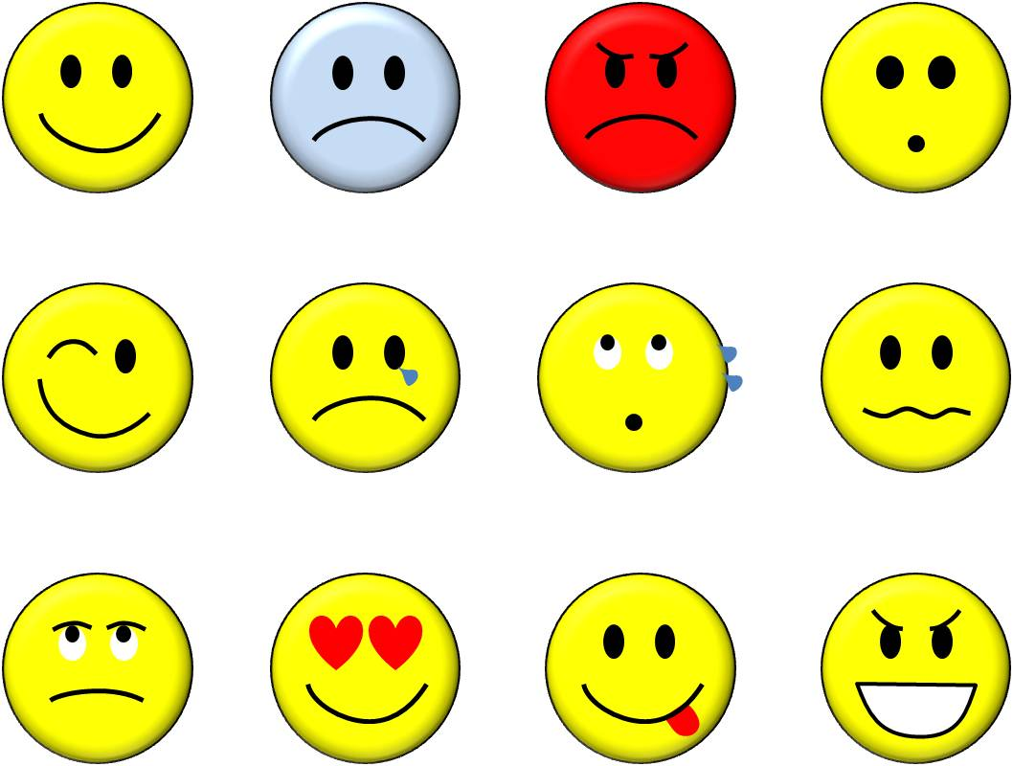
Outline
What is Sentiment?
● Sentiment = feelings
– Attitudes
– Emotions
– Opinions

Slide 3
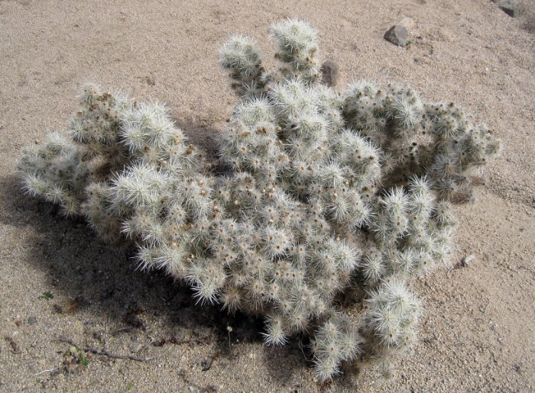
Outline
What is Sentiment?
● Subjective impressions, not facts
● Fuzzy Concept

Slide 4
Outline
Questions SA Might Ask
Is this product review positive or negative?
Is this customer satisfied or dissatisfied?

Slide 5
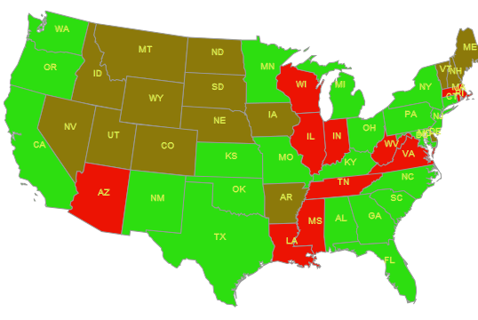
Outline
Questions SA Might Ask
Based on a sample of tweets, how are people responding to this product release?
Sentiment of Doritos Locos Taco by State
Based on geo-tagged tweets.

Slide 6
Outline
Challenges in SA
● People express opinions in complex ways
● Intra-textual reversals, negation

Slide 7

Outline
Gold Standard in SA
● Humans disagree on sentiment about 10-20% of the time.
● Upper Bound on Accuracy 80-90%

Slide 8

Outline
How to Detect Sentiment
By Counting Things!

Slide 9
Outline
How to Detect Sentiment?
● Generally, a binary opposition in opinions is assumed
● For/against, like/dislike, good/bad, etc.

Slide 10

Outline
Old School Sentiment Analysis
Count the number of Positive and Negative words to obtain an aggregate sentiment score.
+1
Good
-2
Horrible

Slide 11
Outline
Old School Sentiment Analysis
Term Function
In the Word Lists dictionary there are 2 default lists Positive and Negative
We can use proximity arguments to infer sentiment

Slide 12
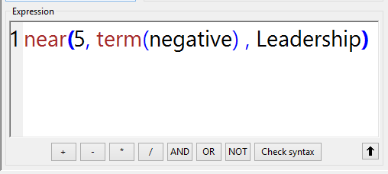
Outline
Example SA through Term Function
Sample PDL Expressions
Pattern looks for a negative term within 5 words distance of the word leadership.

Slide 13
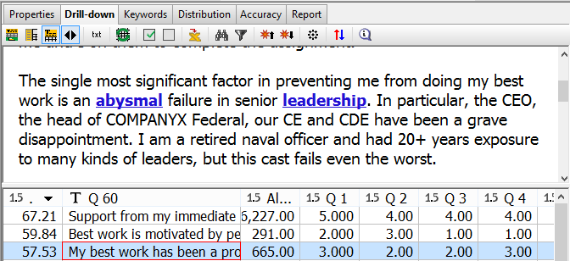
Outline
Example SA through Term Function
Sample Output
Negative Term
Leadership

Slide 14


Outline
Drawbacks from Keywords
+1
+2
-1
“A lot of the identity cards that are issued by the states
are too easy to counterfeit simply.”
Two Positive phrases, 1 Negative word.
Mildly Positive

Slide 15
Outline
Sentiment Analysis
We need a more complex method!

Slide 16
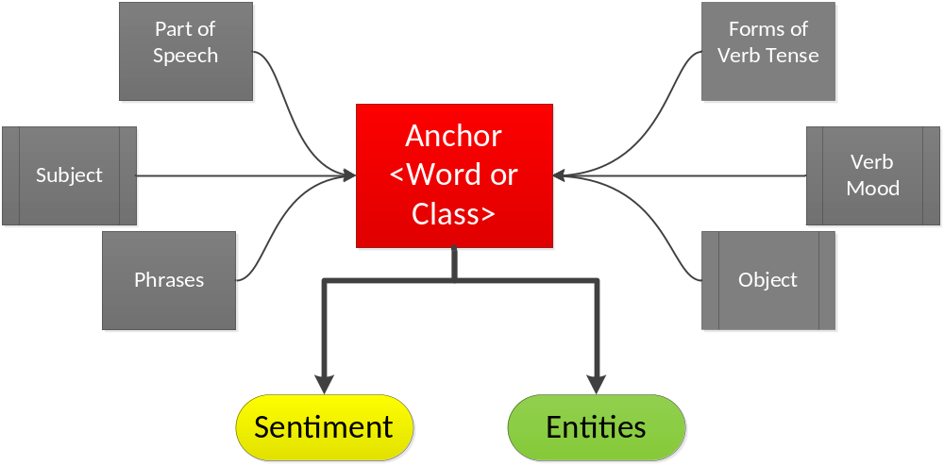
Outline
SA with LinguaMark

Slide 17
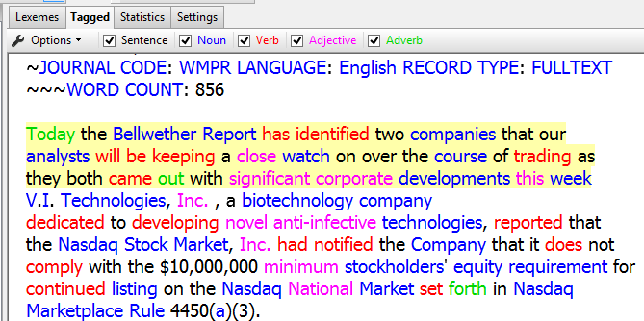
Outline
SA with LinguaMark
LinguaMark tags parts of speech and diagrams the sentence to determine subject and object.

Slide 18

Outline
SA with LinguaMark
PolyAnalyst detects sentiment through a series of Lingua Mark patterns.
Sample Pattern
{Anyt}:Object [','] ['and'] 'that' 'is' {<badadj>:@(Padj)}:Evaluation

Slide 19
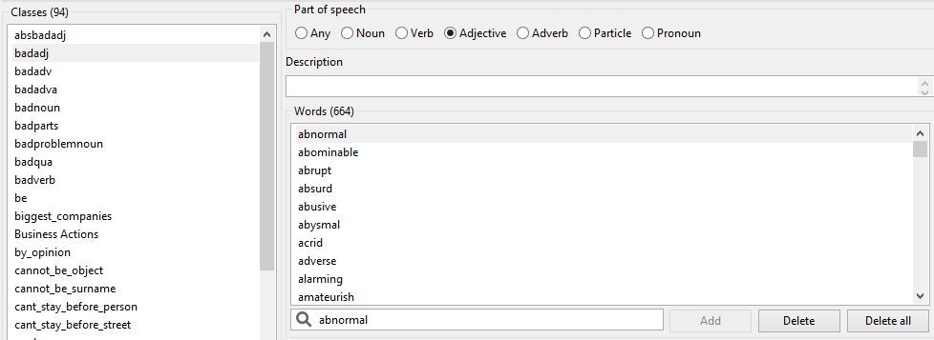
Outline
SA with LinguaMark
<badadj> is a word class of negative adjectives

Slide 20
Word Classes that Convey Sentiment
Sentiment Word Classes convey Polarity, Part of Speech, Degree
absbadadj
Accursed
Awful
Terrible
Default Word class Dictionary
badadv
Badly
Immorally
Irresponsibly
goodadj
Accommodating
Accurate
Adequate

Slide 21
Outline
SA with LinguaMark
Sentiment Word Classes are Customizable
Domain specific additions such as emoticons
:D ☹ ☺ ;( ;)

Slide 22

Outline
Sentiment Analysis Node
Polarity-Positive or Negative

Slide 23
Outline
Sentiment Analysis Node
Object- What is evaluated

Slide 24
Outline
Sentiment Analysis Node
Subject- Who is doing the evaluation

Slide 25
Outline
Sentiment Analysis Node
Evaluation-The anchor or trigger of the sentiment

Slide 26
Outline
Sentiment Analysis Node
Degree-The magnitude of the sentiment

Slide 27
Outline
Sentiment Analysis Node
Certainty- The confidence of the sentiment in the pattern

Slide 28
Outline
Sentiment Analysis Node
Confidence-The accuracy of the pattern

Slide 29
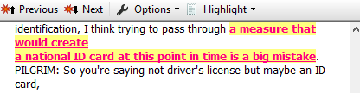
Outline
Sentiment Analysis Node
Polarity -Negative
Object - “a measure that would create a national ID card at this point in time”
Subject – “I”
Evaluation – “Big mistake”
Degree – (-5)
Certainty – (3)
Confidence – (65%)

Slide 30
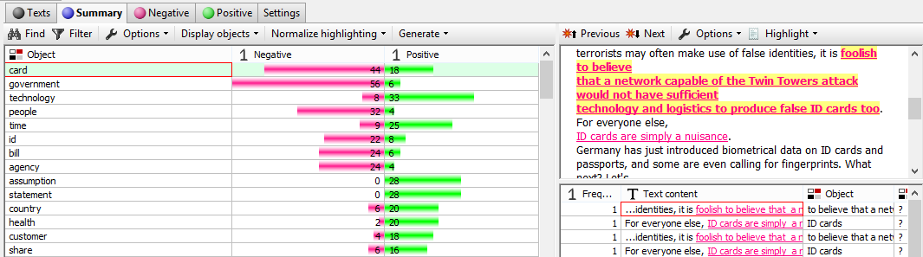
Outline
Sentiment Analysis Node
Object Sentiment Distribution

Slide 31
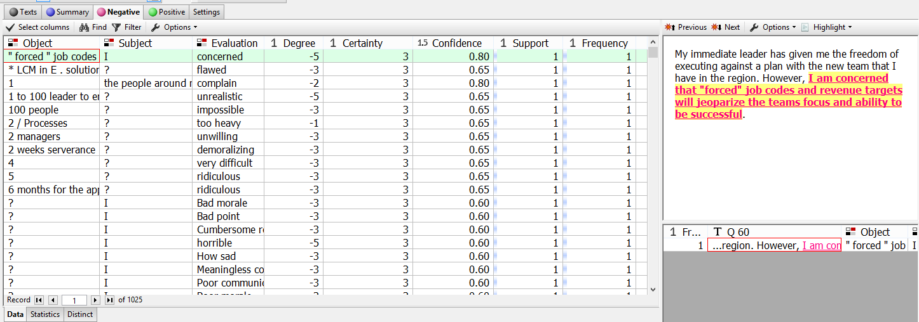
Outline
Negative Sentiment Analysis
Vector of Negative Sentiment

Slide 32
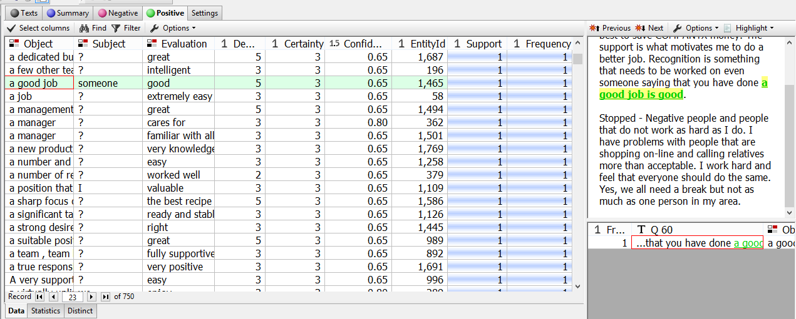
Outline
Positive Sentiment Analysis
Vector of Positive Sentiment

Slide 33
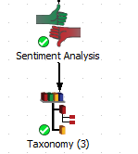
Outline
Connect Taxonomy to Sentiment Analysis
Sentiment can be incorporated into PDL expressions after connecting the taxonomy node to SA.
Uses the “Sentiment” Function

Slide 34
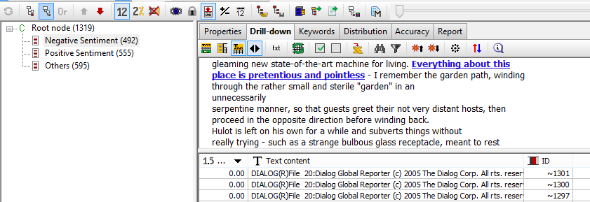
Outline
Sentiment Analysis in the Taxonomy Node

Slide 35
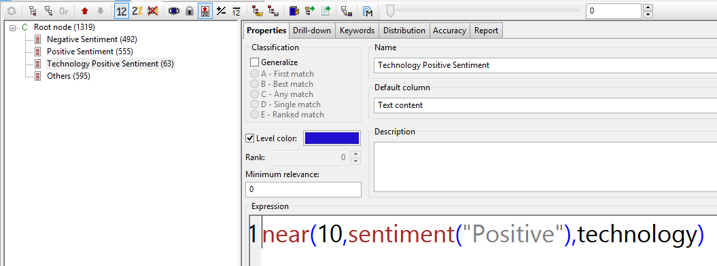
Outline
PDL Expression with Sentiment
Expression looks for positive sentiment within 10 words distance of stem “technology”

Slide 36
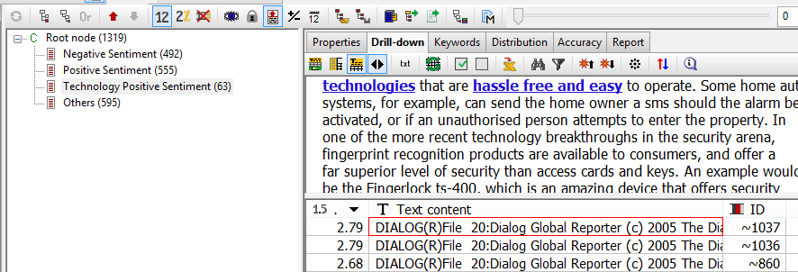
Outline
PDL Expression with Sentiment
Stem Technology
Positive Sentiment

Slide 37
Contacting Megaputer
Questions?

