Slide 1

PolyAnalyst
Web Report Training
Challenges to Implementing Analytics
Megaputer Intelligence
www.megaputer.com
© 2014 Megaputer Intelligence Inc.

Slide 2

Outline
Standard Functional Areas
Company
HR
Customers
Marketing
Suppliers
Customer Service
Loss Prevention
Engineering
Quality Assurance
Finance
Human Resources
General Public
Risk Management
Public Relations
Competitive Intelligence
Audit
Competitors
Legal
Regulators

Slide 3
Outline
Benefits for the Enterprise
Dramatic cost reduction
Increase in quality and speed of the analysis
Objective and uniform data-driven analysis
Discovery of even unexpected issues suggested by data
Automated monitoring of known problems
Timely discovery of newly developing issues
Utilization of 100% of available data: structured and text
Up-to-date reports for executives
Easy to use and maintain solution

Slide 4
Outline
Typical Tasks - examples
Social Media Data Analysis
Call Center Data Analysis
Survey Analysis
Incident Report Analysis
Fraud Detection
Subrogation/Litigation Prediction
Database Marketing
Sales Data Analysis

Slide 5
Example: Warranty Fraud Detection
Dealer level
  Identify and rank Dealers that have a large number of anomalies in submitted claims
Claim level
  Determine and store for application efficient business rules automating payment decision on individual new claims

Slide 6
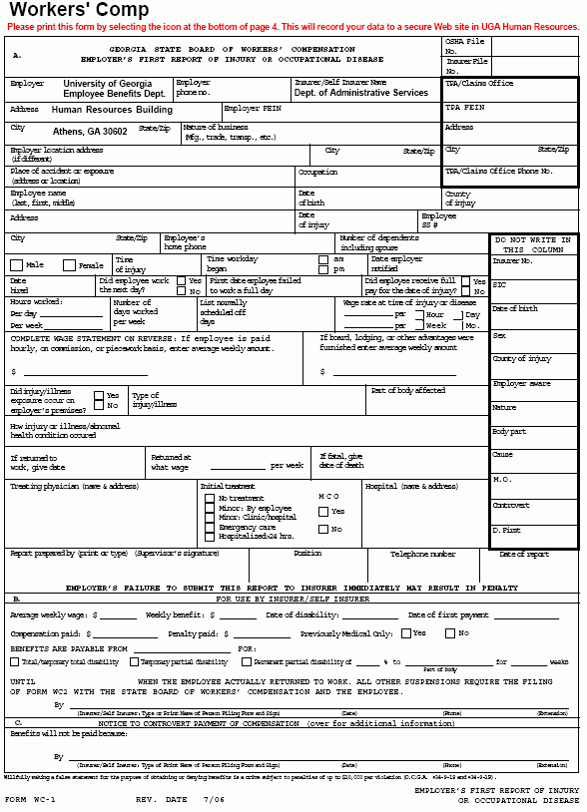



Finding Anomaly Thresholds and Suspect Dealers
Claims Data
New claim
Determine Nature of Distributions
Business Rules for Claim Scoring
Detect Thresholds & Anomalies
Machine Learning & Statistics
Payment Decision
Identify Systematic Anomalies
Group Anomalies by Dealer
List of Anomaly Ranked Dealers
Claim level
Dealer level

Slide 7
Analytics for Individual Claim Processing
Submitted Claims
Business Rules
Discoveries
Data & Text Analysis, Modeling and Scoring
Technology
Assisted Audit
Pay
Reject

Slide 8
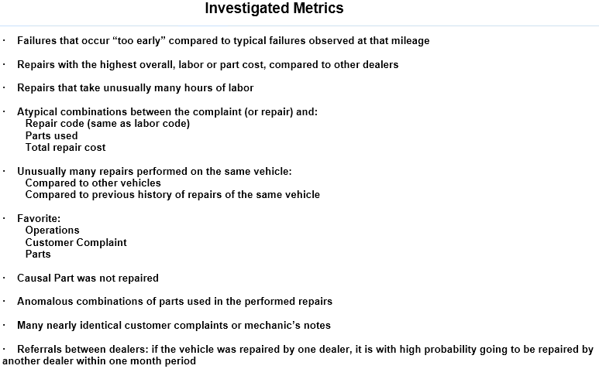
Detecting Anomalies in Data

Slide 9
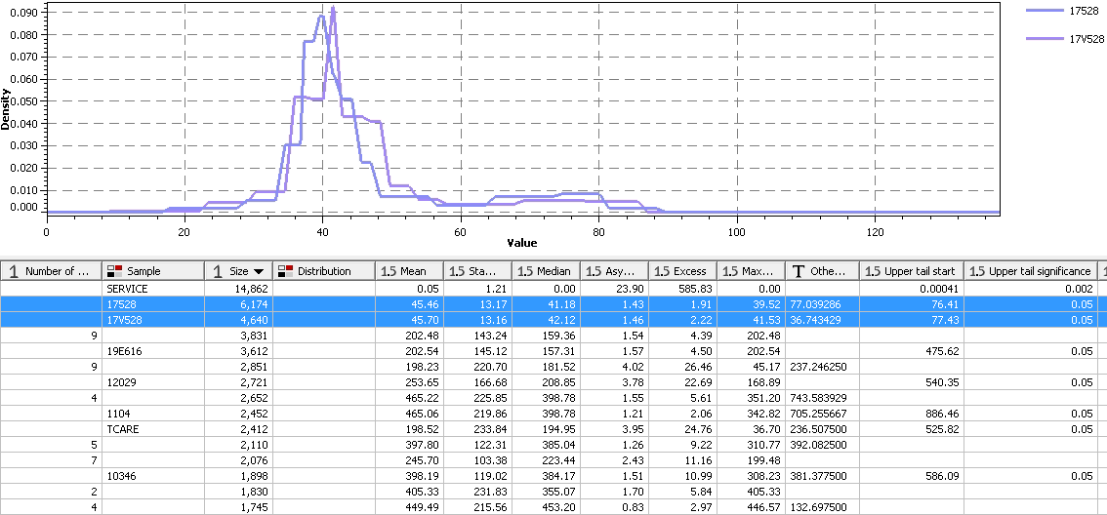
Finding Anomaly Thresholds
Lower Threshold
Upper Threshold

Slide 10
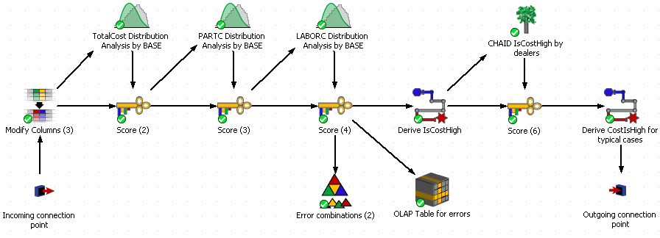
Distribution Analysis (DiAn) script

Slide 11
Tail Thresholds – for each Causal Part
Tail Thresholds

Slide 12
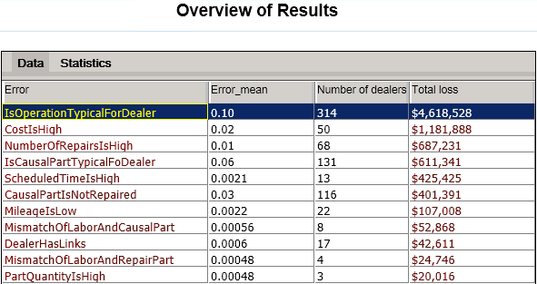
Overall Anomalies in ESP claims

Slide 13
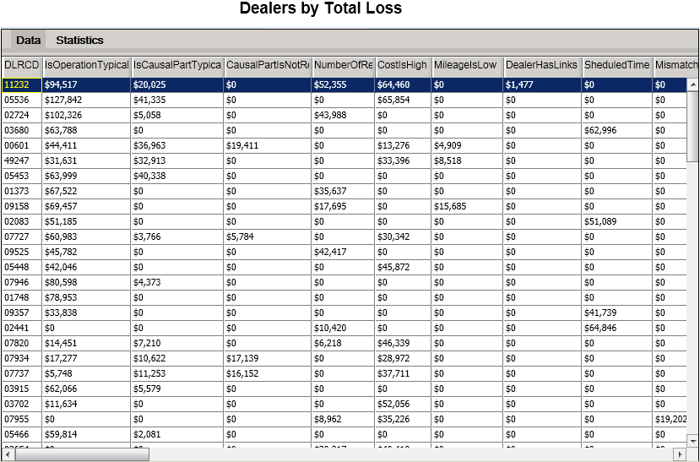
Dealer Total Loss by Anomaly

Slide 14
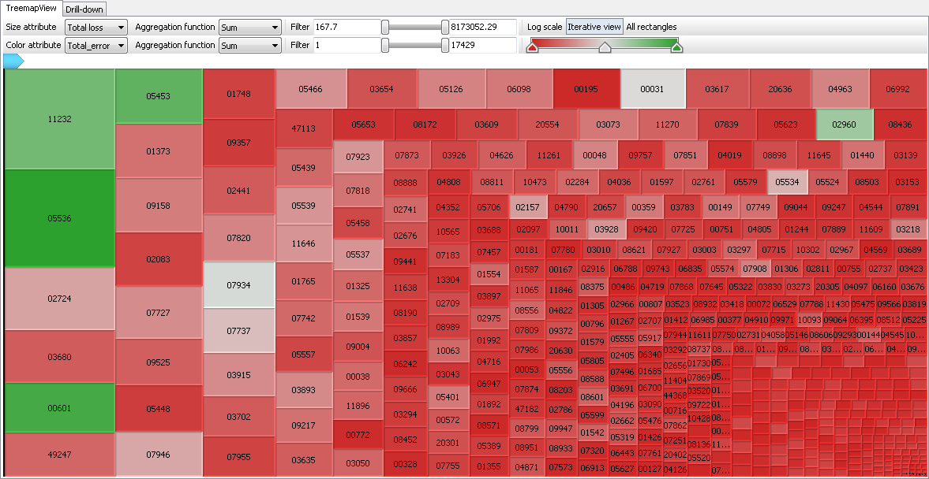
Dealers by Total Loss due to Anomalies

Slide 15
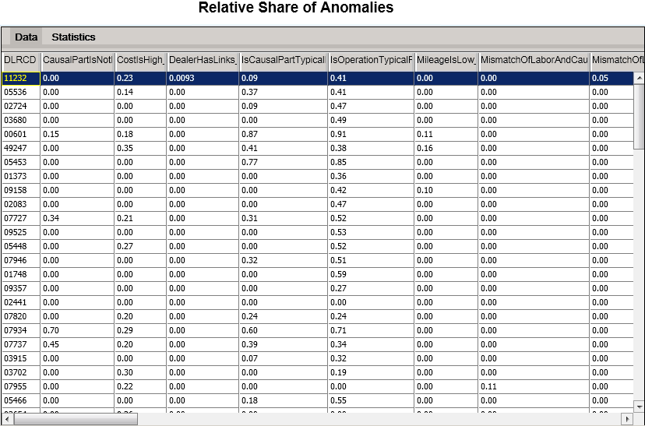
Share of Anomalies to Full Operation

Slide 16
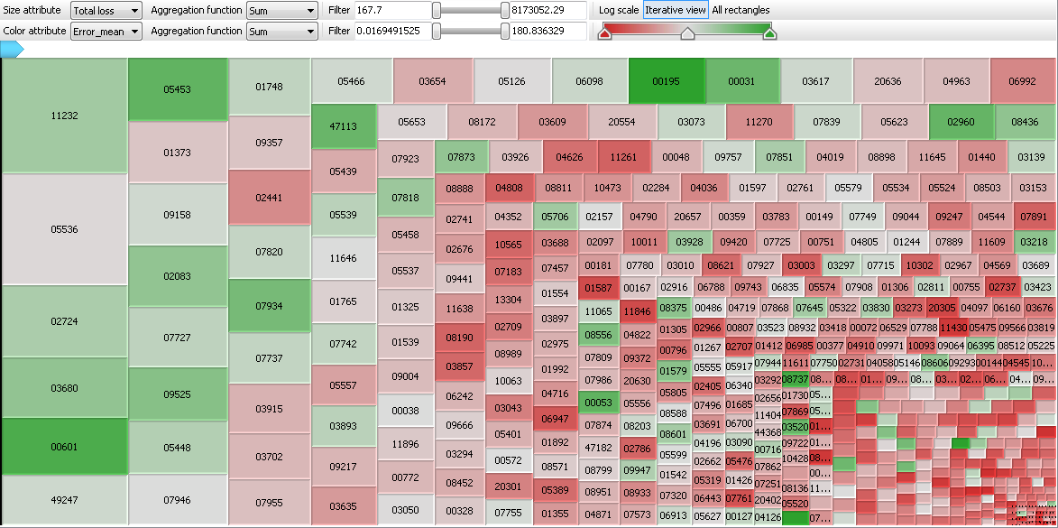
Total Loss by Share of Anomalies

Slide 17
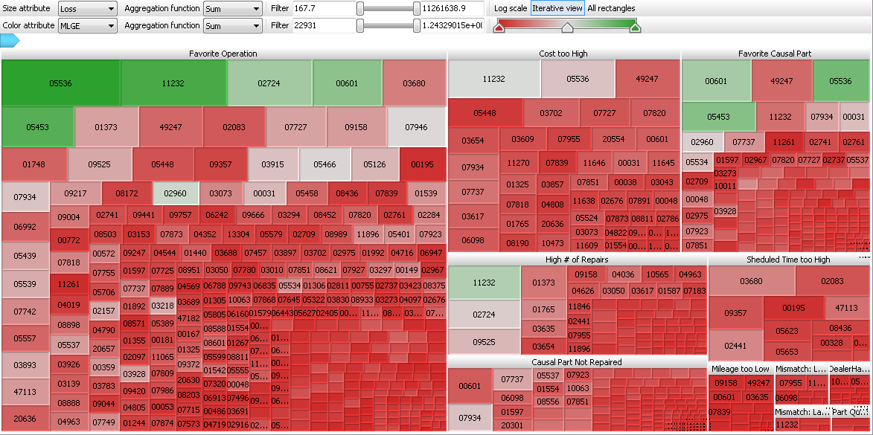
Dealers by Anomaly Type

Slide 18
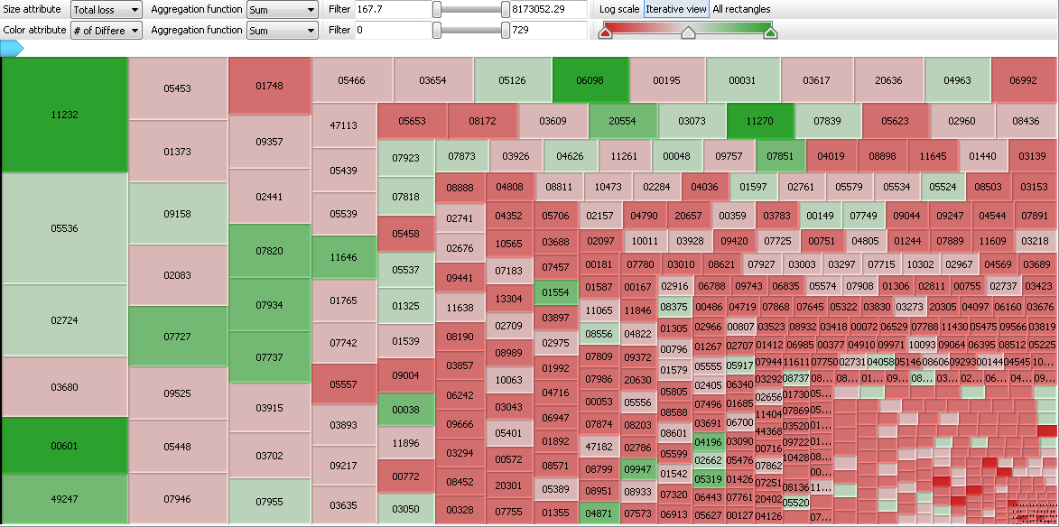
Total Loss by # of Different Anomalies

Slide 19
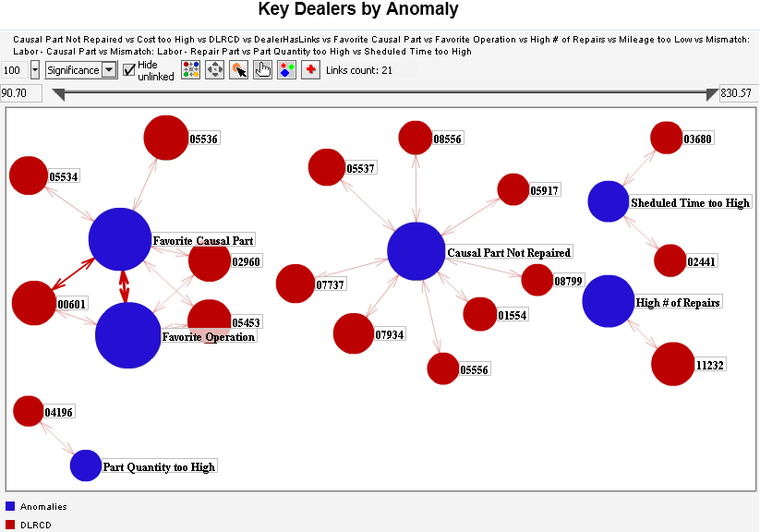
Strongest Correlations: Dealers to Anomalies

Slide 20
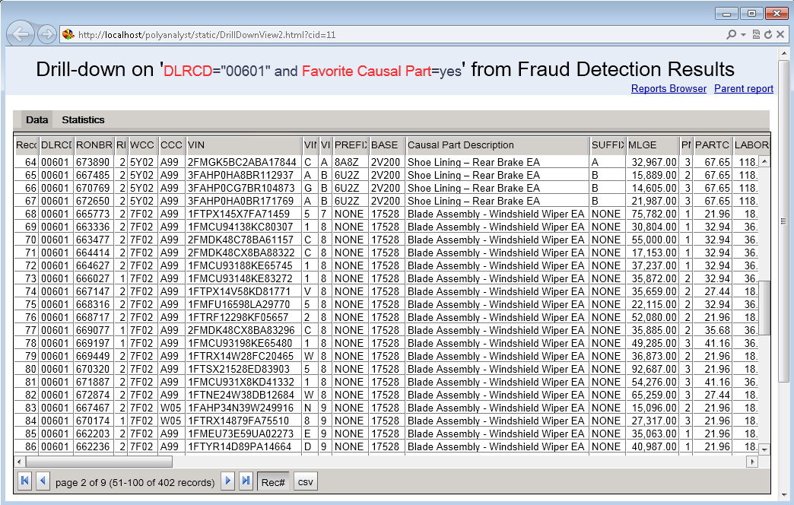
Drilling down to Dealer 00601
Favorite Causal Parts

Slide 21
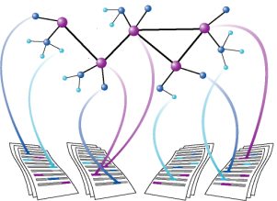
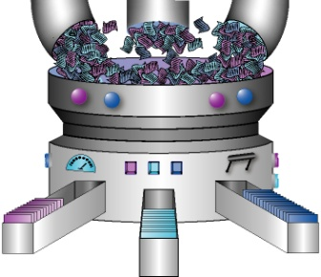
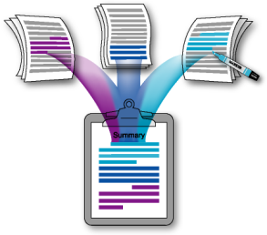
Add Extra Metrics through Text Mining
Feature Extraction
Entity & Event Extraction
Search for Patterns
Clustering
Categorization
Summary Creation
Sentiment Analysis
New Inputs for Predictive Modeling

Slide 22
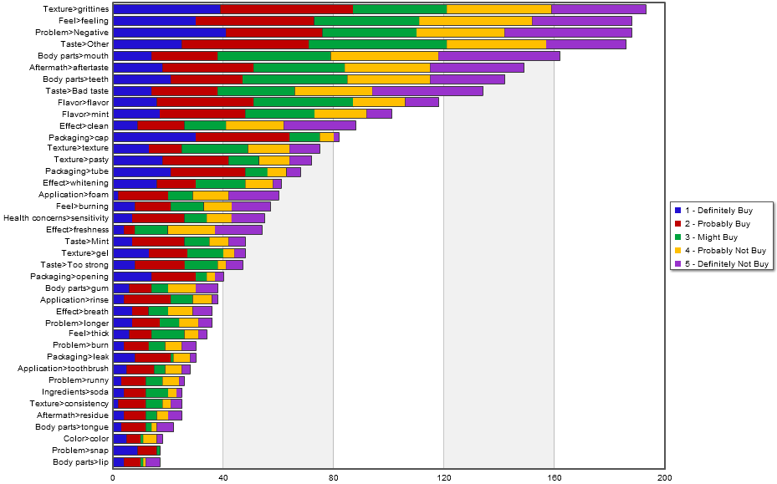
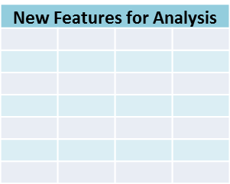
Key Steps of Text Mining
Textual Data
Graphical Reports
1
Data Cleansing
2
Data-driven Analysis
3
Analyst-driven Analysis
4
Enriching Structured Data
OLAP cubes

Slide 23
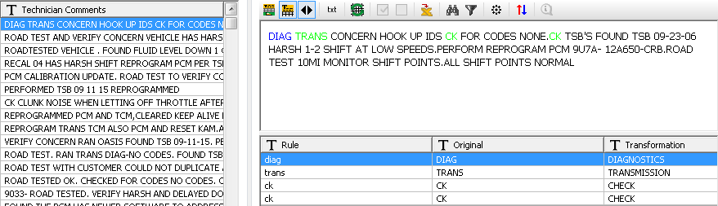
Correct Typical Mechanic’s Abbreviations

Slide 24
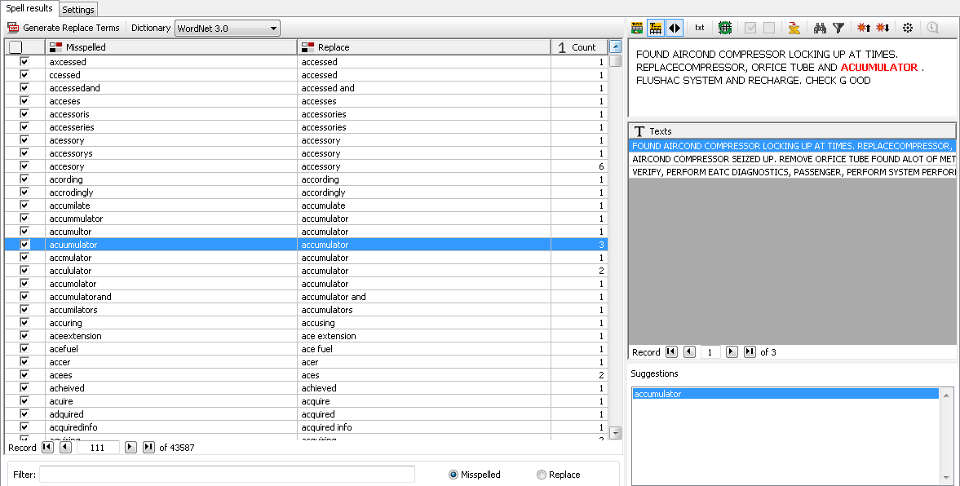
Auto-Correct Misspells
> 43,000 misspells corrected!

Slide 25
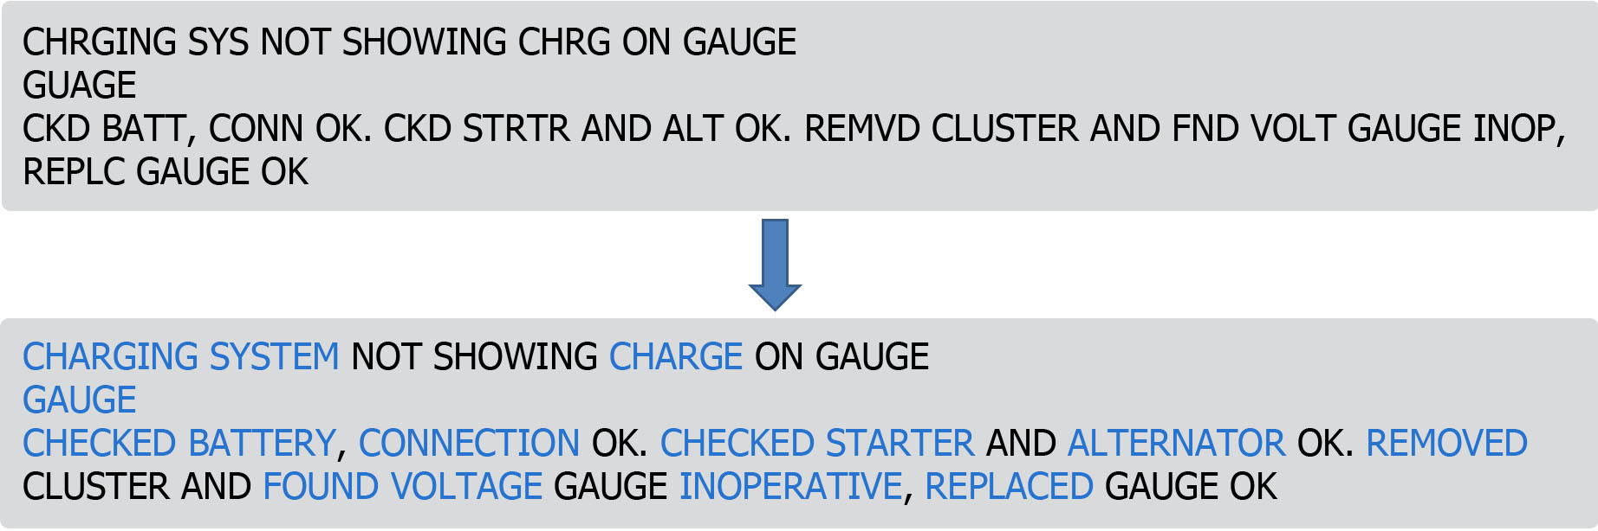
Example: Car Repair Notes

Slide 26
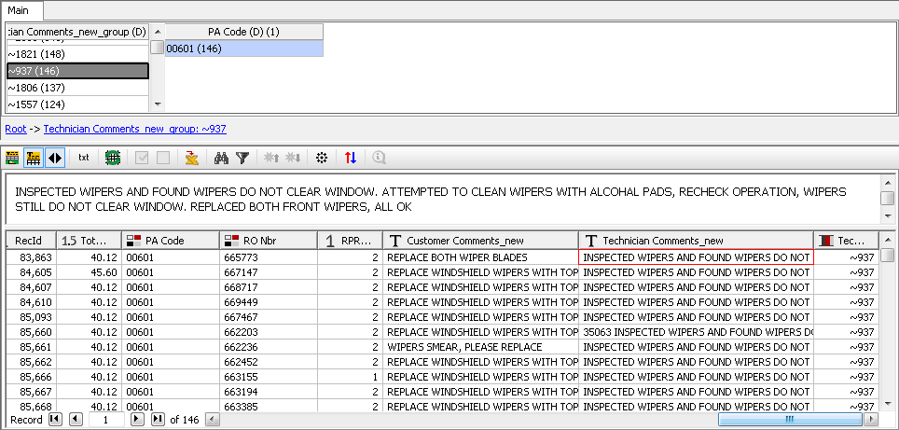
Detect Near Duplicate Descriptions
Near Duplicate Mechanic’s Notes

Slide 27
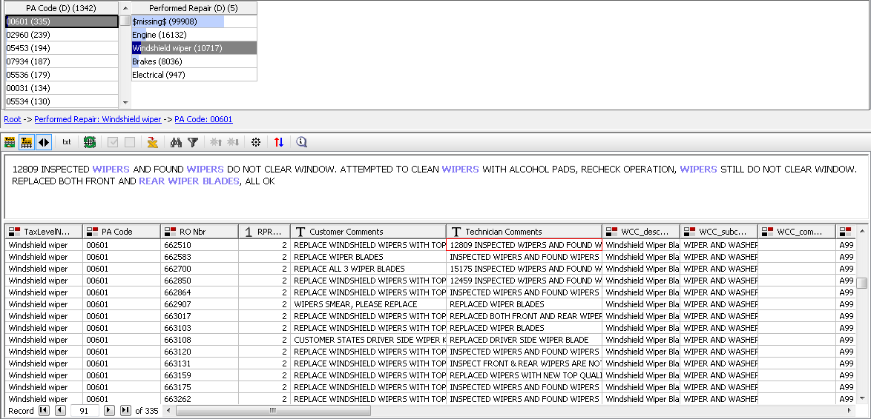
Dealer 00601 only replaces Wipers

Slide 28
Contacting Megaputer
Questions?

