Slide 1

PolyAnalyst
Web Report Training
Custom Entity Extraction
Using Lingua Mark
Megaputer Intelligence
www.megaputer.com
© 2014 Megaputer Intelligence Inc.

Slide 2

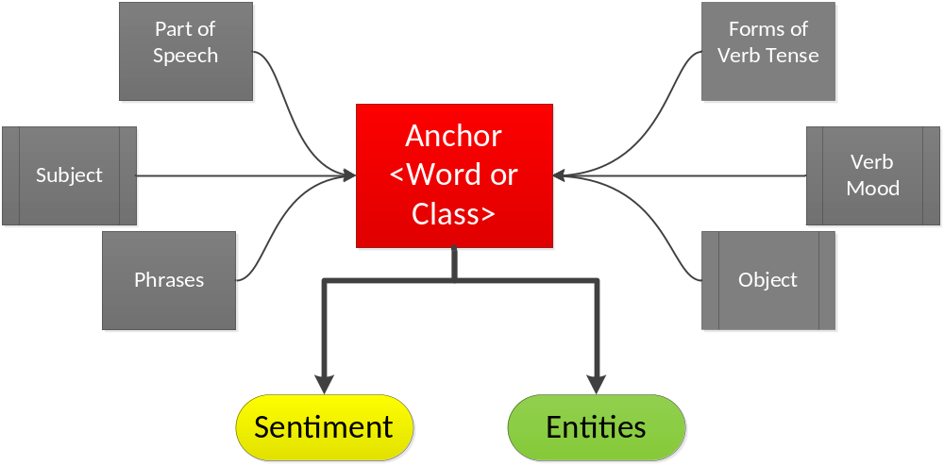
Outline
LinguaMark

Slide 3
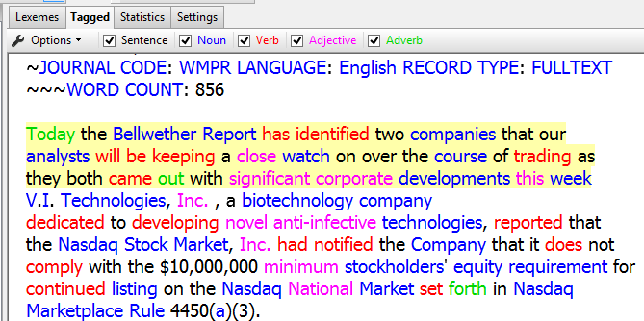
Outline
SA with LinguaMark
LinguaMark tags parts of speech and diagrams the sentence to determine subject and object.

Slide 4
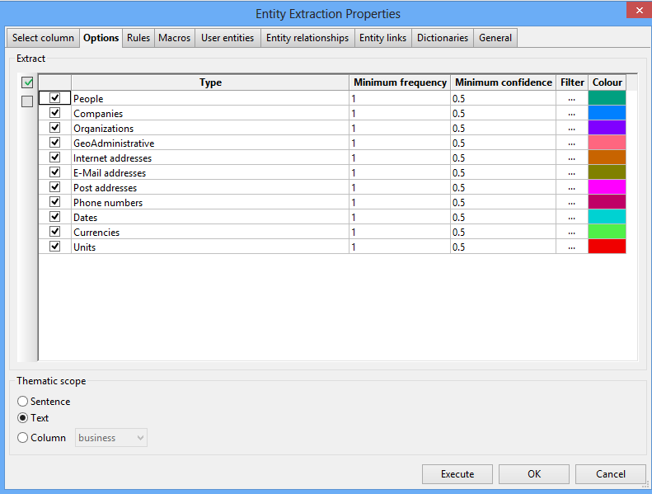
Outline
Default Entity Extraction
People- “Leader Alvaro Hernandez”, “Bill Martin”
Companies-”Blue Shield of California”, ”Global Systems Inc.”
GeoAdministrative- “Tucson Arizona”, “Ecuador”
Units- “Second, Meter, Degree”

Slide 5
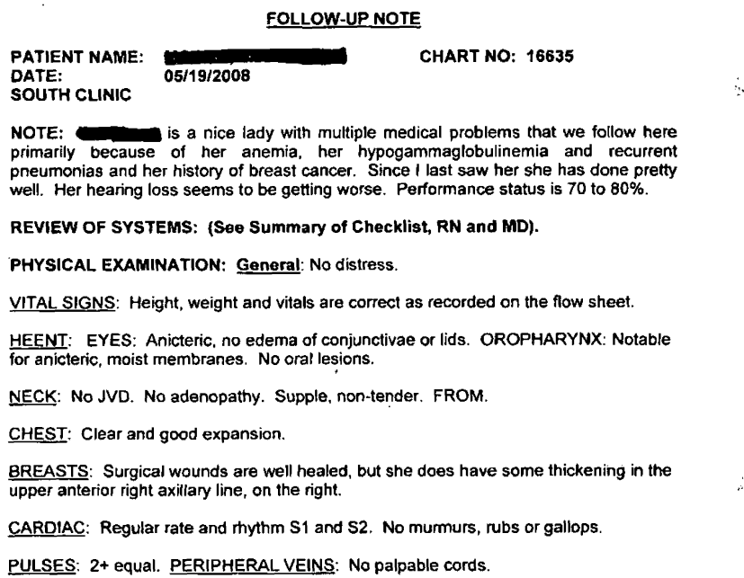

Outline
Electronic Health Records Analysis

Slide 6
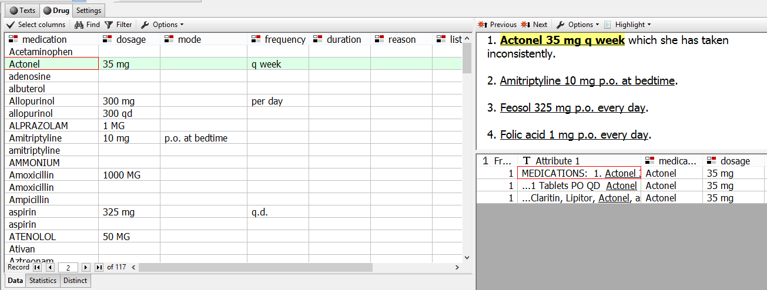
Outline
Custom Entity Extraction Medications
Vector Entity- [Medication, Dosage, mode, frequency, duration]

Slide 7
Outline
Custom Entity Extraction Medications
Medication Word Class
Dosage Word Class
Mode Word Class
Frequency Word Class
RxNorm
Drug Database
Unit
Mg
g
Orally
Injection
p.o
q.h.s
Every day
After meals
Duration Word Class
Days
Weeks
Months

Slide 8
Extracting Medication
LinguaMark pattern:
  <Medication,P(N)>:@ [{<,P(1)> <dosage,P(N)>}:dosage] [{<mode,P(N)>}:mode] [{<frequency,P(N)>}:frequency]
Matches:
  Feosol 325 mg p.o. every day
  Lantus 20 units qhs
  Tylenol #3 p.r.n.
Number
Class Dosage
Class Mode
Class Frequency
Anchor
Class Drug
Extracted Medication
Extracted
Dosage
Extracted
Mode
Extracted Frequency

Slide 9
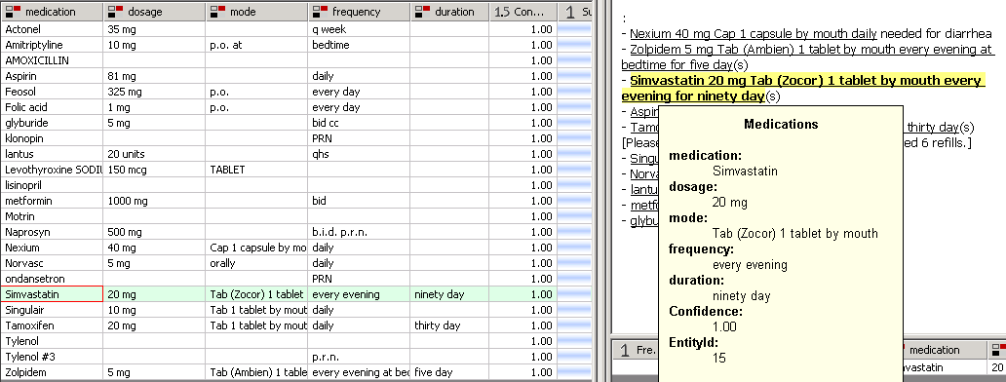
Outline
Extracted Medication Information
With the associated:
  Dosage
  Mode
  Frequency
  Duration

Slide 10

Outline
Custom Entity Extraction Contracts
Custom Entities
Effective Date
Signatory
Parties Involved

Slide 11

Outline
Writing Your Own Custom Entities
Step 1) Connect the Index Node (optional) and Entity Extraction Node

Slide 12
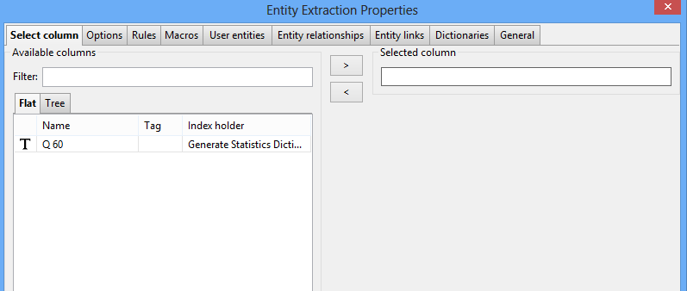
Outline
Writing Your Own Custom Entities
Step 2) Right Click the Entity Extraction Node and select the text column.

Slide 13
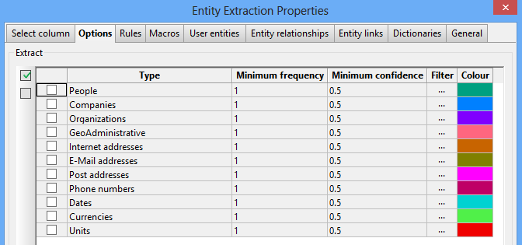
Outline
Writing Your Own Custom Entities
Step 3) In the Options tab deselect the default entities to increase execution speed.

Slide 14
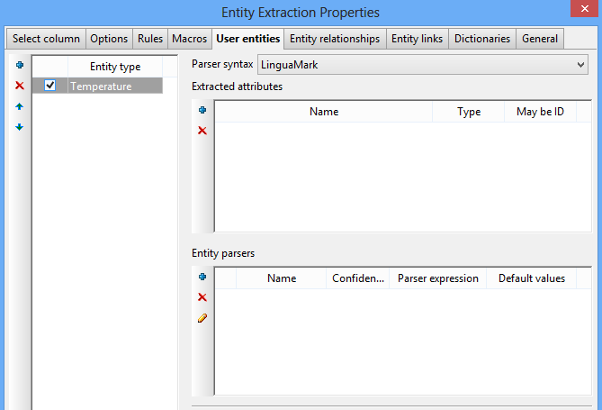
Outline
Writing Your Own Custom Entities
Step 4) In the User entities node add an entity type and select Lingua Mark

Slide 15
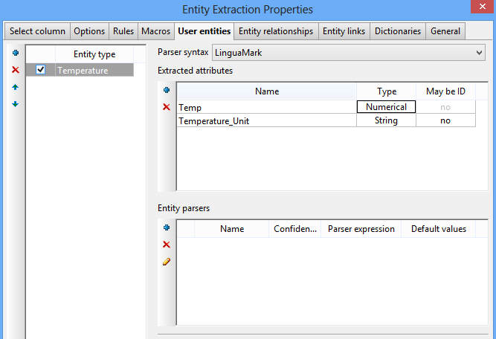
Outline
Writing Your Own Custom Entities
Step 5) Add the Extracted attributes

Slide 16
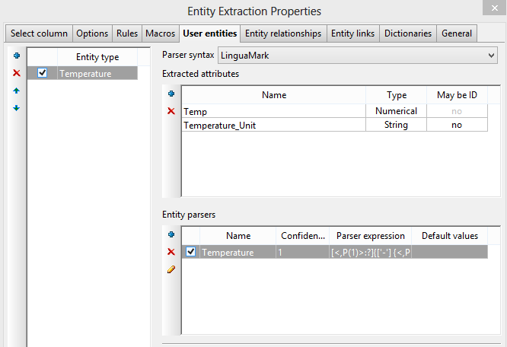
Outline
Writing Your Own Custom Entities
Step 6) Write the Entity parser

Slide 17

Outline
Writing Your Own Custom Entities
[<,P(1)>:?]{['-'] {<,P(1)>}:Temp {<Temperature,PL(SP)>:@ [<Temperature,P(N)>] }:Temperature_Unit
The high for Wednesday is 105 degrees F
Room temperature is about 25 C
The product was left in the freezer at -3 Celsius
75 degrees Fahrenheit is a comfortable temperature

Slide 18
Lingua Mark Construction Anchors
‘token’:@
All parser expression begin with exactly one anchor to quickly filter relevant sentences.
Anchor is always a single word or single class of words.
Example Single Word: ‘temperature’:@
matches “temperature", "Temperature” and “teMpEratURe” but not “degrees” or “Celsius”
Example Class of Word: <temperature,PL(SP)>:@
Matches all words of the class temperature

Slide 19
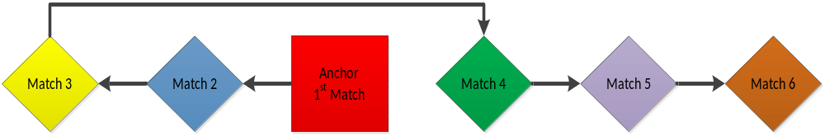
Lingua Mark Parser Algorithm
Finds the anchor and restricts to the sentence.
Matches terms left of the anchor from right to left.
Matches terms right of the anchor from left to right.
If any non-optional term does not match the parser is terminated.

Slide 20
Lingua Mark Constructions
{ }:Entity Extracts the tokens within the brackets into the attribute
EX: {‘temperature’:@}:Temp extracts the anchor “temperature” into the attribute Temp.

Slide 21
Lingua Mark Constructions
(a|b|c) matches one of the terms in the parenthesis
Ex: {(‘boiling’|’freezing’) ‘temperature’:@}:Entity
Matches “boiling temperature” and “freezing temperature” but not “boiling freezing temperature” nor “temperature”

Slide 22
Lingua Mark Constructions
[ ] Denotes the term is optional
Ex: {[(‘boiling’|’freezing’)] temperature:@}:Entity
Matches “Boiling temperature” and “freezing temperature” and “temperature”

Slide 23
Lingua Mark Constructions
< > Denotes a class
Ex: <badadj,P(A)> All adjectives in class badadj
<badadj> is a class of negative words used in sentiment analysis
<,P(A)> Matches any adjective
Anchors must be specific <badadj,P(A)> is a valid anchor, but <,P(A)> is not.

Slide 24
Lingua Mark Constructions
<,P(1)> Any number
“11,-23,one”
<,GF(OF)> Any Preposition
“of,through,under”
<,GF(OF)> pnou -A noun phrase starting with a preposition
“Under the bridge, with force, of the participants”

Slide 25
Lingua Mark Constructions
“token” All forms of the Token
Ex: “be” Matches is, am, are, were was, etc
“degree” Matches degree or degrees

Slide 26
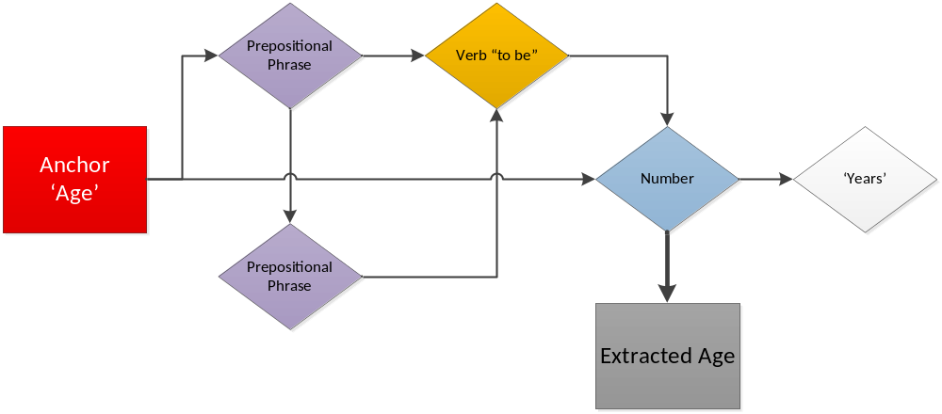
Lingua Mark Example
age at menopause for postmenopausal women was 47 years
age 52 years
age of participants was 53 years
'age':@ [<,GF(OF)>pnou] [<,GF(OF)> pnou] ["be"] {<,P(1)>}:Age ('years'|'y')

Slide 27
Lingua Mark Example
age at menopause for postmenopausal women was 47 years
age 52 years
age of participants was 53 years
'age':@ [<,GF(OF)>pnou] [<,GF(OF)> pnou] ["be"] {<,P(1)>}:Age ('years'|'y')
Parser Algorithm

Slide 28
Lingua Mark Constructions Wildcards
<,W> matches 1 word wildcard
[<,W>] standard wildcard of any class
[<,W>] <,P(1)> <Temperatures,PL(SP)>:@
Matches: Under 32 Degrees
XXX zero C

Slide 29
Lingua Mark Constructions Wildcards
Anyt- Matches all tokens until end of Sentence.
Ex: ‘anchor’:@ Anyt
“We lowered the anchor chain over the side of the ship into the ocean.

Slide 30
No Match Term
:! Not matching
:? Not matching optional construction [ ]
[‘Megaputer’:?] ‘Intelligence’:@
Matches “Intelligence” but not “Megaputer Intelligence”

Slide 31
Outline
Custom Entity Extraction Contract
Custom Entities
Effective Date
Signatory
Parties Involved

Slide 32
Custom Entities using Entity Relationships
It’s possible to use predefined entities in a relationship expression as well as user defined entities.
‘Director’ <,GF(OF)> <$Company>:@ ‘is’ <$Person>
Matches “Director of Microsoft Corp. is Bill Gates”
<$Person>:@ <,P(V)> <$Medication> [<,GF(OF)>] <$Frequency> Anyt
Matches “Bill takes acetaminophen daily for back pain.”

Slide 33
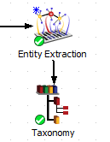
Outline
Custom Entity Extraction Using PDL
PDL can be combined with Lingua Mark using a taxonomy node.

Slide 34

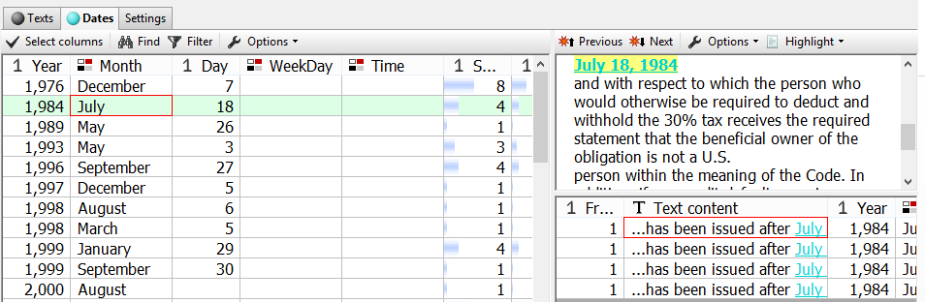
Outline
Custom Entity Extraction Using PDL
Step 1) Extract Dates Using Default Patterns

Slide 35
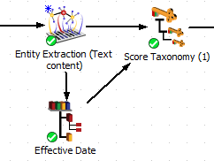
Outline
Custom Entity Extraction Using PDL
Step 2) Connect The Taxonomy to the Extract Terms Node

Slide 36
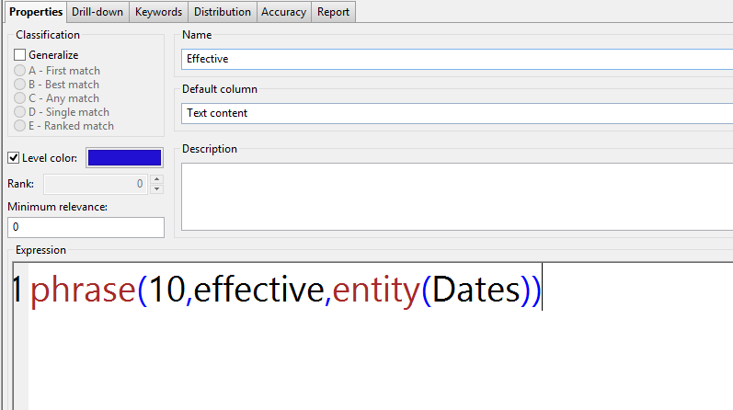
Outline
PDL Expression and Lingua Mark
Step 3) Write a PDL expression with the Entity Function

Slide 37
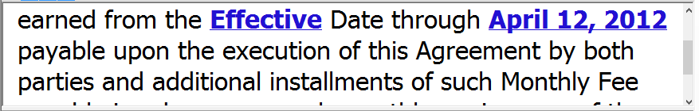
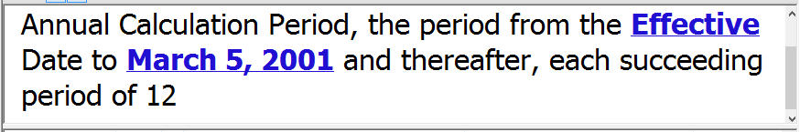
Outline
PDL Expression and Lingua Mark
Example Output

Slide 38
Questions?
Contacting Megaputer

