Slide 1

PolyAnalyst
Web Report Training
Text Mining for
Analysis of Financial Loan Applications
Megaputer Intelligence
www.megaputer.com
© 2014 Megaputer Intelligence Inc.

Slide 2

Lending Services is a
Multi-Trillion Dollar Industry

Slide 3

Traditional loan default models rely only on structured attributes, completely ignoring free-form text

Slide 4

We can extract attributes from text to augment risk models and improve accuracy

Slide 5

Are they the same?
Are they the same?
Borrower A
Income $89,000
Debt to Income Ratio: 6.9%
FICO Range: 755-759
Derogatory Public Records: 0
Loan Grade: B2
APR: 13.00%
Borrower B
Income $80,000
Debt to Income Ratio: 6.0%
FICO Range: 755-759
Derogatory Public Records: 0
Loan Grade: B2
APR: 13.72%

Slide 6
Are they the same?
Are they the same?
Borrower A
Income $89,000
Debt to Income Ratio: 6.9%
FICO Range: 755-759
Derogatory Public Records: 0
Loan Grade: B2
APR: 13.00%
Borrower B
Income $80,000
Debt to Income Ratio: 6.0%
FICO Range: 755-759
Derogatory Public Records: 0
Loan Grade: B2
APR: 13.72%
Traditional methods place these borrowers on equal terms…

Slide 7


Are they the same?
Are they the same?
…but Text Analysis can reveal the differences between them.
Desire to borrow 15K to help a family member. No debt other than mortgage. Have more than adequate resources to guarantee payment.
Please I really need your help. I promise that i will pay my loan payment on time. I can't even have a good vacation with all this debt and stress.
Borrower A
Borrower B

Slide 8
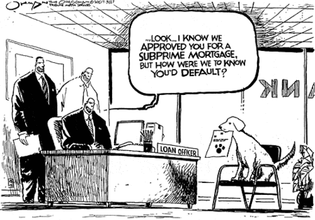
Leaving Information on the Table

Slide 9

Case Study Data
Analyzed roughly 100,000
Real Loan Applications from a
Personal Loan Organization

Slide 10


Case Study Data
Structured Attributes
Extracted from Text
41
352
(393)
Demographic Data
  City, State
Employment Data
  Employment Length, Income
Credit History Data
  FICO score, Debt-to-income Ratio, Delinquencies
Loan Data
  Loan Amount, Term, Grade, APR
Number of Grammar Errors
Employment Industry
Sentiment
Keywords
Loan Purpose
Marital Status
Children?
Job Stability
Collateral
Attitude
etc…

Slide 11
Case Study Data
Structured Attributes
Extracted from Text
41
352
Demographic Data
  City, State
Employment Data
  Employment Length, Income
Credit History Data
  FICO score, Debt-to-income Ratio, Delinquencies
Loan Data
  Loan Amount, Term, Grade, APR
Number of Grammar Errors
Employment Industry
Sentiment
Keywords
Loan Purpose
Marital Status
Children?
Job Stability
Collateral
Attitude
etc…

Slide 12
PolyAnalyst
Web Report Training
Methodology
Extract Information from Text
Explore Relationships
Incorporate all Structured Attributes in Further Analysis

Slide 13
PolyAnalyst
Web Report Training
Methodology
Extract Information from Text
  Data-driven Extraction
  Analyst-driven Categorization
Explore Relationships
Incorporate all Structured Attributes in Further Analysis

Slide 14
PolyAnalyst
Web Report Training
Methodology
Extract Information from Text
  Data-driven Extraction
  Analyst-driven Categorization
Explore Relationships
Incorporate all Structured Attributes in Further Analysis
  Predictive Modeling

Slide 15
PolyAnalyst
Web Report Training
Methodology
Extract Information from Text
  Data-driven Extraction
  Analyst-driven Categorization
Explore Relationships
Incorporate all Structured Attributes in Further Analysis
  Decision Tree to Predict Loan Status

Slide 16
PolyAnalyst
Web Report Training
Extracted from Text
Grammar & Spelling

Slide 17
Grammar Check
PolyAnalyst’s Grammar Check node identifies number and type of error
  Grammar
  Style
  Punctuation
  Capitalization
  Spelling

Slide 18
Grammar Check
“This loan is to cover my son’s wedding. This will teach him great responsibilty. If he don’t, I will take care of this loan. It will be more easier for me.”
1 Spelling Error
2 Grammar Errors
subject-verb agreement error
“more” before comparative

Slide 19
Why Do We Care?

Slide 20
Why Do We Care?
As the number of grammar and spelling errors increases, …

Slide 21
Why Do We Care?
… the proportion of defaulted loans increases as well

Slide 22
Why Do We Care?
… the proportion of defaulted loans increases as well

Slide 23
PolyAnalyst
Web Report Training
Extracted from Text
Industry Categories

Slide 24
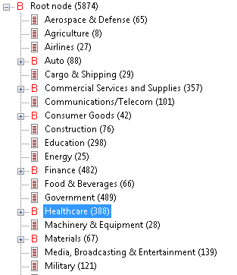
Industry Categorization
Use employer names to extract
employment industries

Slide 25

Industry Categorization
Industry Category Subcategory Employer Name
Healthcare
Doctor's Offices
Vision
Brown & Toland Physicians
Haug Optometry
Dr. Farenbloom
Magruder Eye Institute

Slide 26
Why Do We Care?
Commercial Services & Supplies
Restaurants
Aerospace & Defense
Hospitality
Investment
Leisure
Accounting
Appliances & Furniture
Banks
Surgery
Religious Organizations
Real Estate
Government
Transportation
Energy
Cargo & Shipping
Construction
Fully Paid
Charged Off

Slide 27
Why Do We Care?
Commercial Services & Supplies
Restaurants
Restaurants
Aerospace & Defense
Hospitality
Investment
Leisure
Accounting
Appliances & Furniture
Banks
Surgery
Religious Organizations
Real Estate
Real Estate
Government
Transportation
Energy
Cargo & Shipping
Construction
Fully Paid
Charged Off
Restaurateurs and Real Estate Agents are more likely to default than those in Aerospace or Finance

Slide 28
PolyAnalyst
Web Report Training
Extracted from Text
Sentiment

Slide 29
Sentiment Analysis
We can determine whether borrowers are positive or negative in their description of the situation…
Positive
My job is stable, I have many responsibilities with the organization and I’m very happy working for them.
Negative
I have made every attempt to sell for what I owe but the housing market is just horrible. I just want to start fresh. I hate being in this situation.

Slide 30
Sentiment Analysis
…and to what degree.
Negative
Object: being in this situation Subject: I Evaluation: hate Degree: -5 Certainty: 3 Confidence: 0.80
Negative
I have made every attempt to sell for what I owe but the housing market is just horrible. I just want to start fresh. I hate being in this situation.

Slide 31
PolyAnalyst
Web Report Training
Extracted from Text
Key Words and Phrases

Slide 32
Keyword Extraction
We can identify frequently occurring terms and phrases…
Keyword Description
"car payments"
"I am consolidating Credit Cards and my remaining car payment to lower my monthly payments by $400."
"I am trying to get out of a high car payment. So I can afford to live comfortable."
"My rent is low, no car payments - low insurance."
"These funds will be used to purchase a reliable vehicle to replace my husband's car. I have already paid off two infiniti G35s since I started at my job over 9 years ago and currently have no car payment."
"no car payments"

Slide 33
Keyword Extraction
…and divide them into direct and negated occurrences.
Keyword Description
"car payments"
"I am consolidating Credit Cards and my remaining car payment to lower my monthly payments by $400."
"I am trying to get out of a high car payment. So I can afford to live comfortable."
"My rent is low, no car payments - low insurance."
"These funds will be used to purchase a reliable vehicle. I have already paid off two cars since I started at my job over 9 years ago and currently don’t have any car payments."
"no car payments"

Slide 34
Why Do We Care?
credit card balances
excellent borrower
excellent credit
funeral expenses
credit card companies
extra money
car loan
holiday season
investment property
financial freedom
primary residence
medical expense
monthly minimum
home based business
credit score
business loan
decent income
Fully Paid
Charged Off

Slide 35
Why Do We Care?
credit card balances
excellent borrower
excellent credit
funeral expenses
credit card companies
extra money
car loan
holiday season
investment property
financial freedom
primary residence
medical expense
monthly minimum
home based business
credit score
business loan
decent income
Fully Paid
Charged Off
Claims of excellent credit and car loans tend to be paid off…
…while claims of being an excellent borrower and medical expenses default

Slide 36


Still More Important Information Buried in the Loan Description

Slide 37
Like What?
Loan Description
I am diligent about my monthly payments. My job is stable. I'm pleased to say my credit history is good with no delinquencies. We are looking to sell my wife's suburban condominium to move a more rural setting more appropriate to our long-term business and personal goals.
Information Within
Attitude: Responsible Job Stability History of Payments Loan Purpose: Housing (Downsizing) Status: Marital (Married) Loan Purpose: Moving Attitude: Goal-Oriented

Slide 38
PolyAnalyst
Web Report Training
Extracted from Text
Taxonomy Categories

Slide 39
Taxonomy Categorization
Perspectives in Research*
&
Results of Exploratory Analyses
Taxonomy Categories
* Bastos (2008); Flint (1997); Karlan, Mullainathan & Robles (2011); OCC (2001)

Slide 40
Taxonomy Categorization
Perspectives in Research:
Economic
Socio-demographic
Psychological
Main Categories:
Loan Purpose
Job Stability
History of Payments
Intended Payment Date
Planned Source of Income
Collateral

Slide 41
Taxonomy Categorization
Perspectives in Research:
Economic
Socio-demographic
Psychological
Main Categories:
Education Level
Employment Status
Marital Status
Children?

Slide 42
Taxonomy Categorization
Perspectives in Research:
Economic
Socio-demographic
Psychological
Main Categories:
Attitude
  Confidence
  Desperation
  Gratefulness
  Goal-Orientation
  Responsibility

Slide 43
Taxonomy Categorization
Results of Exploratory Analyses:
Keywords
  “medical expenses”
  “funeral expenses”
  “car loan”
Main
Categories:
Loan Purpose
  Medical
  Funeral
  Transportation
    Car

Slide 44
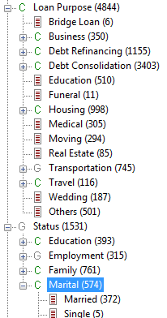
Taxonomy Categorization
Create logical, hierarchical structure

Slide 45
Taxonomy Categorization

Slide 46
Taxonomy Categorization
Query text to assign to categories

Slide 47
Taxonomy Categorization
Category Subcategory Description
Marital
Status
Married
Divorced
"I was recently married and am moving to San Diego, CA."
"This loan is to cover unexpected legal fees stemming from my divorce and custody battle."
"My husband is in the navy."
"My ex wife rang up a lot of bills."

Slide 48
Why Do We Care?
Loan Purpose>Transportation>Motorcycle
Loan Purpose>Debt Consolidation>Medical
Loan Purpose>Debt Refinancing
Loan Purpose>Business>Purchase Existing
Loan Purpose>Housing>Mortgage
Loan Purpose>Business>Start New
Loan Purpose>Education
Loan Purpose>Business>Expand
Loan Purpose>Wedding
Loan Purpose>Business
Status>Education>College
Loan Purpose>Medical
Status>Education
Attitude>Optimistic
Attitude>Desperate
Attitude>Grateful
Fully Paid
Charged Off

Slide 49
Why Do We Care?
Loan Purpose>Transportation>Motorcycle
Loan Purpose>Debt Consolidation>Medical
Loan Purpose>Debt Refinancing
Loan Purpose>Business>Purchase Existing
Loan Purpose>Housing>Mortgage
Loan Purpose>Business>Start New
Loan Purpose>Education
Loan Purpose>Business>Expand
Loan Purpose>Wedding
Loan Purpose>Business
Status>Education>College
Loan Purpose>Medical
Status>Education
Attitude>Optimistic
Attitude>Desperate
Attitude>Grateful
Fully Paid
Charged Off
College-educated borrowers & Debt Refinancing loans tend to be fully paid…
…while optimistic borrowers and Business loans tend to default

Slide 50
PolyAnalyst
Web Report Training
Incorporate Extracted Information
Predictive Modeling

Slide 51

Predictive Modeling
Systematically investigate relationship between loan default and
combinations of factors

Slide 52
Predictive Modeling
All attributes – structured, as well as those extracted from text – are used as input

Slide 53
Predictive Modeling
PolyAnalyst Supported Models
  Decision Trees
  CHAID
  Random Forests
  Neural Networks
  Support Vector Machines
  Logistic Regression

Slide 54
Predictive Modeling
PolyAnalyst Supported Models
  Decision Trees
  CHAID
  Random Forests
  Neural Networks
  Support Vector Machines
  Logistic Regression

Slide 55
Predictive Modeling
  Decision Trees
    Robust
    Flexible
    Scalable
    Efficient
    Easy to Interpret

Slide 56
Predictive Modeling
  Decision Trees
    Robust – missing, messy, or correlated data
    Flexible
    Scalable
    Efficient
    Easy to Interpret

Slide 57
Predictive Modeling
  Decision Trees
    Robust
    Flexible – any data type as predictors
    Scalable
    Efficient
    Easy to Interpret

Slide 58
Predictive Modeling
  Decision Trees
    Robust
    Flexible
    Scalable – large amounts of data
    Efficient
    Easy to Interpret

Slide 59
Predictive Modeling
  Decision Trees
    Robust
    Flexible
    Scalable
    Efficient – relatively fast learning and prediction speed
    Easy to Interpret

Slide 60
Predictive Modeling
  Decision Trees
    Robust
    Flexible
    Scalable
    Efficient
    Easy to Interpret – output rules in graphical tree structure

Slide 61
Decision Tree
Grade
Structured
Extracted from Text
Term
Loan Purpose/ Debt Consolidation
Rank factors in order of predictive importance
APR
# Accts Opened in Past 24 mo.s
# Derogatory Public Recs
Loan Purpose/ Debt Refinancing
# Satisfactory Acct.s
Annual Income
Marital Status
Punctuation Errors
Notes:
Improvement in accuracy which is equivalent 2% in predicting new loans

Slide 62
Decision Tree
Whether the loan is for Debt Consolidation is highly predictive of loan default status
Grade
Structured
Extracted from Text
Term
Loan Purpose/ Debt Consolidation
Loan Purpose/ Debt Consolidation
APR
# Accts Opened in Past 24 mo.s
# Derogatory Public Recs
Loan Purpose/ Debt Refinancing
# Satisfactory Acct.s
Annual Income
Marital Status
Punctuation Errors
Notes:
Improvement in accuracy which is equivalent 2% in predicting new loans

Slide 63
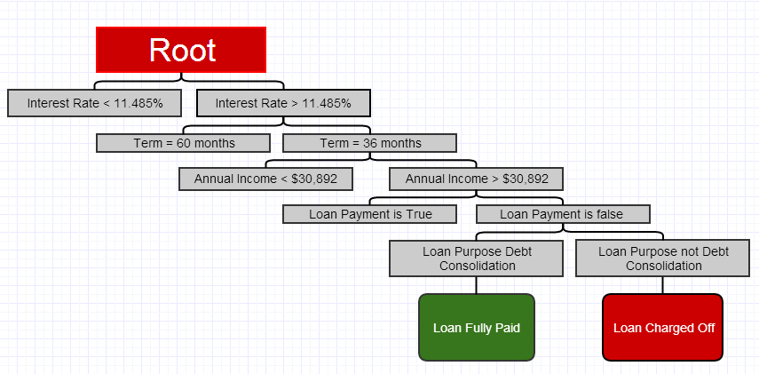
Decision Tree

Slide 64

Decision Tree
If interest rate > 11.485%, …

Slide 65
Decision Tree
…term is 36 months, …

Slide 66

Decision Tree
…income > $30,892/year, …

Slide 67
Decision Tree
…and keyword “loan payment” is not mentioned, …

Slide 68
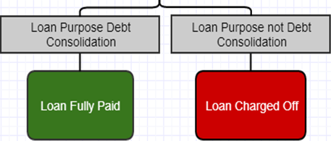
Decision Tree
…then the prediction hinges on whether the loan is for Debt Consolidation.

Slide 69
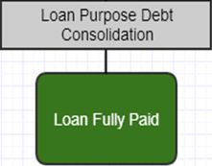
Decision Tree
If loan purpose is Debt Consolidation, then the loan will be fully paid.

Slide 70
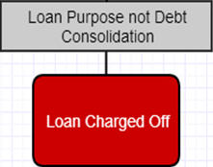
Decision Tree
If loan purpose is not Debt Consolidation, then the loan will be charged off.

Slide 71
Text Mining in Loan Model
Predictive Modeling: Outcome
By including text attributes, we get 2% improvement in prediction accuracy
Notes:
Improvement in accuracy which is equivalent 2% in predicting new loans

Slide 72

Why Do We Care?
For a large bank,
2% could mean about
$200 million in savings
Notes:
Improvement in accuracy which is equivalent 2% in predicting new loans

Slide 73

Why Do We Care?
For the credit industry overall,
2% could save about $2 billion
Notes:
Improvement in accuracy which is equivalent 2% in predicting new loans

Slide 74
Conclusion
Lenders can use PolyAnalyst to:
Extract information from text
Augment traditional loan risk models
Build reusable, automatic, efficient, and scalable models
Increase accuracy and comprehensiveness of models

Slide 75
Conclusion
Decrease Cost of Lending
Better Identify Factors
Affecting Loan Default
Improve Lending Strategies
Increase
Lending Opportunity while Reducing Risk

Slide 76

Contacting Megaputer
Questions?

