Slide 1

PolyAnalyst
Web Report Training
What is next for PolyAnalyst?
Megaputer Intelligence
www.megaputer.com
© 2014 Megaputer Intelligence Inc.

Slide 2

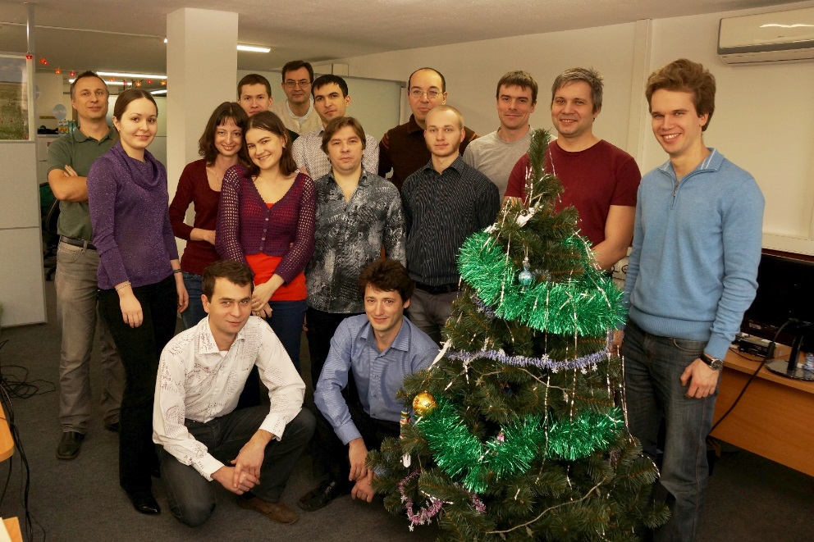
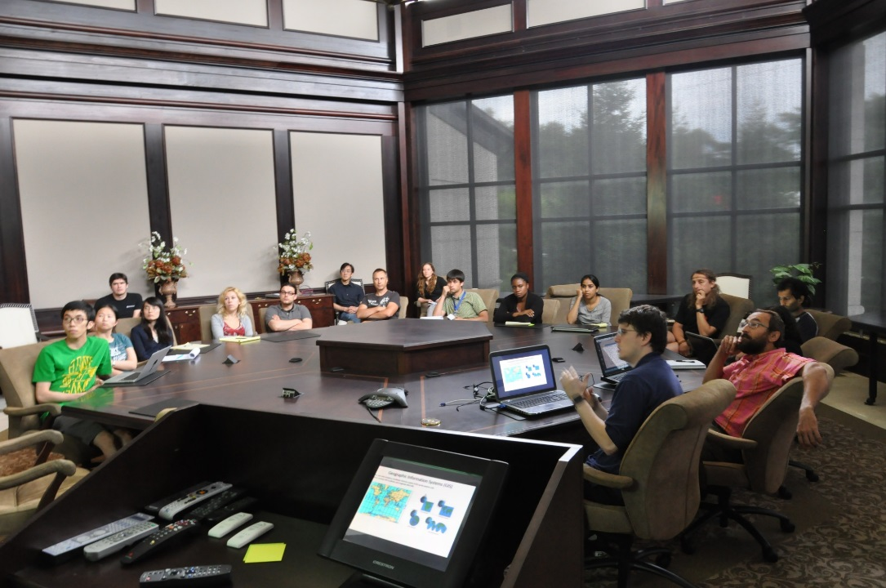
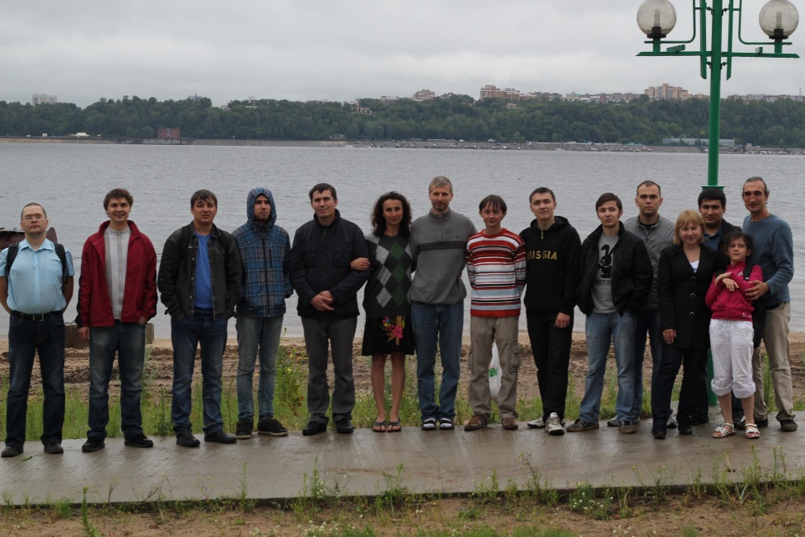
Outline
Growing Team of Consultants

Slide 3
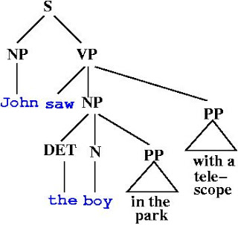
Outline
Enhanced Linguistic Parsing
Dependency Parser
Enhanced Standard Entities Extraction
Enhanced Sentiment Analysis

Slide 4
Outline
Context-based Disambiguation
Had some numb feeling going down his leg earlier in 1998 which resolved. Sounds like it
might have been a nerve-root problem. Strength and reflexes full. Mid-2000 had similar
probs w LBP and numbness down leg (either), esp noted driving. Resolved spont. Exam
unremarkable. Discussed and given back exercises.
LBP
Lower back pain?
Low blood pressure?
Lipopolysaccharide-binding protein?
Local binary pattern?

Slide 5
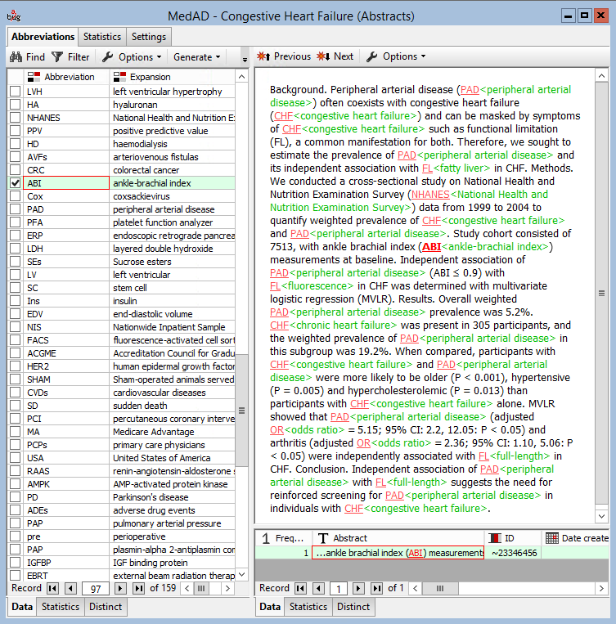
Outline
Context-based Disambiguation

Slide 6
Outline
Multi-Lingual Capabilities
Support for 14 languages
  11 European
    Spanish, French, English, Russian, German, Dutch, Portuguese, Italian, Greek, Polish, Turkish
  3 Asian
    Chinese, Japanese, Korean

Slide 7
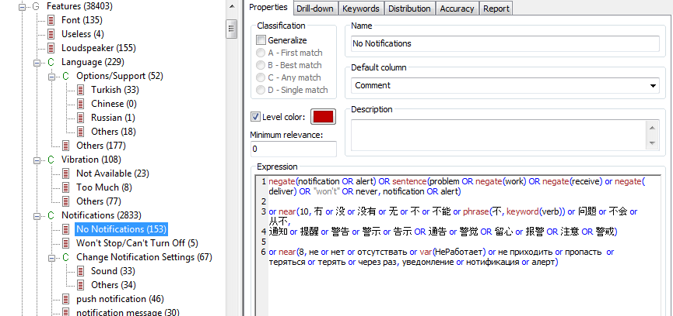
Outline
Multi-Lingual Capabilities

Slide 8
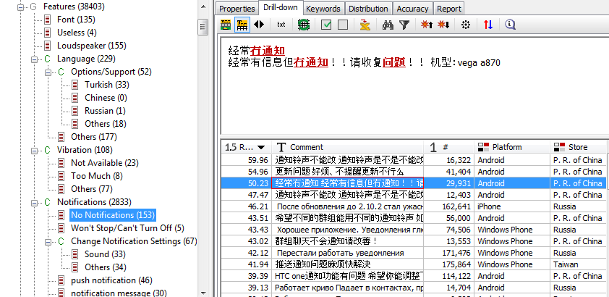
Outline
Multi-Lingual Capabilities

Slide 9
Outline
Custom Entity Extraction - setup
LinguaMark pattern:
  <Medication,P(N)>:@ [{<,P(1)> <dosage,P(N)>}:dosage] [{<mode,P(N)>}:mode] [{<frequency,P(N)>}:frequency]
Matches:
  Feosol 325 mg p.o. every day
  lantus 20 units qhs
  Tylenol #3 p.r.n.
Number
Class Dosage
Class Mode
Class Frequency
Anchor
Class Drug
Extracted Medication
Extracted
Dosage
Extracted
Mode
Extracted Frequency

Slide 10
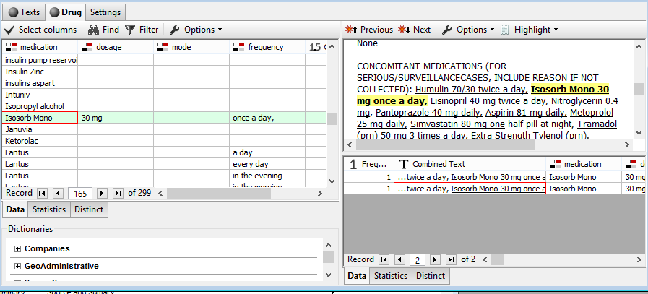
Outline
Custom Entity Extraction - results
Medications & Dosage

Slide 11
Outline
Industry-specific libraries of resources
Dictionaries
Taxonomies
Industry standard (MeSH, RxNorm, etc.)
Custom developed

Slide 12
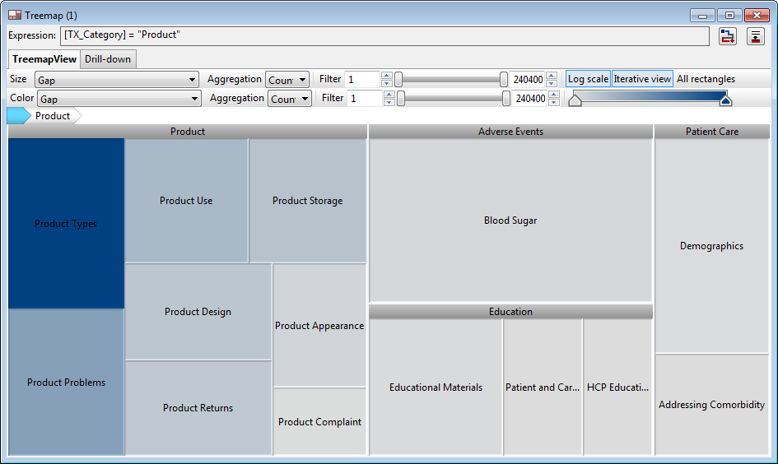
Outline
Visualizations - TreeMap

Slide 13
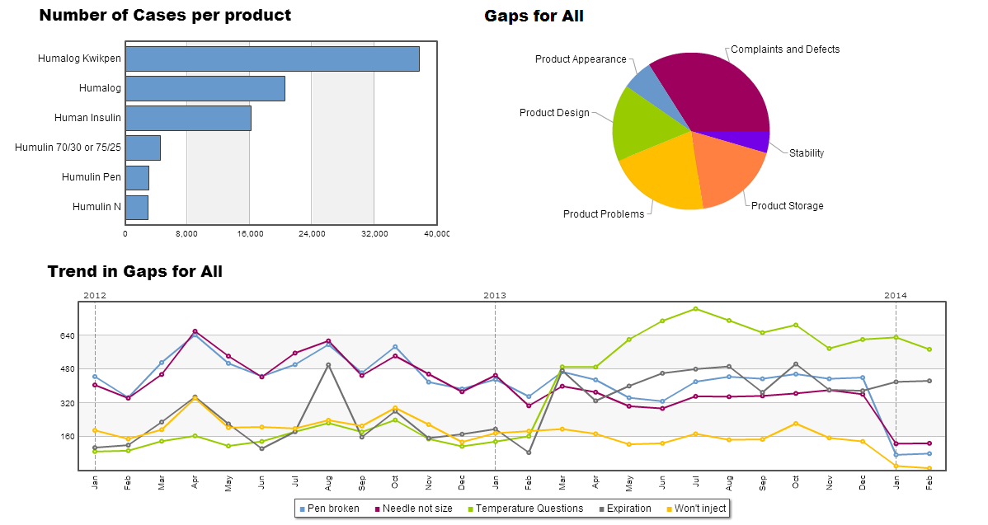
Outline
Web based reports

Slide 14

Outline
Web based reports

Slide 15
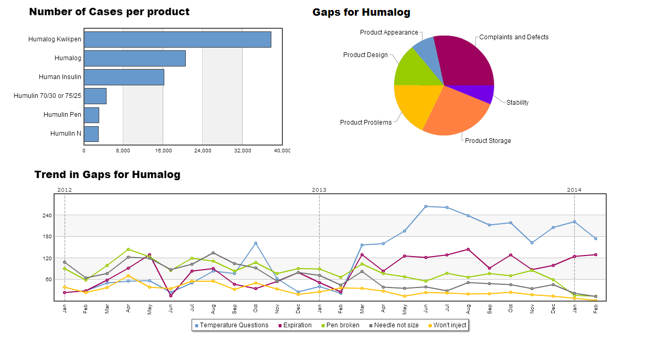
Outline
Web based reports

Slide 16
Outline
Web reports
WYSWYG paradigm
Simplified browser-based user interface
Fast response

Slide 17
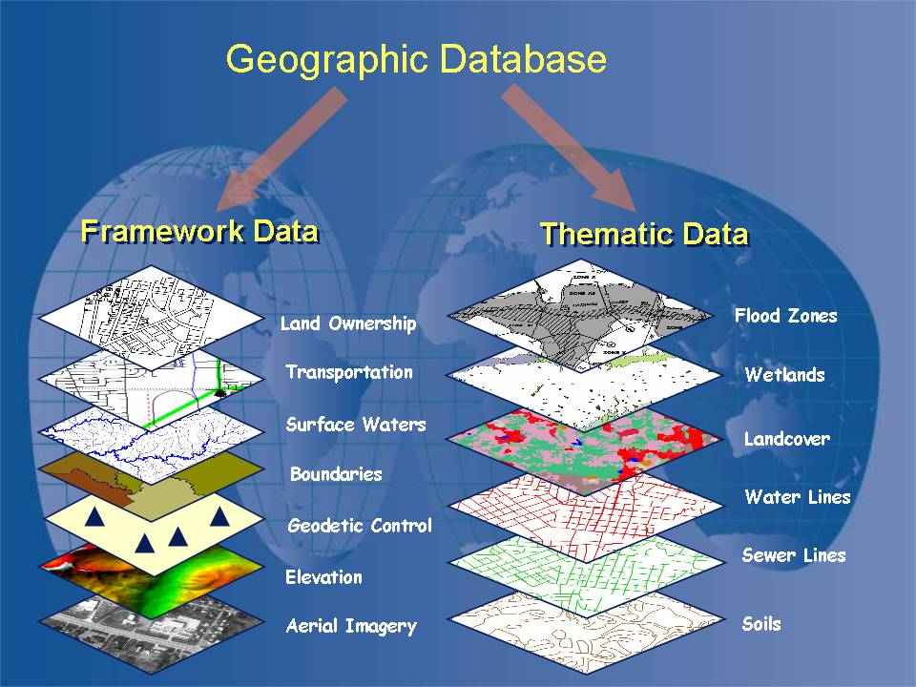
Outline
GIS capabilities

Slide 18
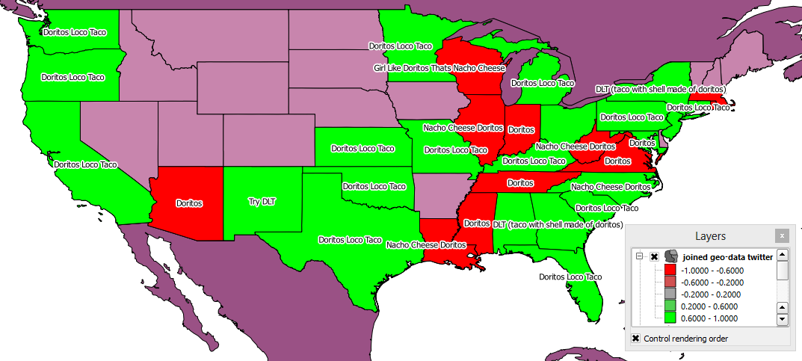
Outline
GIS capabilities
Geo-tagged Twitter Data
Sentiment of Doritos Locos Taco

Slide 19

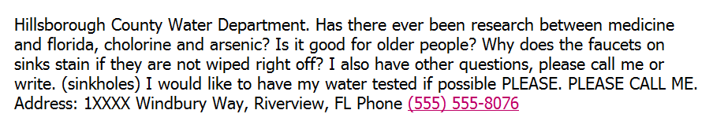
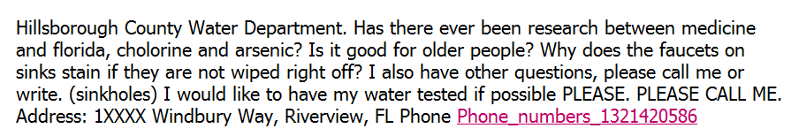
Outline
Entity anonymization

Slide 20
Outline
Expanding the reach
OCR-ing
Machine translation
Speech-to-Text conversion

Slide 21
Outline
Cluster-based Architecture
Running on a cluster of low-grade machines
Parallel execution
High availability
Fast response (in-memory calculations)

Slide 22
Outline
Hadoop-based algorithms
Indexing
Keyword extraction
Categorization

Slide 23
Contacting Megaputer
Questions?

