Slide 1


PolyAnalyst
Web Report Training
PolyAnalyst Dictionaries
© 2014 Megaputer Intelligence Inc.
Notes:
Welcome to the PolyAnalyst User Group Meeting Technical Session.
This session we’ll focus on PolyAnalyst dictionaries

Slide 2






Outline
Why do we use Dictionaries?
Dictionaries are essential to good Text Mining
Notes:
So I thought I’d just start with the question why we use dictionaries
Dictionaries are essential to good text mining
Many of the text mining nodes depend heaviliy on good text mining
The better the underlying dictionaries the better the results.
Nodes Include:
The spell check Node
…

Slide 3
Outline
Changes In PolyAnalyst Dictionary
Old Dictionary Split into Multiple Parts
Companies
Statistics
Spell Checks
GeoAdministrative
Stop Lists
Morphology
Old Dictionary
Human Names
Word Lists
Synonyms
Organizations
Semantics
Word classes
Phrases
Notes:
The reason we split the dictionary is to make it easier to edit.
This way if I want to add say a synonym I can directly add it in the synonyms dictionary

Slide 4
Dictionaries
Keyword Extraction
Companies
Statistics
Spell Checks
GeoAdministrative
Morphology
Entity Extraction
Sentiment Analysis
New Dictionary
Human Names
Multiple Nodes
Synonyms
Organizations
Stop Lists
Phrases
Word classes
Word Lists
Semantics

Slide 5
Statistics Dictionary
Statistics
Notes:
We’ll start with the statistics dictionary which is used in the keyword extraction node

Slide 6
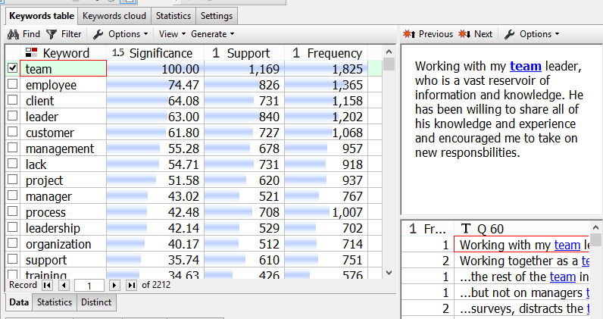
Statistics Dictionary
Keyword Extraction computes Significance from base frequencies in the Statistics Dictionary
Notes:
The support is the number of records that contain the word team
The frequency is the total number of instances in the dataset
The significance is a relative measure of the frequency compared to the base frequency in the dictionary
Essentially how often do I expect the word team to occur in a dataset this large vs the actual number of times.

Slide 7
Improving Keyword Extraction
The Default Statistics dictionary is based on a large corpus of text to estimate word frequency in typical English.
Your data might not be typical.

Slide 8
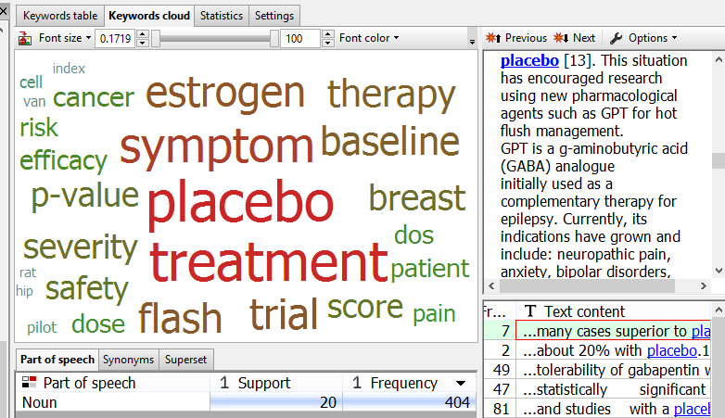
Domain Specific Statistics Dictionaries
In Pubmed Medical Abstracts the most significant word is “Placebo”
“Placebo” is a common word in clinical drug trials and not helpful in this domain

Slide 9



Domain Specific Statistics Dictionaries
Train the Statistics Dictionary on Domain Data
Statistics Dictionary
Apply on our data

Slide 10
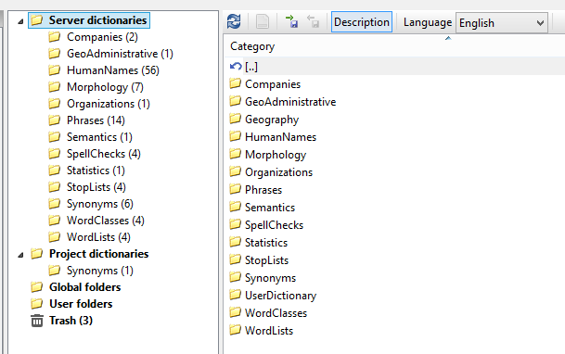
Editing a Dictionary
All Dictionaries are the Dictionary Manager
Go To File-> Manage Dictionaries or Ctrl +D
Notes:
Before I go any further I just wanted to note that all dictionaries are edited in the dictionary manager.
So to not be so redundant to get the dictionary manager click File-> New Dictionaries or CTrl + D
Also there are 2 types of dictionaries. Server dictionaries which can be used in all projects on the server and project dictionaries that can only be used on a specific project.

Slide 11
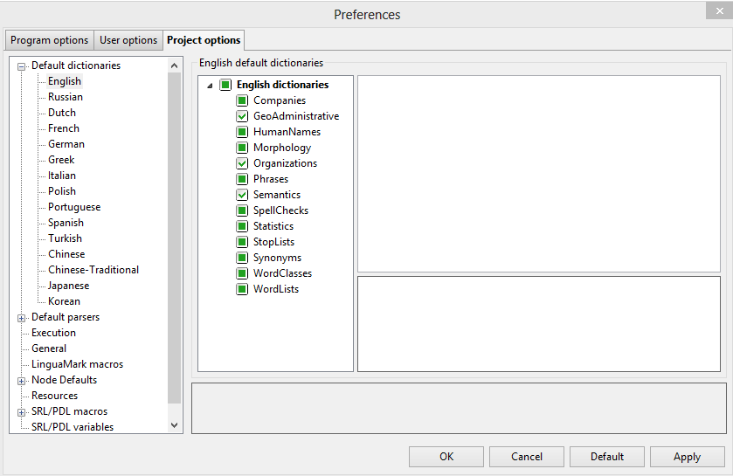
Setting Default Dictionaries
Go to Settings -> Program options -> Project options
Notes:
Before I go any further I just wanted to note that all dictionaries are edited in the dictionary manager.
So to not be so redundant to get the dictionary manager click File-> New Dictionaries or CTrl + D
Also there are 2 types of dictionaries. Server dictionaries which can be used in all projects on the server and project dictionaries that can only be used on a specific project.

Slide 12
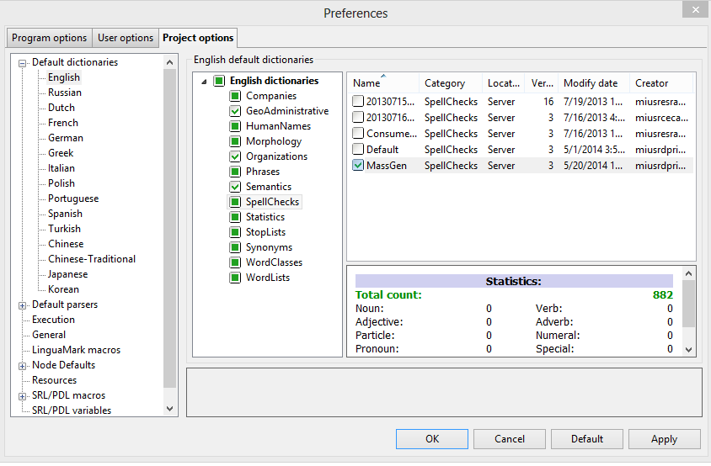
Setting Default Dictionaries
Select Default Dictionaries for the project
Notes:
Before I go any further I just wanted to note that all dictionaries are edited in the dictionary manager.
So to not be so redundant to get the dictionary manager click File-> New Dictionaries or CTrl + D
Also there are 2 types of dictionaries. Server dictionaries which can be used in all projects on the server and project dictionaries that can only be used on a specific project.

Slide 13
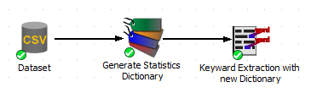
Training a Statistics Dictionaries
The Statistics Dictionary is generated in the Index Node

Slide 14
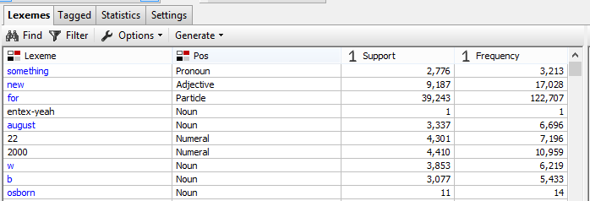

Training a Statistics Dictionaries
Go to Generate -> Statistic Dictionary

Slide 15
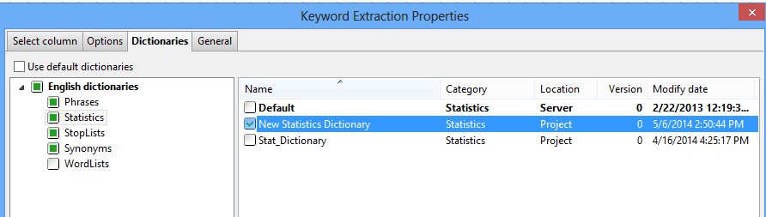
Statistics Dictionaries
In the Keyword Extraction Node Select the Statistics Dictionary
Notes:
In the properties menu of the keyword extraction node go to dictionaries tab and select the new dictionary over the default.
This will use the new base frequencies from the larger set of text.

Slide 16
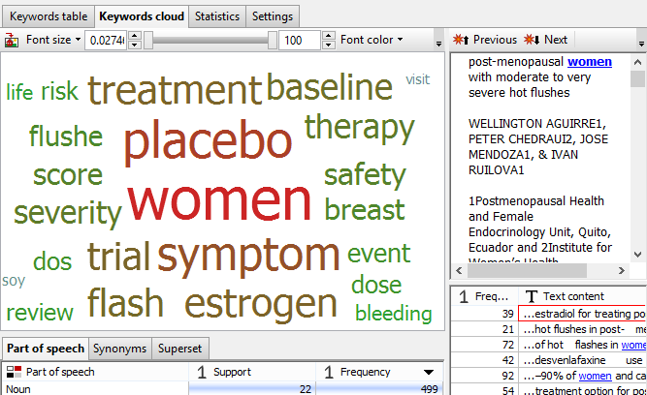
Statistics Dictionaries
Updated keywords from new dictionaries

Slide 17
Multiple Nodes Dictionaries
Spell Checks
Synonyms
Multiple Nodes
Stop Lists
Notes:
Next we’ll move on to 3 of the most common dictionaries used in projects.
Spell Checks
Synonyms
Stop Lists

Slide 18
Spell Checks Dictionary
Spell Checks
Notes:
First we’ll look at the Spell Checks Dictionary, used by the Spell Check node.

Slide 19
Good Spell Check Practices
Editing the default spell checks dictionary isn’t best if you’re working in a group.
Create a project Spell Check dictionary or a personal user dictionary.
Notes:
But first I’d like to digress into some good Spell check dictionary practices.

Slide 20
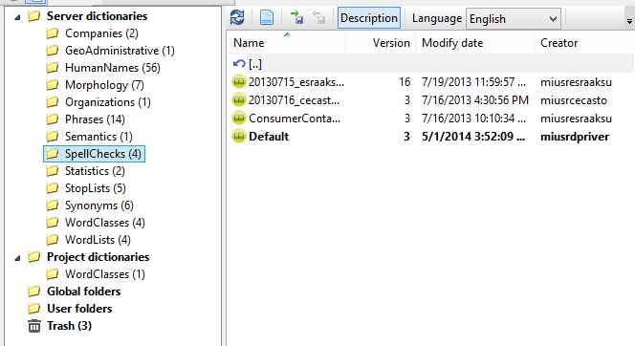
Creating a Spell Checks Dictionary
Create New Dictionary
Dictionary Manager
Notes:
To create a new spell checks dictionary in the dictionary manager select the spell checks dictionary

Slide 21
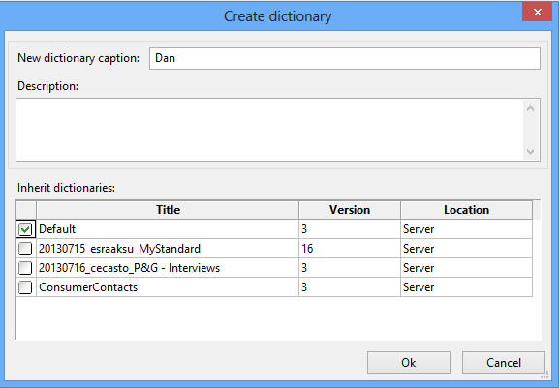
Creating a Spell Check Dictionary
Inherit Default Dictionaries
Notes:
Next We’ll name the dictionary and have the option to inherit other dictionaries.
Inherit means to incorporate the previous dictionaries into the new dictionary.
If we inherit the default dictionary this new dictionary will initially be a clone of the default dictionary until we edit it.

Slide 22
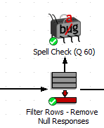
Outline
Editing Spell Checks Dictionary
Improving the Spell Checks Dictionary from within the spell check node .
Notes:
Next

Slide 23
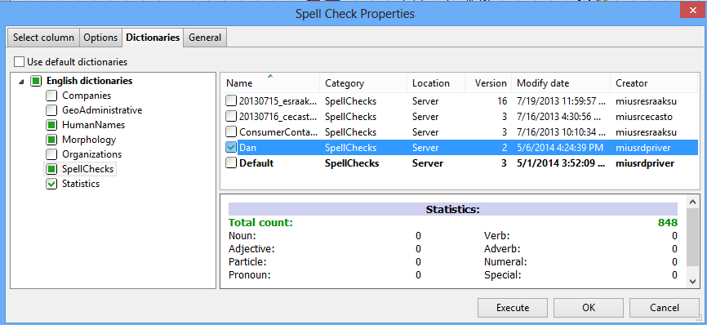
Outline
Editing Spell Checks Dictionary
Select the Proper Dictionary
Notes:
The first step is to select the proper dictionary.
From within the spell check node go to the dictionaries tab and select your new dictionary.

Slide 24
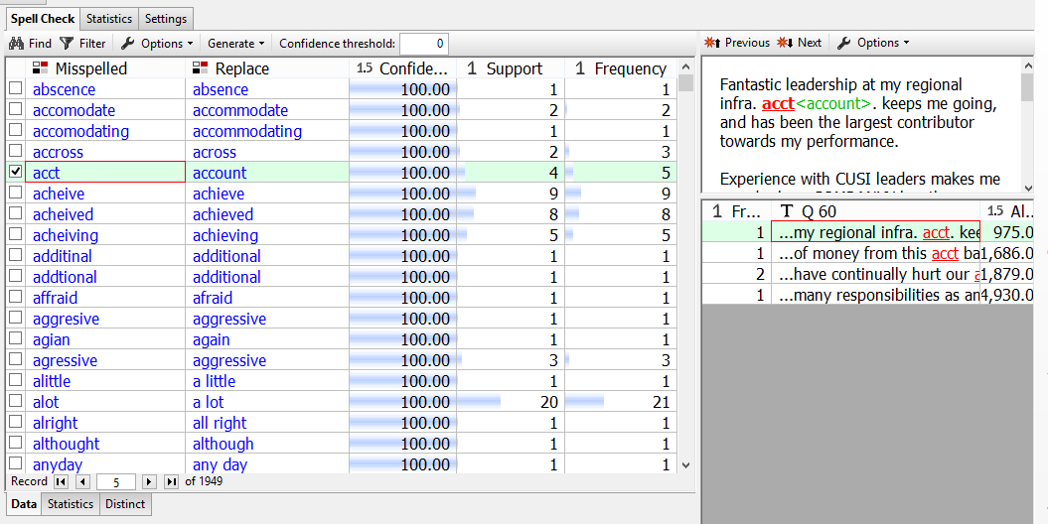
Outline
Spell Checks Dictionary
Green color shows suggested correction.

Slide 25
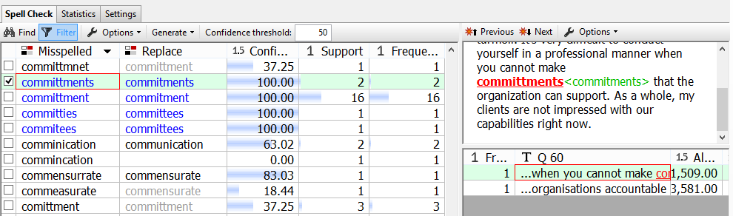
Outline
Spell Checks Dictionary Coding
Blue = Known Misspell from Dictionary (Confidence = 100%)
Black = Probable Misspell from Algorithm (Confidence > Threshold)
Grey = Suggested Misspell from Algorithm (Confidence < Threshold)
Empty = Unknown Misspell (Confidence = 0)

Slide 26
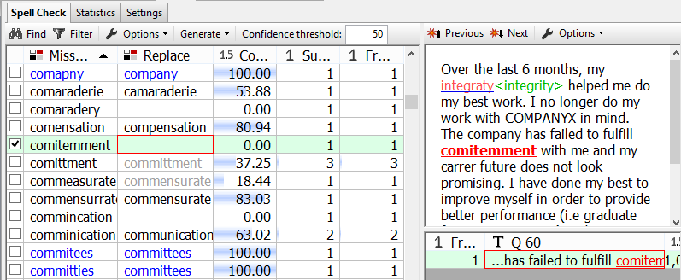
Outline
Improving Spell Checks Dictionary
Case 1) Correcting a misspell
Spell Check Algorithm is baffled.
From context we can infer the word is “commitment.”

Slide 27
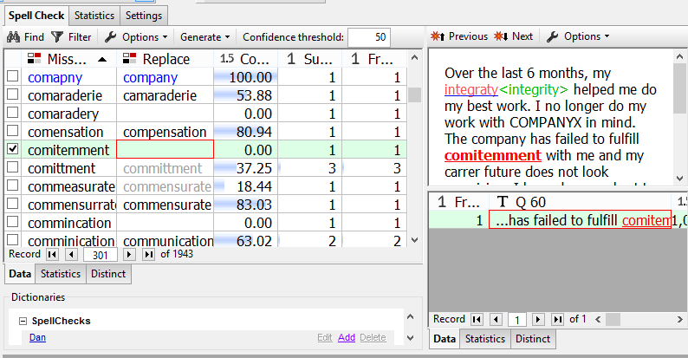
Outline
Improving Spell Checks Dictionary
Case 1) Correcting a misspell
Select the word and click the Add button

Slide 28
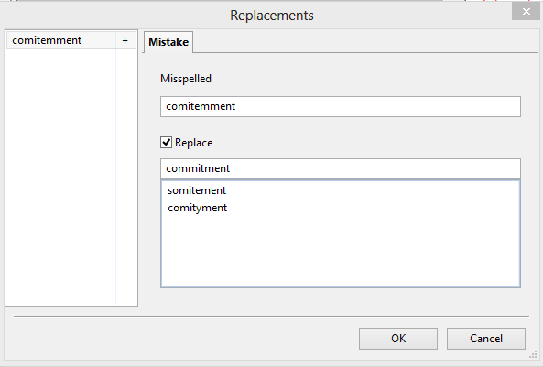
Outline
Improving Spell Checks Dictionary
Case 1) Correcting a known word
Write the corrected word and click OK
Notes:
A dialog box will pop up and allow you to edit the list of known mispells

Slide 29
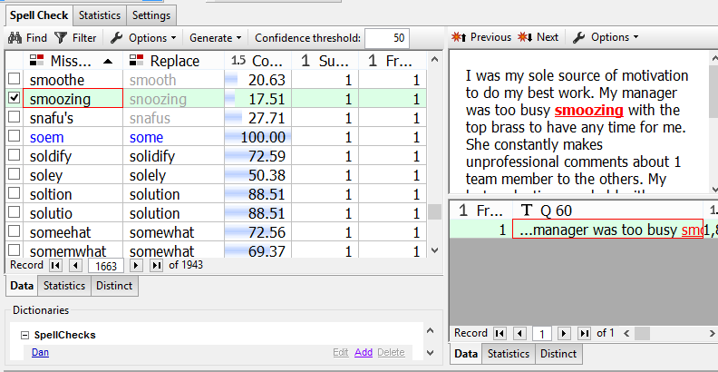
Outline
Improving Spell Checks Dictionary
Case 2) To add a new word to the Spell Check dictionary
Right Click -> Mark as known Word

Slide 30
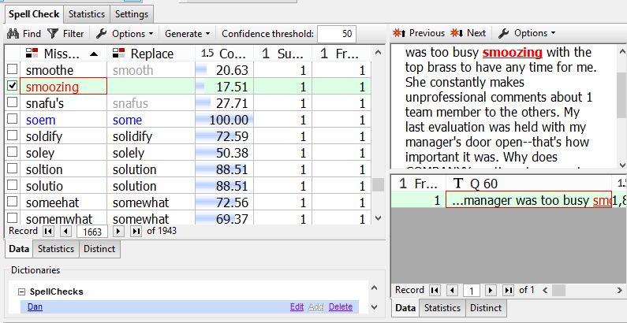
Outline
Improving Spell Checks Dictionary
Case 2) To add a new word to the Spell Check dictionary
The new word will turn red and be added to the dictionary.

Slide 31
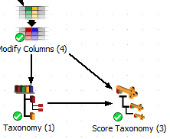
Outline
Improving Text Mining through Synonyms
Synonyms

Slide 32
Outline
Improving Text Mining through Synonyms
Many PDL functions make use of Relationships within the dictionary.
Synonym is the most common relationship.
Notes:
If you attended the technical session on Pattern Definition Language you’ve seen examples of these relationships such as synonyms, antonyms, meronyms, hyponyms, etc.
Synonym is by far the most common relationship used in text mining so we’ll focus on it.

Slide 33
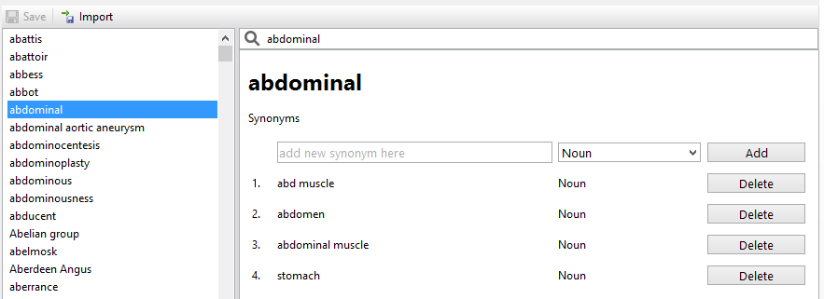
Outline
Dictionary Synonyms
Notes:
In this case I was looking through medical literature and wanted to find synonyms of the word abdominal

Slide 34
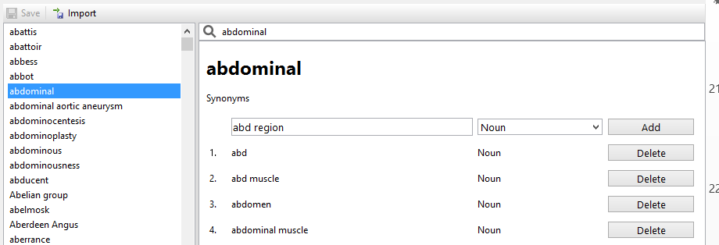
Outline
Edit Dictionary Synonyms Manually
Notes:
There are 2 ways to edit the synonyms list the first is manually.
You simply type the term in and click add

Slide 35
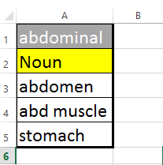
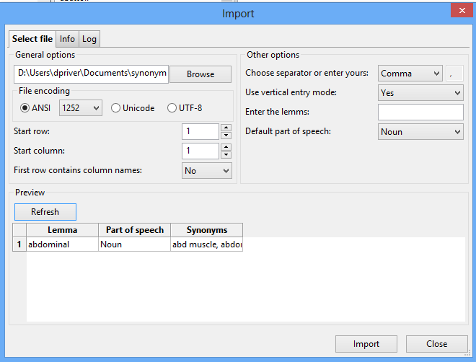
Outline
Import Dictionary Synonyms List
Synonym List
Import Dialog
Notes:
The second is through a list.
In this case I’ve created a csv and am importing through vertical entry mode.

Slide 36
Outline
Dictionary Synonyms PDL
The thesaurus function matches all synonyms of a token.

Slide 37
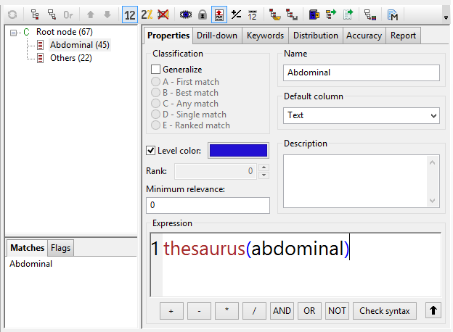
Outline
Dictionary Synonyms PDL

Slide 38
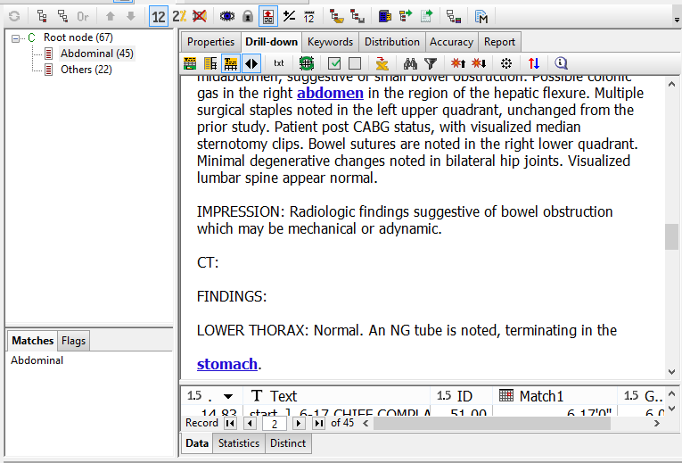
Outline
Dictionary Synonyms PDL

Slide 39

Outline
Stop List Dictionary
The Stop List Dictionary is a list of terms to ignore in Text Analysis.
Keyword Extraction doesn’t include terms in stop list by default

Slide 40
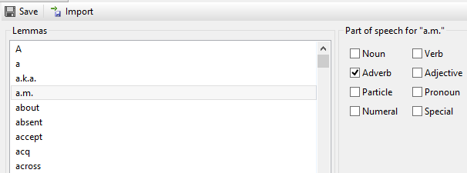
Outline
Stop List Dictionary
Stop Lists

Slide 41
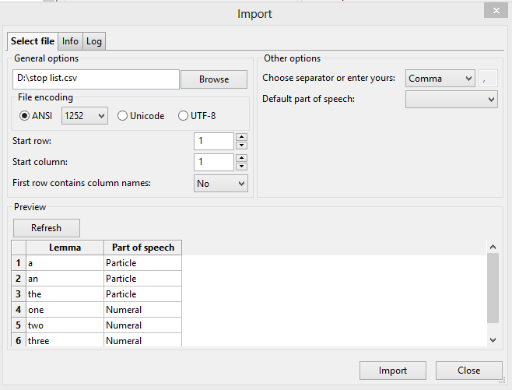
Outline
Stop List Dictionary
Import Dialog

Slide 42
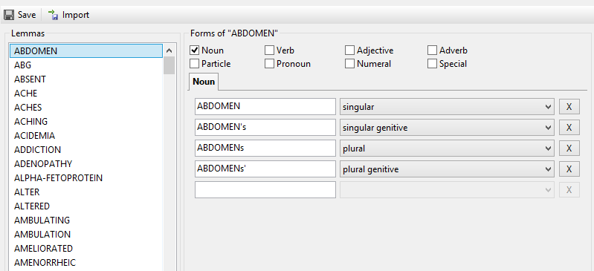
Outline
Morphology Dictionary
Morphology

Slide 43
Outline
Morphology Dictionary
Singular
Abdomen
Lemma
Singular Possessive
Abdomen’s
Abdomen
Abdomens
Plural
Plural Possessive
Abdomens’

Slide 44
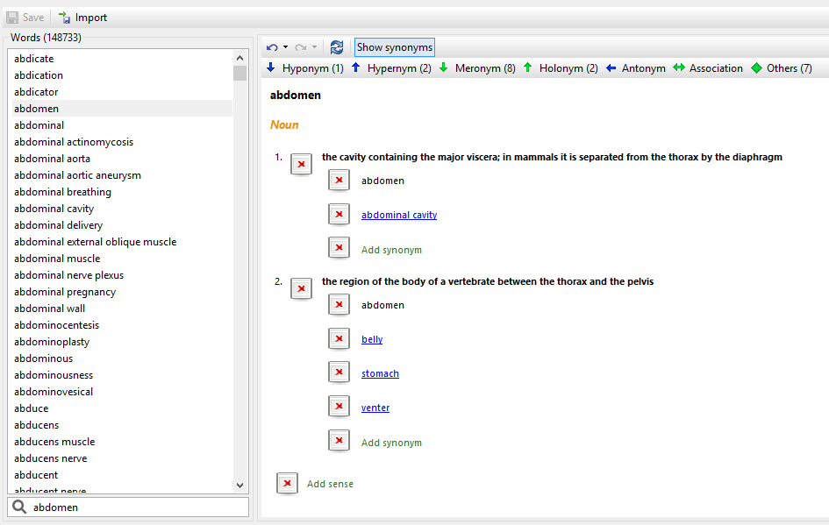
Outline
Semantics Dictionary

Slide 45


Outline
Semantics Dictionary
Dictionary Relationships
Hypernyms
Holonyms
Synonyms
Hyponyms
Meronyms
Antonyms

Slide 46

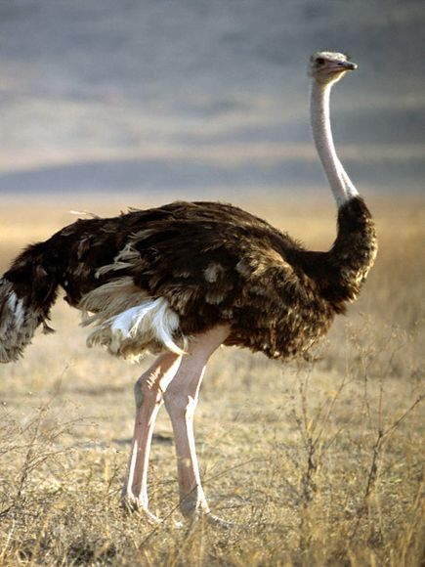
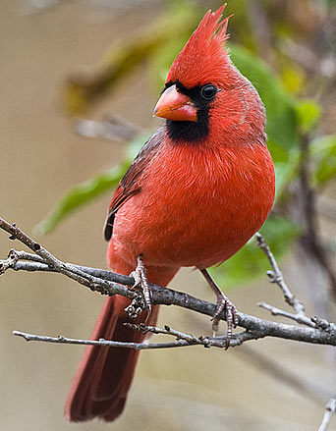
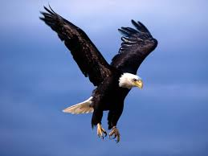
Outline
Hyponyms and Hypernyms
“Cardinal”, “Eagle”, and “Ostrich” are all hyponyms of “Bird”
“Bird” is a hypernym of “Cardinal”

Slide 47

Outline
Meronyms and Holonyms
Meronym = Is Part Of
“Feather” is a Meronym of “Cardinal”
“Cardinal” is a Holonym of “Feather”

Slide 48
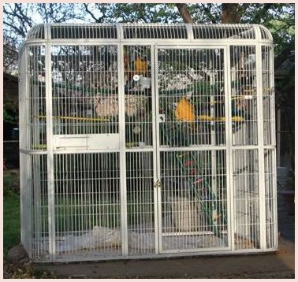
Outline
Synonym and Antonyms
“Birdcage” is a synonym of “Aviary”
“Heat” is a antonym of “Cold”

Slide 49


Outline
PolyAnalyst Dictionaries
Companies
GeoAdministrative
Entity Extraction
Sentiment Analysis
Human Names
Organizations
Word classes
Notes:
Now we’ll look at the PolyAnalyst Dictionaries used for entity extraction and sentiment analysis with particular attention to word classes.
In the first example I was interested on extracting measures of temperature from the records.

Slide 50
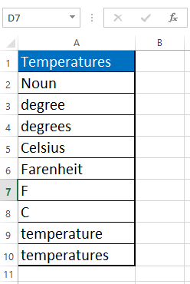
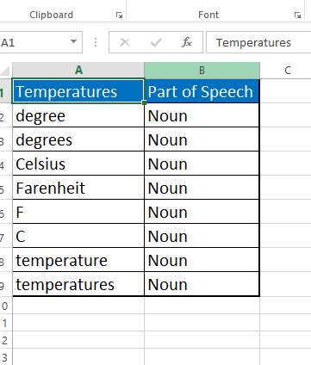
Outline
Adding Word Classes
Step 1) Create a CSV File
Vertical Entry
Horizontal Entry
Notes:
In this case I wanted to extract the entity temperature from the dataset.

Slide 51
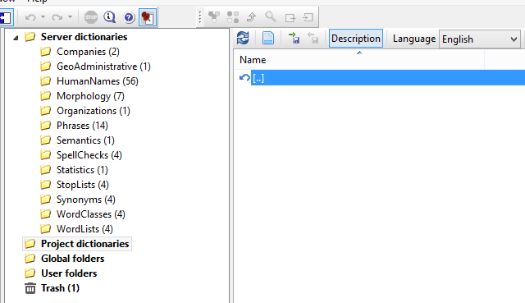
Outline
Adding Word Classes
Step 2) Create a New Dictionary

Slide 52
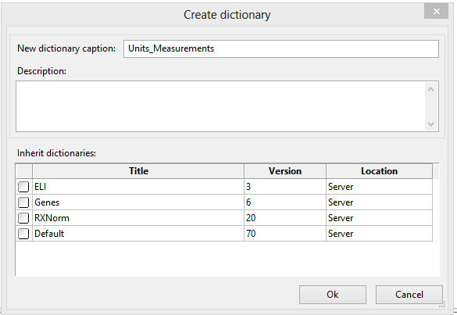
Outline
Dictionary Import Screen
Step 3) Name the Dictionary
The inherit option clones the inherited dictionaries

Slide 53
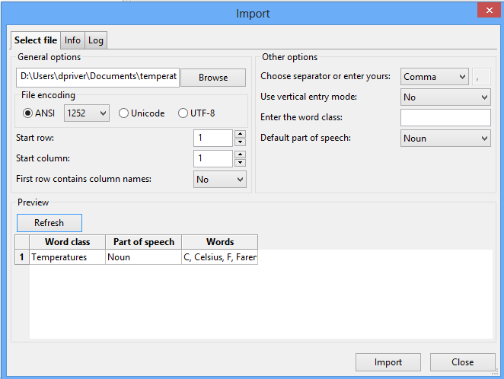
Outline
Dictionary Import Screen
Step 4) Import CSV as Word class

Slide 54
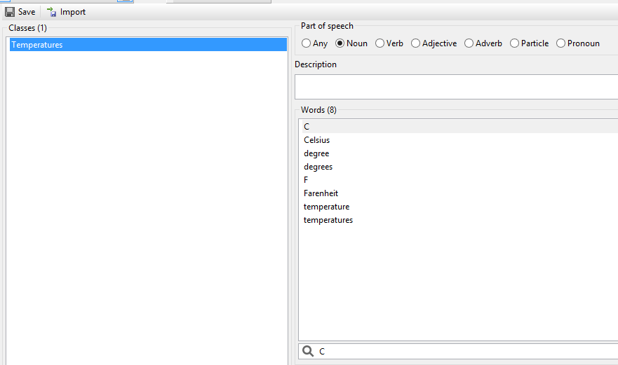
Outline
New Word Class

Slide 55
Outline
Use in a Lingua Mark Expression
{<,P(1)> <Temperatures,PL(SP)>:@}:Temp

Slide 56
Extracted Temperature
{<,P(1)> <Temperatures,PL(SP)>:@}:Temp
The high for Wednesday is 105 degrees
Room temperature is about 25 C
The product was left in the freezer at 11 F
75 Fahrenheit is a comfortable temperature

Slide 57
Word Classes that Convey Sentiment
The sentiment analysis relies heavily on wordclasses that convey sentiment.

Slide 58
Word Classes that Convey Sentiment
Sentiment Word Classes convey Polarity, Part of Speech, Degree
absbadadj
Accursed
Awful
Terrible
Default Word class Dictionary
badadv
Badly
Immorally
Irresponsibly
goodadj
Accommodating
Accurate
Adequate

Slide 59
Outline
Sentiment Word Classes
Sentiment Word Classes are Customizable
Domain specific additions such as slang and emoticons.
:D ☹ ☺ ;( ;)

Slide 60
Word Lists Dictionary
Wordlists are an older form of wordclasses
Lists of associated words
Default Wordlists are “Positive” and “Negative” and are used for Sentiment Analysis

Slide 61
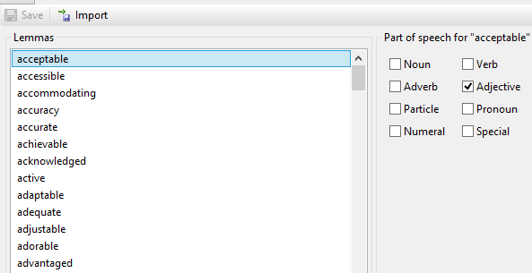
Word Lists Dictionary
Positive Word List

Slide 62

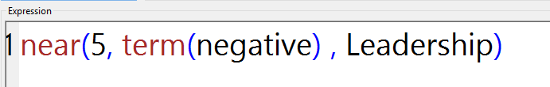
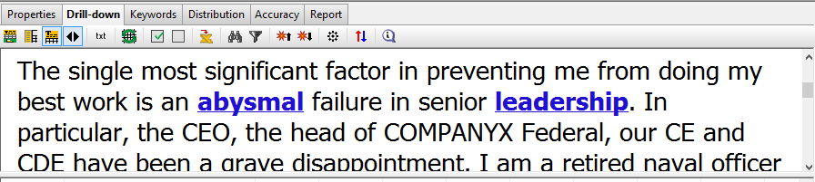
Using Word Lists
In the Taxonomy Node use the Term Function

Slide 63
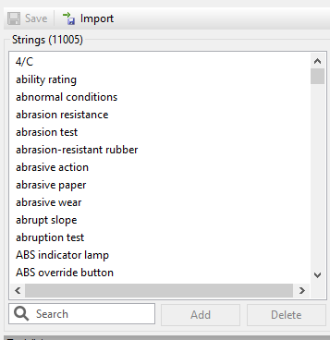
Phrases Dictionary
Phrases Dictionary is similar to Wordlists using multiple words or “Phrases”

Slide 64
Other Dictionaries
Companies
Entity Extraction
Sentiment Analysis
GeoAdministrative
Human Names
Organizations

Slide 65
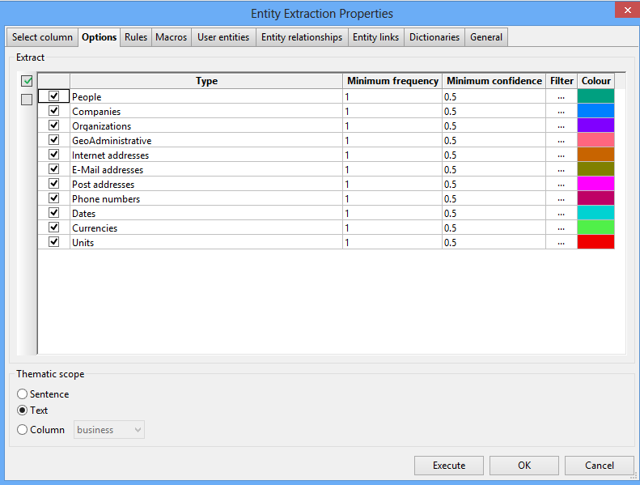
Outline
Default Entity Extraction
People- “Leader Alvaro Hernandez”, “Bill Martin”
Companies-”Blue Shield of California”, ”Global Systems Inc.”
GeoAdministrative- “Tucson Arizona”, “Ecuador”
Units- “Second, Meter, Degree”

Slide 66
Outline
Dictionaries are essential to good Text Mining

Slide 67
Contacting Megaputer
Questions?

