Slide 1

PolyAnalyst
Web Report Training
Building the analytics empowered enterprise
Megaputer Intelligence
www.megaputer.com
© 2014 Megaputer Intelligence Inc.

Slide 2

Outline
Standard Functional Areas
Company
HR
Customers
Marketing
Suppliers
Customer Service
Loss Prevention
Engineering
Quality Assurance
Finance
Human Resources
General Public
Risk Management
Public Relations
Competitive Intelligence
Audit
Competitors
Legal
Regulators

Slide 3
Outline
Typical Tasks - examples
Social Media Data Analysis
Call Center Data Analysis
Survey Analysis
Incident Report Analysis
Fraud Detection
Subrogation/Litigation Prediction
Database Marketing
Sales Data Analysis

Slide 4
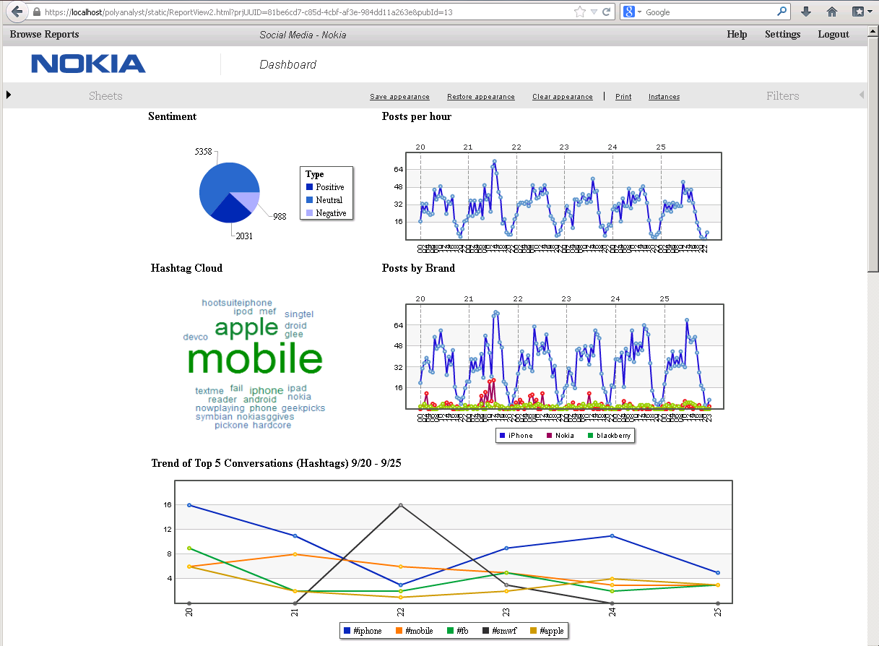
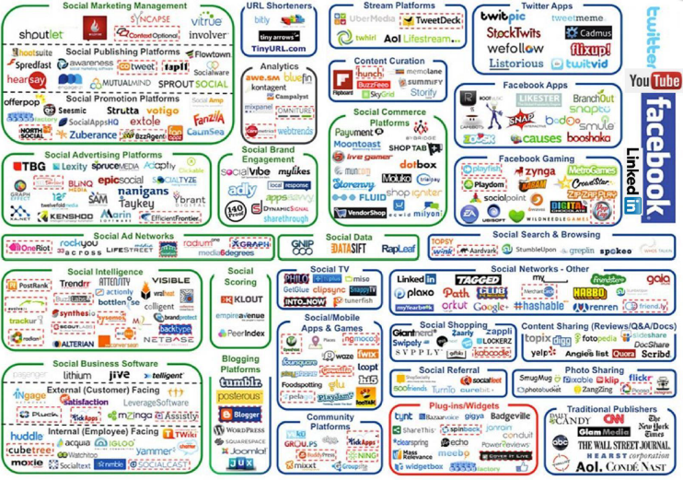
Outline
Social Media Data Analysis
Implemented in:
    Marketing Dept
Thousands of communications
Key topics, sentiment & trends
Customer-driven insights
Immediate & intelligent action

Slide 5
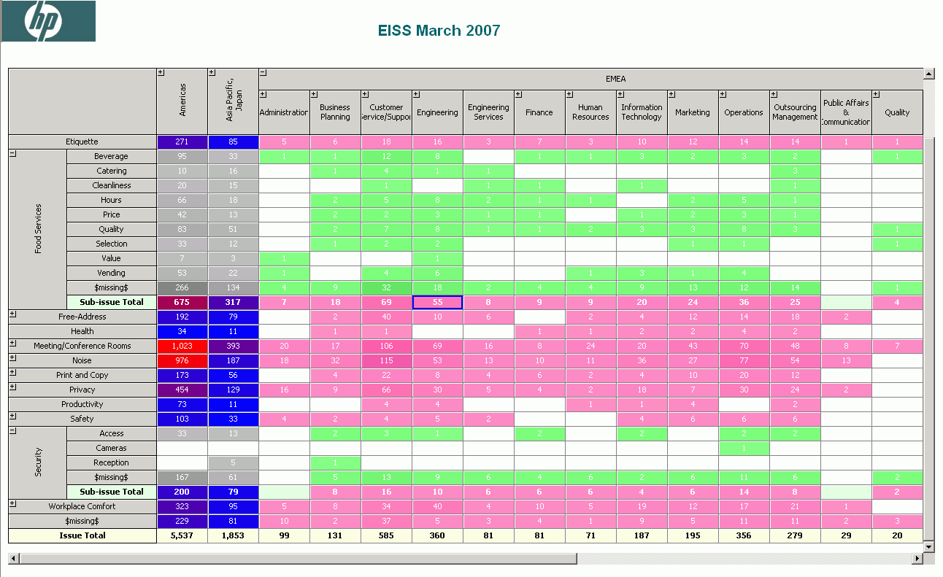

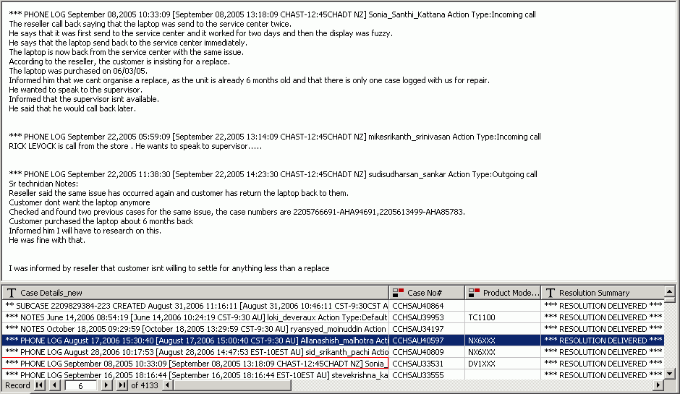
Outline
Call Center Data Analysis
Implemented in:
    Call Center
Millions of phone call transcripts (text)
Results of categorization offered in OLAP cubes
Objective, consistent results
Corporate awareness

Slide 6
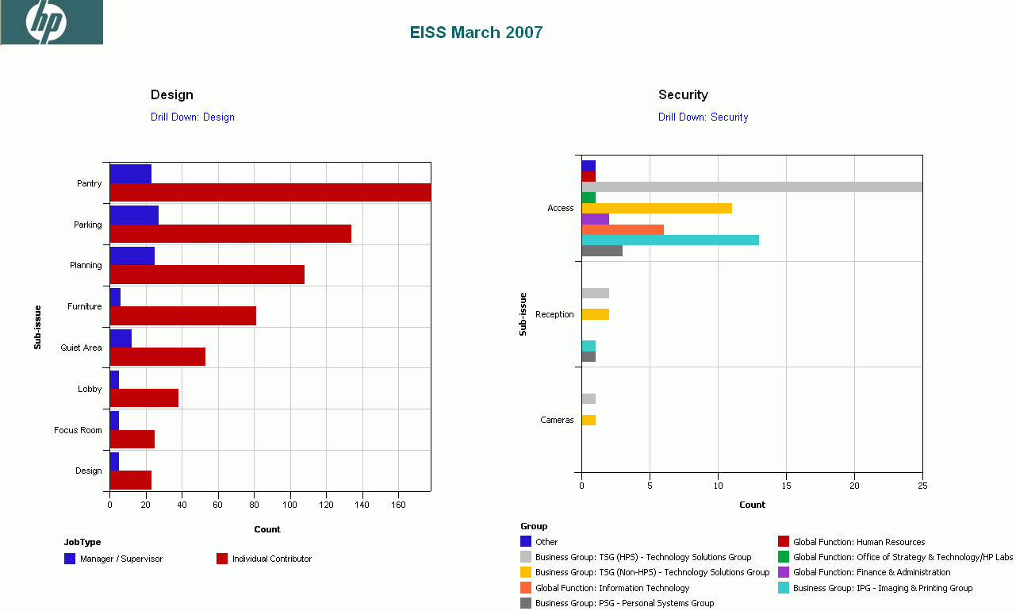
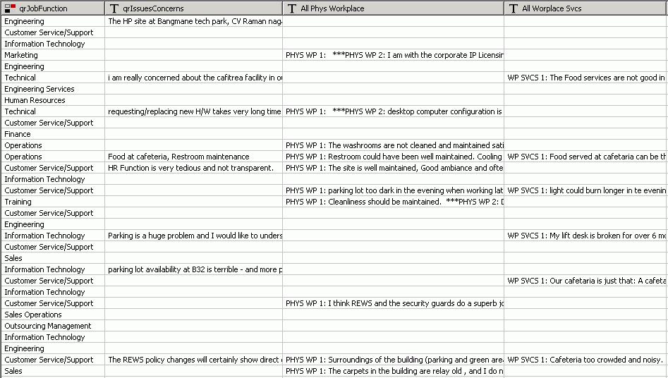
Outline
Survey Analysis
Implemented in:
    VoC
    VoE
Thousands of free text survey responses
Easy to comprehend reports
Analysis of 100% of data
Responsive company

Slide 7
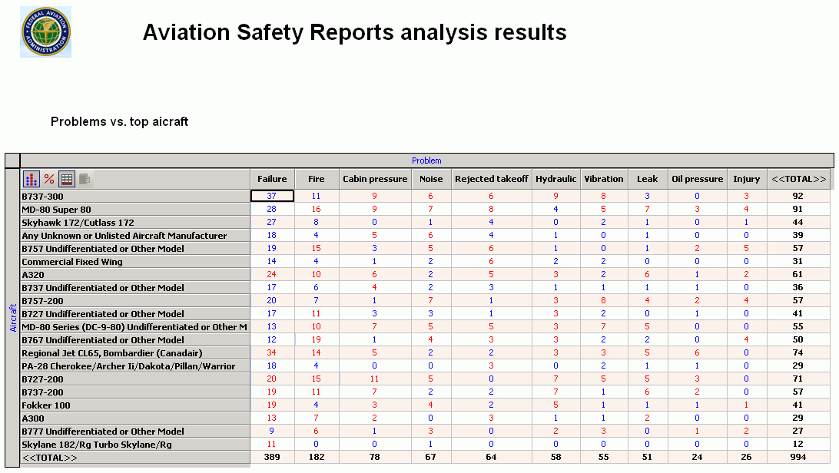
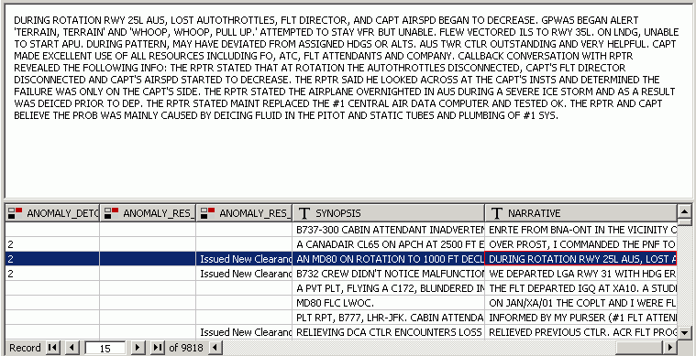
Outline
Incident Report Analysis
Implemented in:
    Safety Department
Thousands mixed incident reports
Key issues and root causes
Improved Safety
Shortened response time

Slide 8
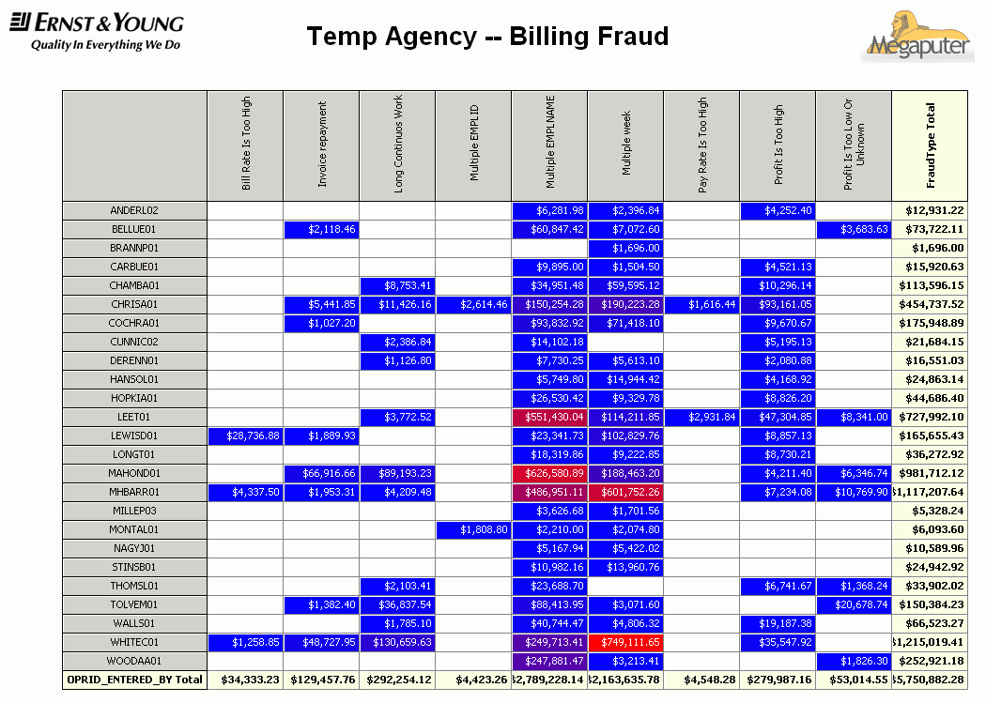
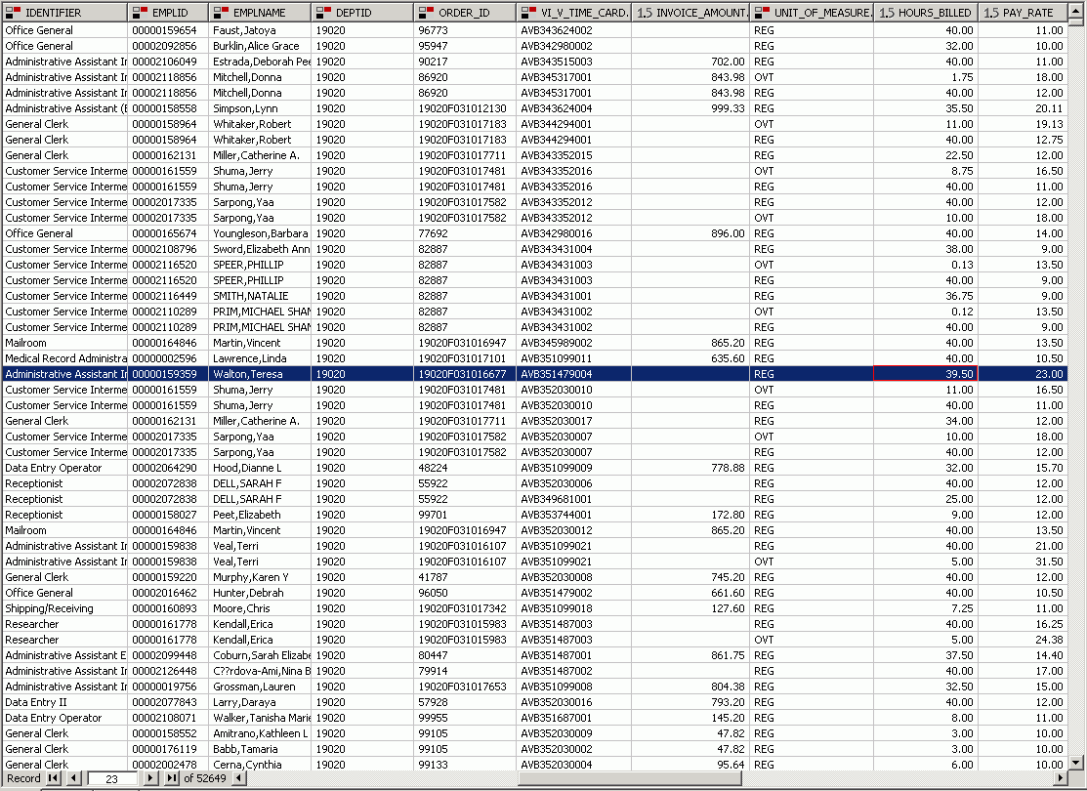
Outline
Fraud Detection
Implemented in:
    SIU
Millions of financial transactions
Anomalies and potential fraud cases + Investigation
Prevention/recovery of losses
Enhanced system integrity

Slide 9
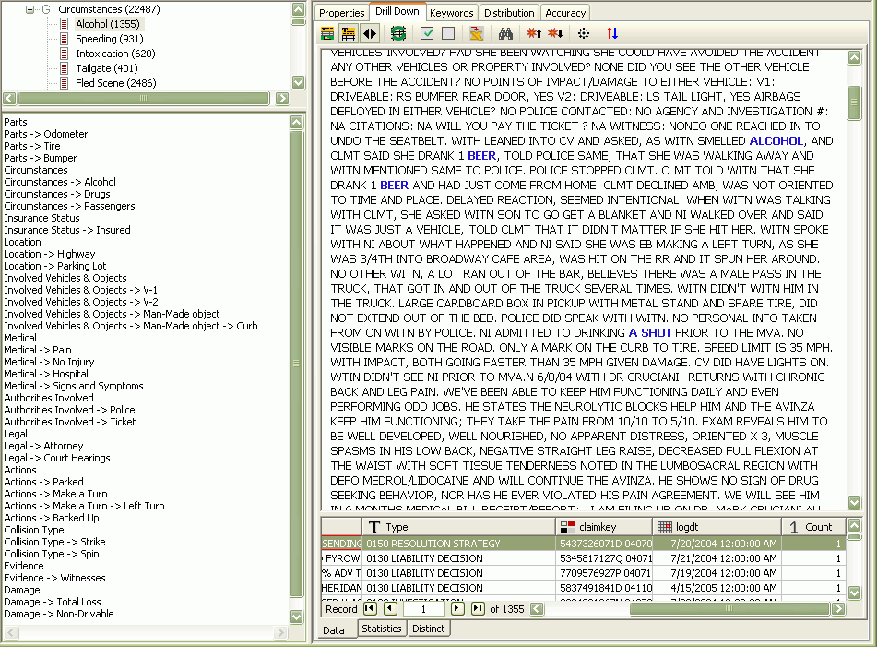
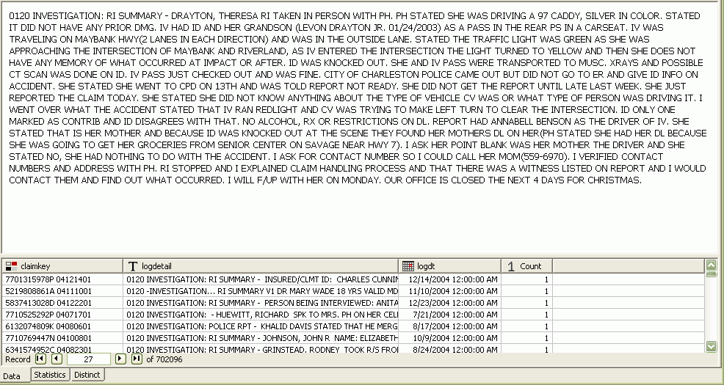
Outline
Subrogation Prediction
Implemented in:
    Subrogation Dept
Millions of free text claims notes
Extracted key patterns + Subrogation potential
Predicting probable subros
Real time and retrospective

Slide 10
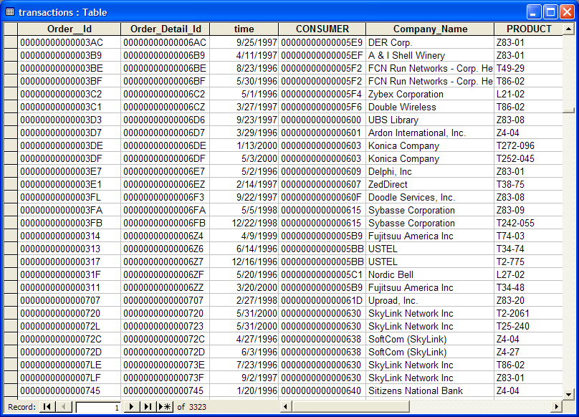

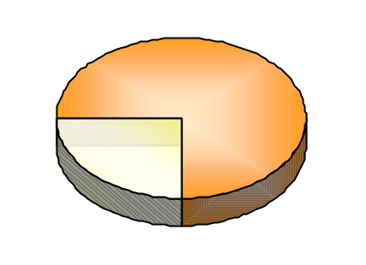
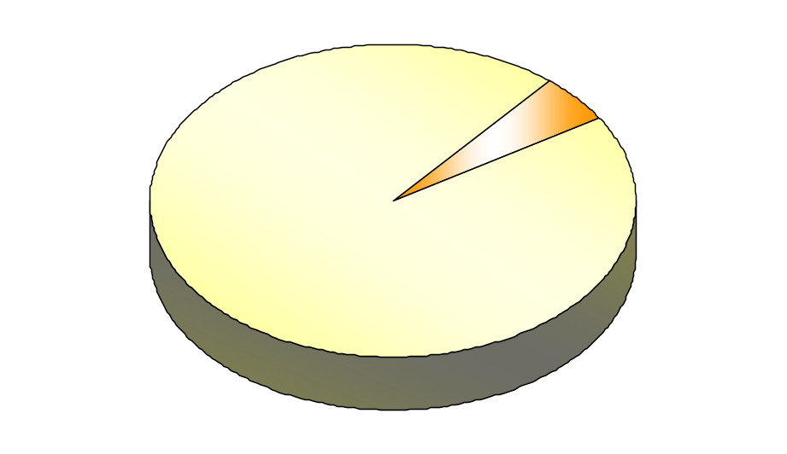
Outline
Database Marketing
Implemented in:
    Marketing Dept
Millions of random prospects
Increased response rate through better targeting
Increased response rate
Better allocation of resources

Slide 11
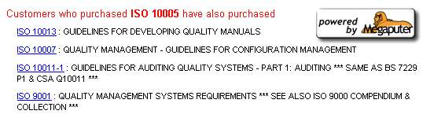
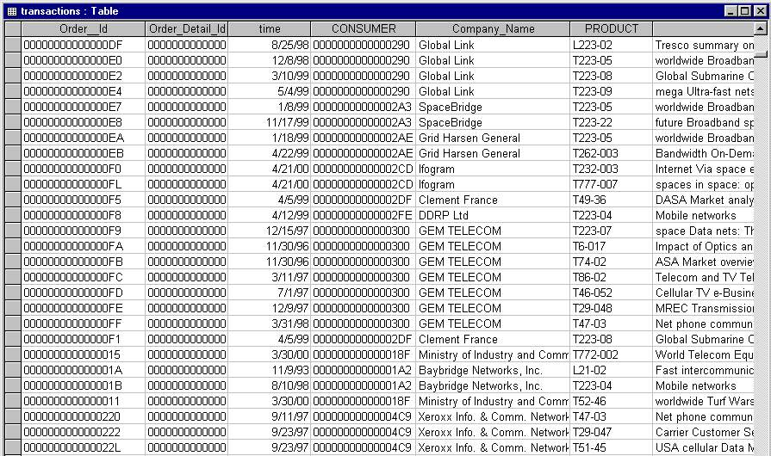
Outline
Cross-Sell Analysis
Implemented in:
    Call Center
    Internet Store
Real-time recommendations
Millions of
historical transactions
Significant increase in sales
Better customer experience

Slide 12
Outline
Benefits for the Enterprise
Dramatic cost reduction
Increase in quality and speed of the analysis
Objective and uniform data-driven analysis
Discovery of even unexpected issues suggested by data
Automated monitoring of known problems
Timely discovery of newly developing issues
Utilization of 100% of available data: structured and text
Up-to-date reports for executives
Easy to use and maintain solution

Slide 13
Example: Warranty Fraud Detection
Dealer level
  Identify and rank Dealers that have a large number of anomalies in submitted claims
Claim level
  Determine and store for application efficient business rules automating payment decision on individual new claims

Slide 14
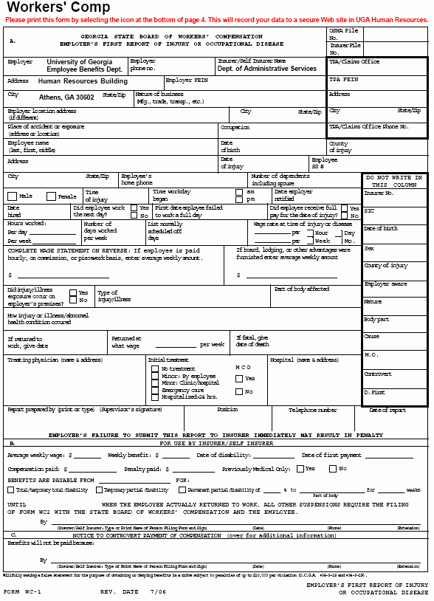



Finding Anomaly Thresholds and Suspect Dealers
Claims Data
New claim
Determine Nature of Distributions
Business Rules for Claim Scoring
Detect Thresholds & Anomalies
Machine Learning & Statistics
Payment Decision
Identify Systematic Anomalies
Group Anomalies by Dealer
List of Anomaly Ranked Dealers
Claim level
Dealer level

Slide 15
Analytics for Individual Claim Processing
Submitted Claims
Business Rules
Discoveries
Data & Text Analysis, Modeling and Scoring
Technology
Assisted Audit
Pay
Reject

Slide 16
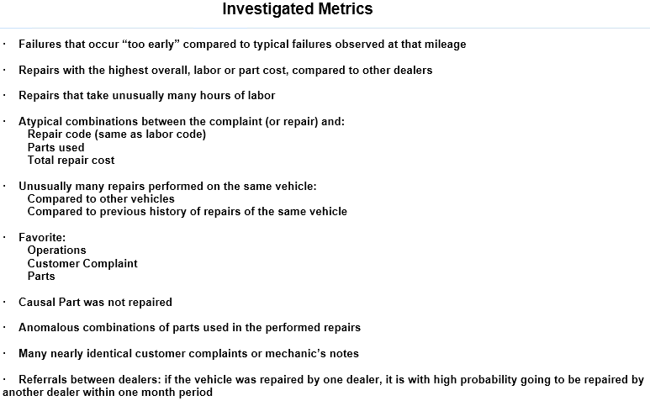
Detecting Anomalies in Data

Slide 17
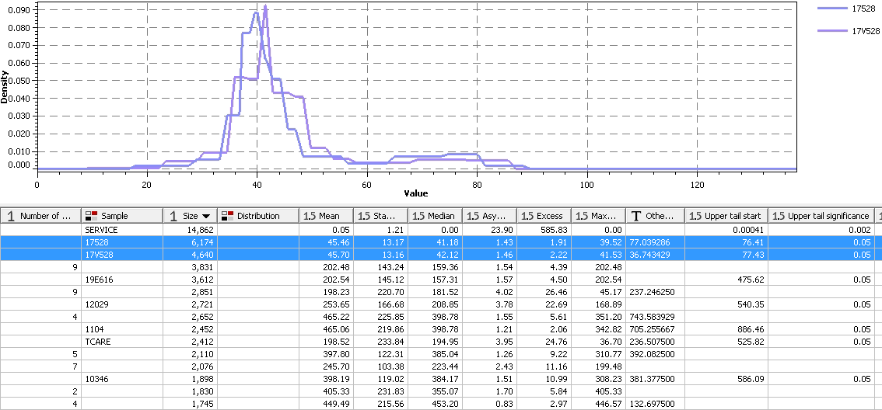
Finding Anomaly Thresholds
Lower Threshold
Upper Threshold

Slide 18
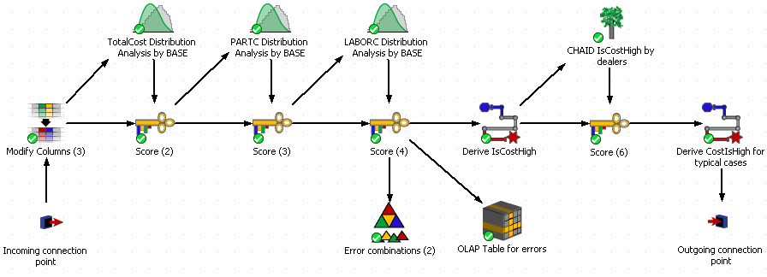
Distribution Analysis (DiAn) script

Slide 19
Tail Thresholds – for each Causal Part
Tail Thresholds

Slide 20
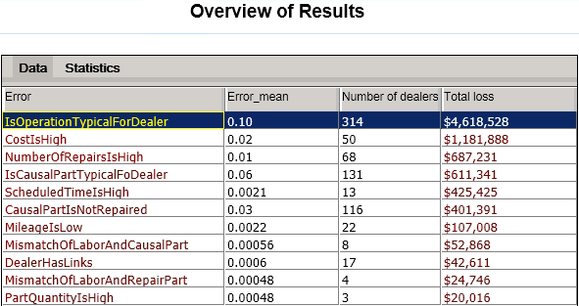
Overall Anomalies in ESP claims

Slide 21
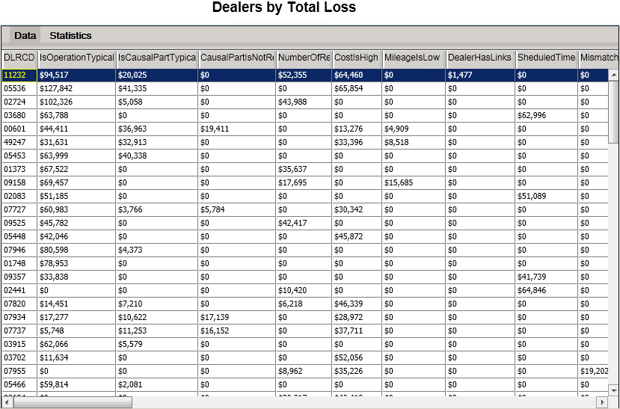
Dealer Total Loss by Anomaly

Slide 22
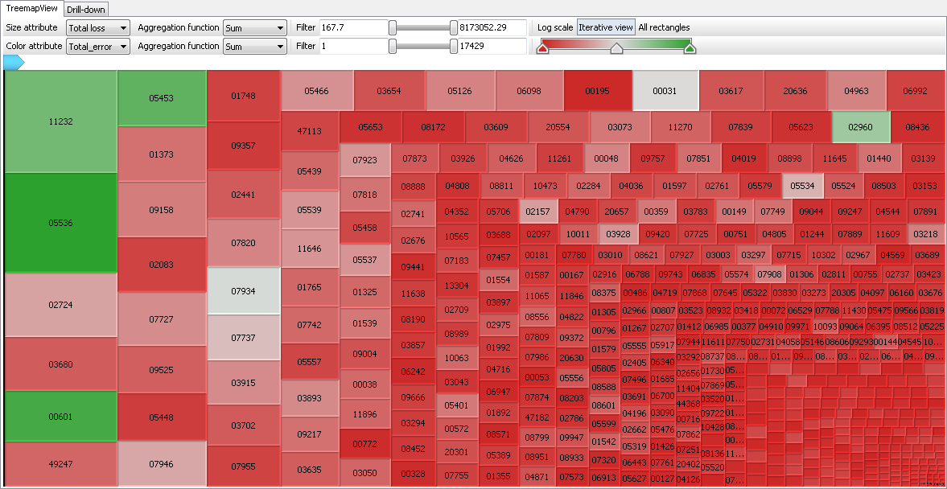
Dealers by Total Loss due to Anomalies

Slide 23
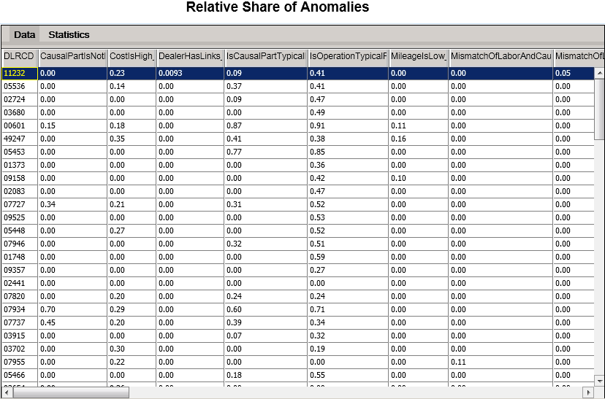
Share of Anomalies to Full Operation

Slide 24
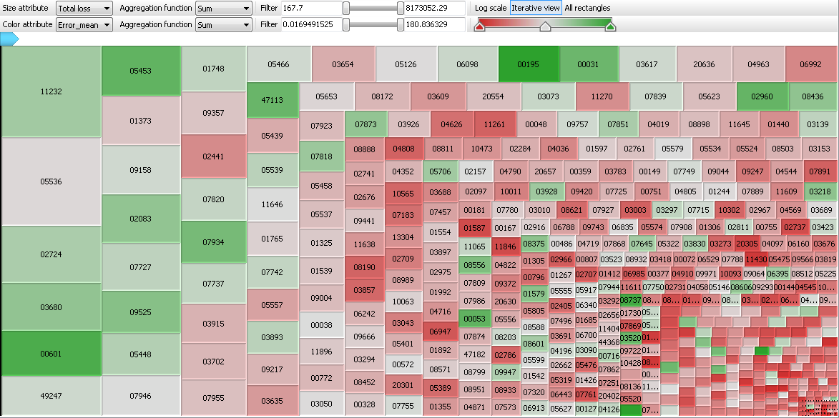
Total Loss by Share of Anomalies

Slide 25
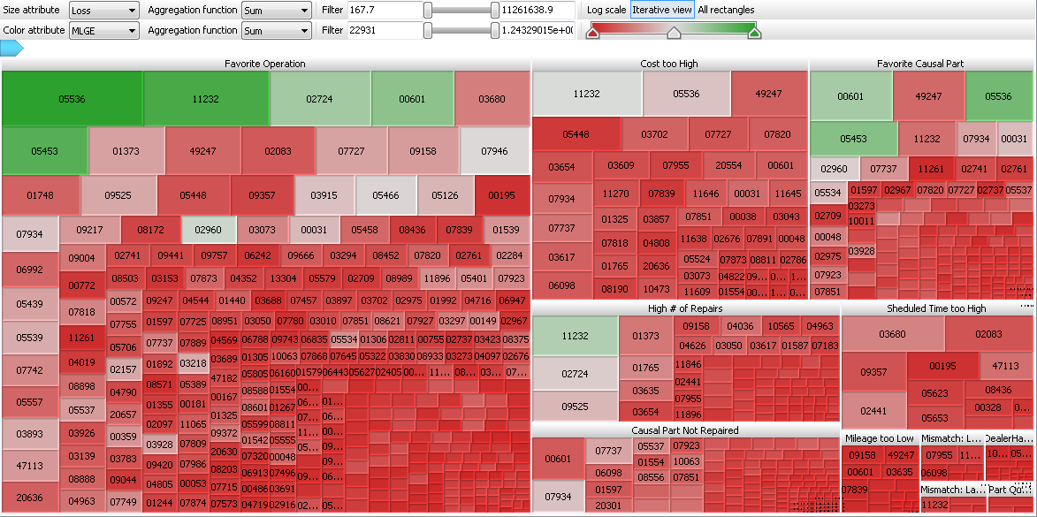
Dealers by Anomaly Type

Slide 26
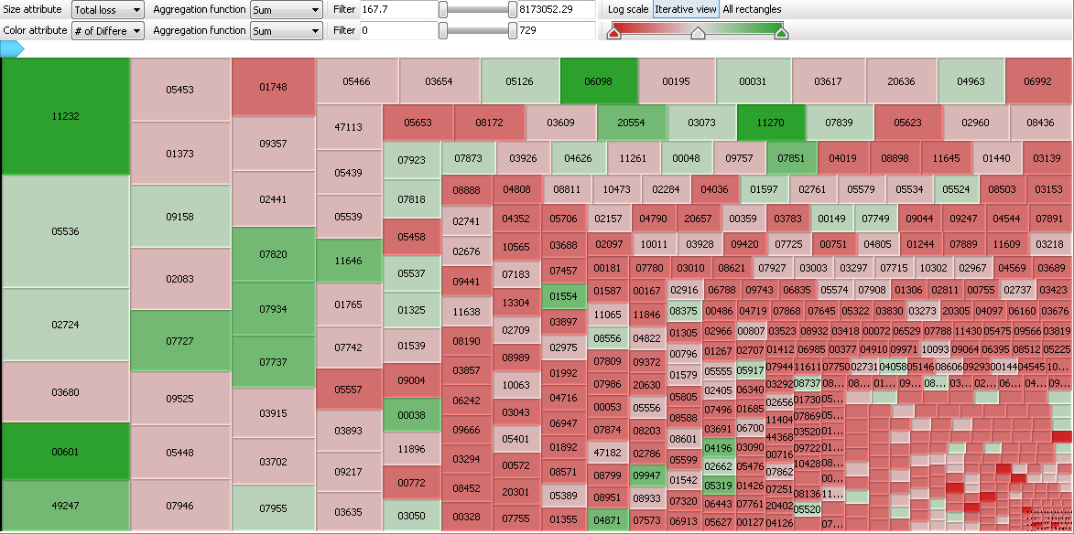
Total Loss by # of Different Anomalies

Slide 27
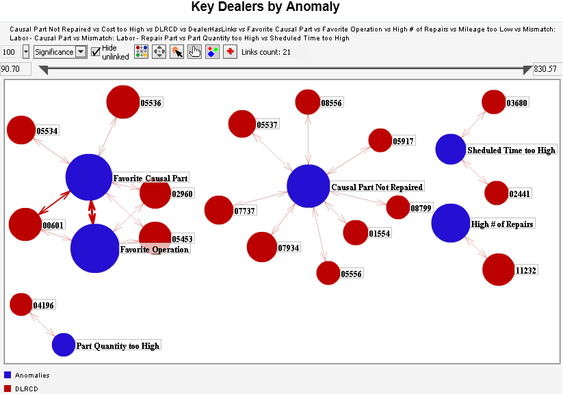
Strongest Correlations: Dealers to Anomalies

Slide 28
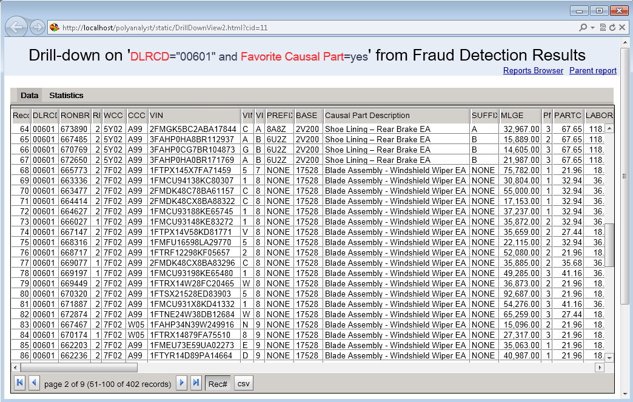
Drilling down to Dealer 00601
Favorite Causal Parts

Slide 29
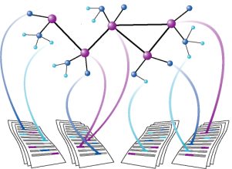
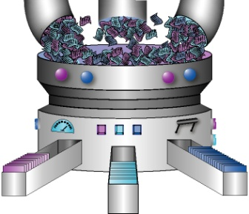
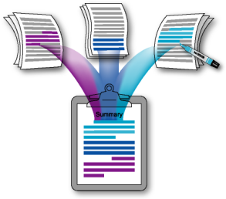
Add Extra Metrics through Text Mining
Feature Extraction
Entity & Event Extraction
Search for Patterns
Clustering
Categorization
Summary Creation
Sentiment Analysis
New Inputs for Predictive Modeling

Slide 30
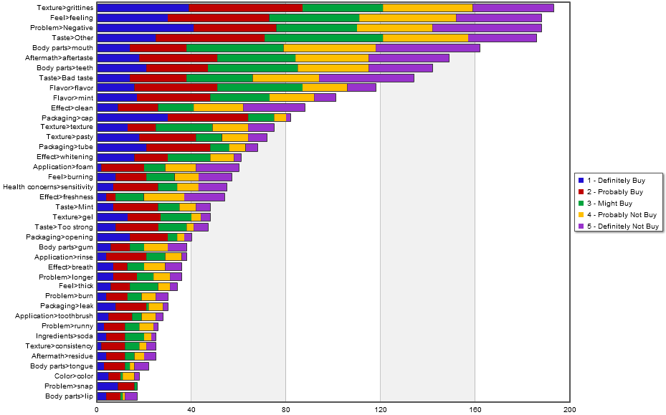
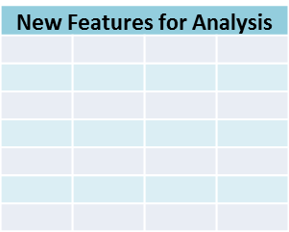
Key Steps of Text Mining
Textual Data
Graphical Reports
1
Data Cleansing
2
Data-driven Analysis
3
Analyst-driven Analysis
4
Enriching Structured Data
OLAP cubes

Slide 31
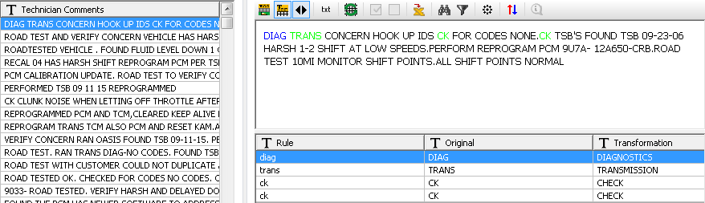
Correct Typical Mechanic’s Abbreviations

Slide 32
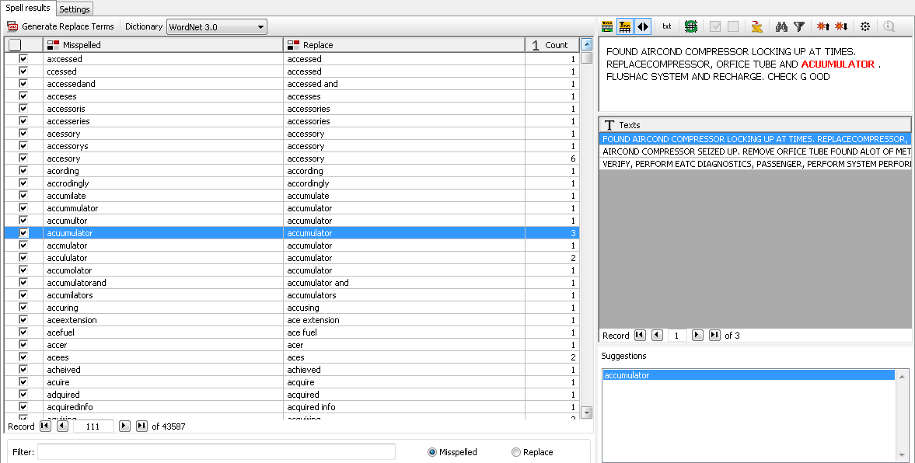
Auto-Correct Misspells
> 43,000 misspells corrected!

Slide 33
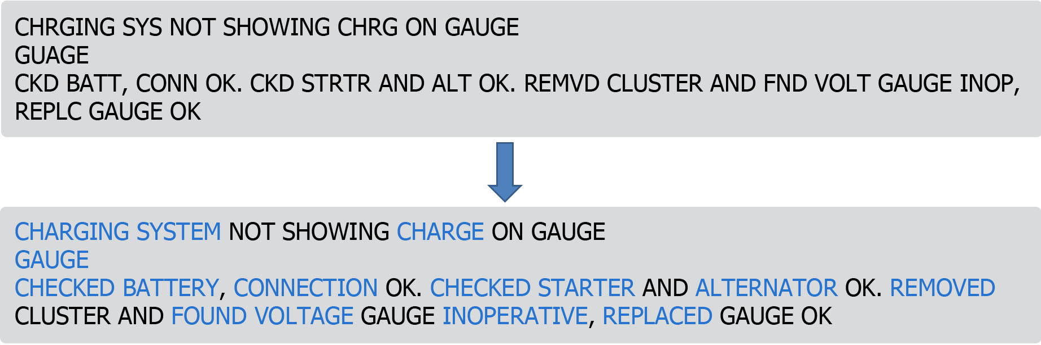
Example: Car Repair Notes

Slide 34
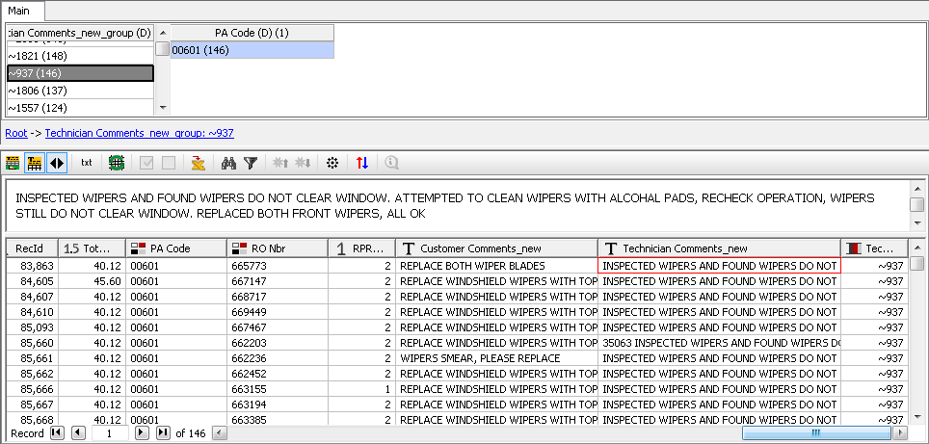
Detect Near Duplicate Descriptions
Near Duplicate Mechanic’s Notes

Slide 35
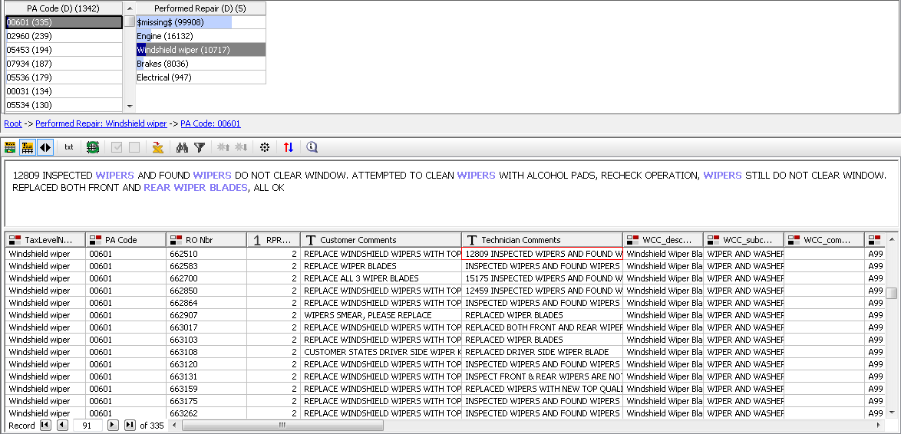
Dealer 00601 only replaces Wipers

Slide 36
Contacting Megaputer
Questions?

