Slide 1

PolyAnalyst
Web Report Training
Multilingual Analysis
Megaputer Intelligence
www.megaputer.com
© 2014 Megaputer Intelligence Inc.

Slide 2

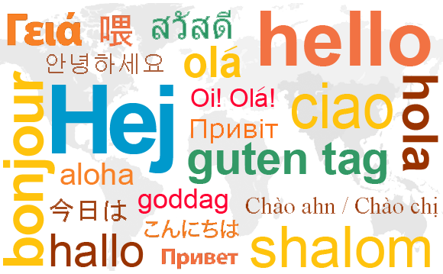
Outline
Multilingual Data

Slide 3
Outline
Internet Usage by Language

Slide 4
Outline
Internet Usage by Language
The proportion of English texts has decreased significantly.

Slide 5
Outline
Growth in Language Usage

Slide 6
Outline
Growth in Language Usage
Growth of English text data is much slower than other languages.

Slide 7

Outline
Lost in Translation
Garfield comic translated to Japanese and back
*http://garfieldlostintranslation.blogspot.com/

Slide 8

Outline
Lost in Translation
Original Garfield comic in English

Slide 9
Outline
PolyAnalyst Languages
European Languages
  English
  Spanish
  French
  German
  Russian
  Italian
  Dutch
  Polish
  Portuguese
  Turkish
  Greek
Asian Languages
  Chinese (Simplified & Traditional)
  Japanese
  Korean

Slide 10
Outline
All-Language Functionalities
PDL Functions
  case()
  count()
  empty()
  except()
  follow()
  hcolor()
  header()
  macro()
  near()
  number()
  paragraph()
  pattern()
  phrase()
  regex()
  soundex()
  stem()
  term()
  wildcard()
Nodes
  Bayes & SVM Classification
  Distinct Texts
  Keyword Extraction
  Language Detection
  Link Terms
  Search Query
  Spell Check

Slide 11
Outline
Language-Specific Functionalities
Text Classification Node
  Dutch
  French
  German
  Portuguese
  Russian
negate() & possible() PDL functions
  Chinese (Simplified)
  Russian

Slide 12
Outline
English-Only Functionalities
Advanced Text Analysis Nodes
  Sentiment Analysis Node
  Entity Extraction Node
Semantic PDL Functions
  antonym()
  associate()
  generalize()
  hold()
  part()
  related()
  singleroot()
  thesaurus()

Slide 13

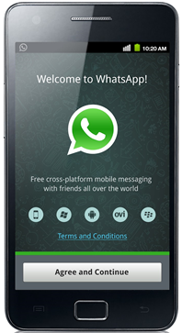
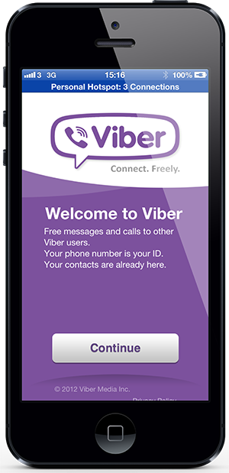
Online Feedback for Mobile Chat Apps
Case Study

Slide 14
Outline
Losing Information: Example 1
Turkish Feedback
“Surekli kullaniyorum.”

Slide 15
Outline
Losing Information: Example 1
Turkish Feedback
Machine Translation
“Surekli kullaniyorum.”
“And a Scrambler.”

Slide 16
Outline
Losing Information: Example 1
Turkish Feedback
Machine Translation
“Surekli kullaniyorum.”
“And a Scrambler.”
Actual Meaning
“I use it all the time.”

Slide 17
Outline
Losing Information: Example 2
Turkish Feedback
“Insanlarla arani aciyor okunmadigi halde okundu demesi ilginç.”

Slide 18
Outline
Losing Information: Example 2
Turkish Feedback
Machine Translation
“Insanlarla arani aciyor okunmadigi halde okundu demesi ilginç.”
“People say, interesting read, even though it hurt okunmadigi arani”

Slide 19
Outline
Losing Information: Example 2
Turkish Feedback
Machine Translation
“Insanlarla arani aciyor okunmadigi halde okundu demesi ilginç.”
“People say, interesting read, even though it hurt okunmadigi arani”
Actual Meaning
“It creates rifts between people it’s interesting that it says read even though it hasn’t been.”

Slide 20
Outline
Losing Information: Example 3
Turkish Feedback
“4 veriyorum çünku ses kalitesi iyi degil ugultulu ve gidiyor internet full oldugu halde duzeltme yapinn”

Slide 21
Outline
Losing Information: Example 3
Turkish Feedback
Machine Translation
“4 veriyorum çünku ses kalitesi iyi degil ugultulu ve gidiyor internet full oldugu halde duzeltme yapinn”
“I'm not as good sound quality 4 because the buzzing and goes well with the internet full duzeltme yapinn”

Slide 22
Outline
Losing Information: Example 3
Turkish Feedback
Machine Translation
“4 veriyorum çünku ses kalitesi iyi degil ugultulu ve gidiyor internet full oldugu halde duzeltme yapinn”
“I'm not as good sound quality 4 because the buzzing and goes well with the internet full duzeltme yapinn”
Actual Meaning
“I give it a 4 because the sound quality isn’t good there’s buzzing and it cuts out even though the internet is full fix it”

Slide 23
End-to-end data analysis
Methodology
Data Loading
Data Cleansing
Data-Driven Analysis
Visualizations
Analyst-Driven Analysis

Slide 24
End-to-end data analysis
Methodology
Data Loading
Data Cleansing
Data-Driven Analysis
Visualizations
Analyst-Driven Analysis

Slide 25
Outline
Dictionaries & Indexing
Dictionaries of each language are stored and accessed separately
Each text analysis node accesses one set of dictionaries at a time
That language is either determined during implicit indexing or can be assigned explicitly using Index node

Slide 26
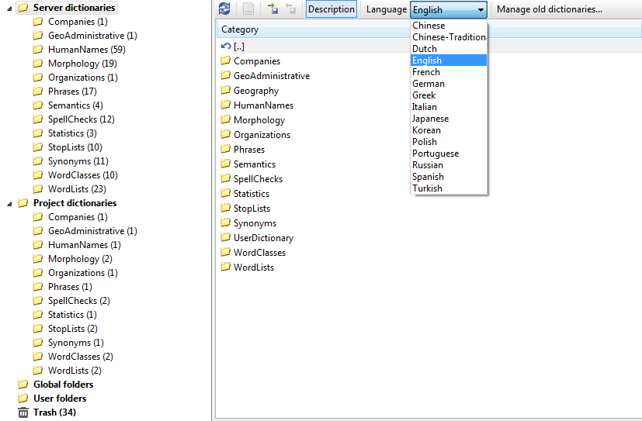
Outline
Dictionary Manager

Slide 27
Outline
Dictionaries & Indexing
Dictionaries of each language are stored and accessed separately
Each text analysis node accesses one set of dictionaries at a time
That language is either determined during implicit indexing or can be assigned using the Index node

Slide 28
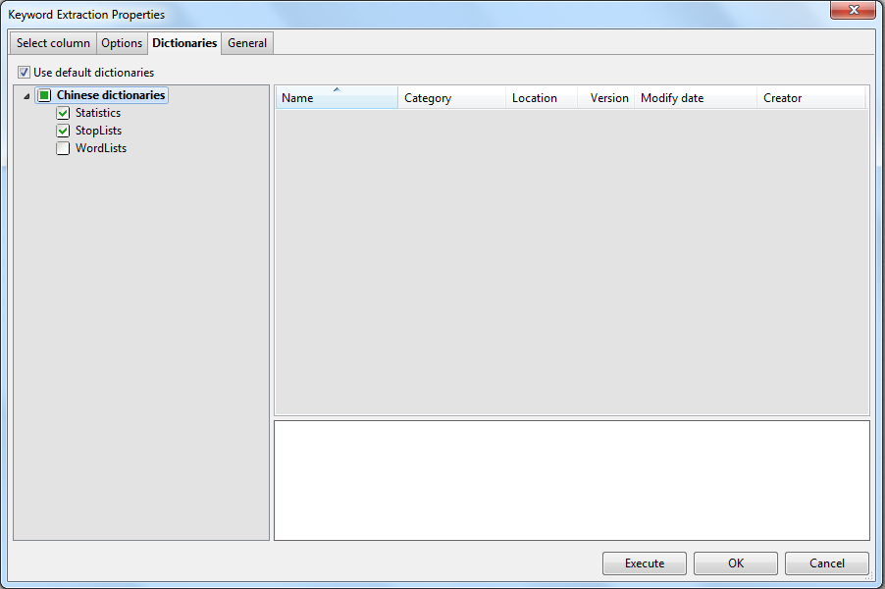
Outline
Text Analysis Node Properties

Slide 29
Outline
Dictionaries & Indexing
Dictionaries of each language are stored and accessed separately
Each text analysis node accesses one set of dictionaries at a time
That language is either determined during implicit indexing or can be assigned explicitly using Index node

Slide 30
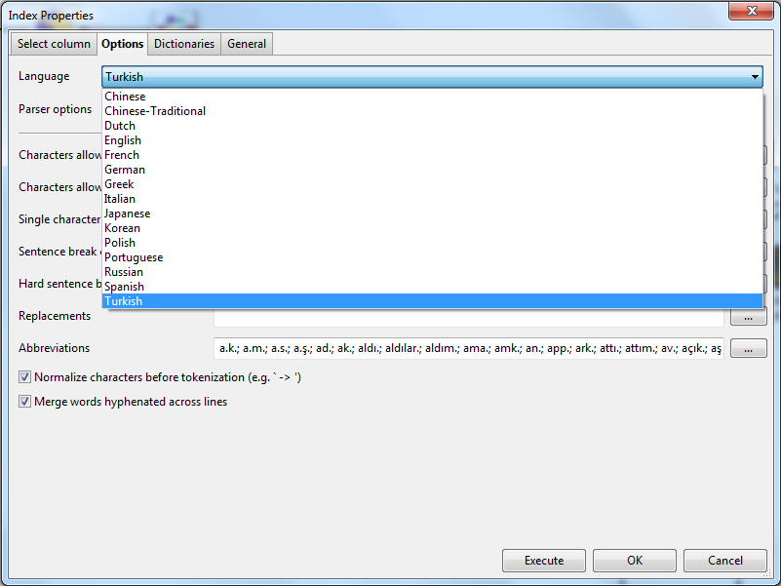
Outline
Index Node

Slide 31
Outline
Best Practices
Run Language Detection
Filter data by language
Run separate analyses on each separate dataset in the original language for that dataset

Slide 32
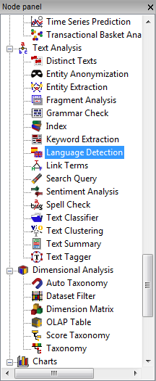
Outline
Best Practices
Run Language Detection
Filter data by language
Run separate analyses on each separate dataset in the original language for that dataset

Slide 33
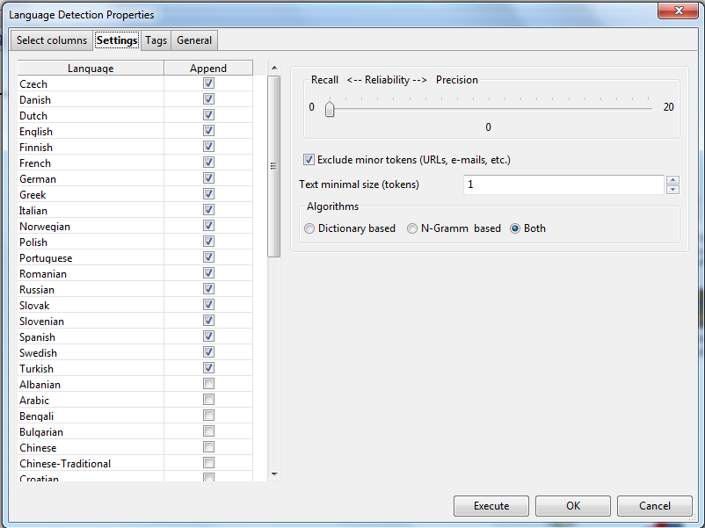
Outline
Language Detection

Slide 34
Outline
Best Practices
Run Language Detection
Filter data by language
Run separate analyses on each separate dataset in the original language for that dataset

Slide 35
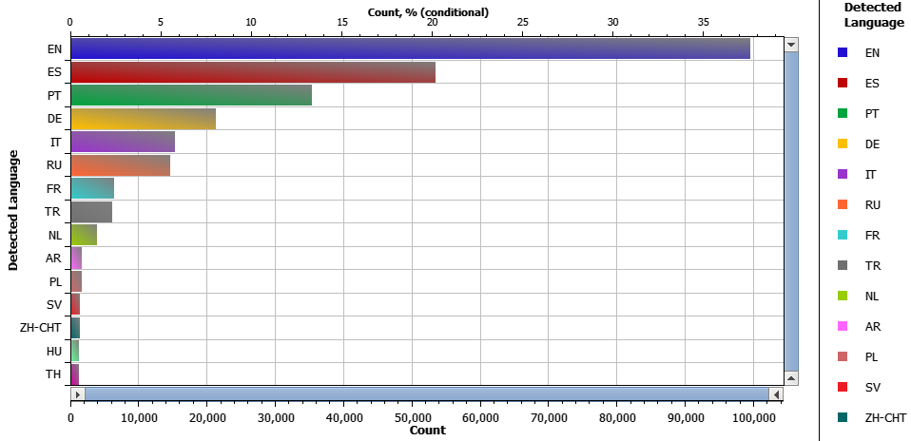
Feedback Languages

Slide 36
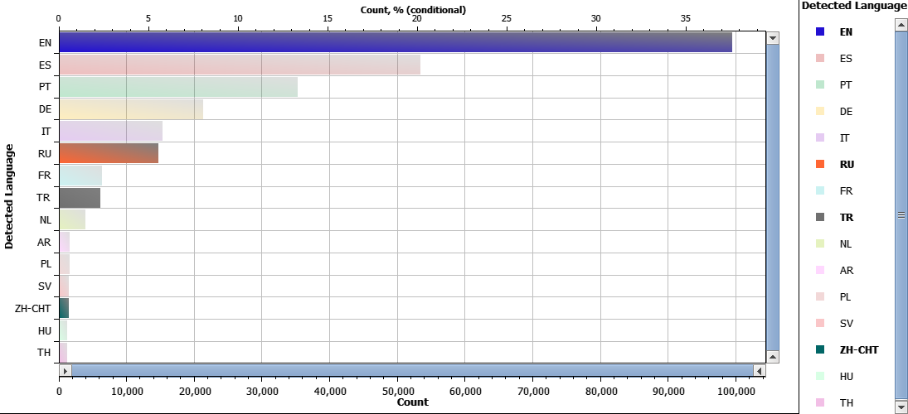
Feedback Languages
Focus on English, Russian, Turkish, and Chinese

Slide 37
Outline
Best Practices
Run Language Detection
Filter data by language
Run separate analyses on each separate dataset in the original language for that dataset

Slide 38
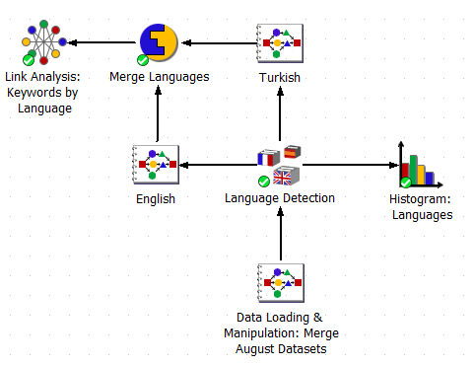
Outline
Separate Analyses per Language

Slide 39
End-to-end data analysis
Methodology
Data Loading
Data Cleansing
Data-Driven Analysis
Visualizations
Analyst-Driven Analysis

Slide 40
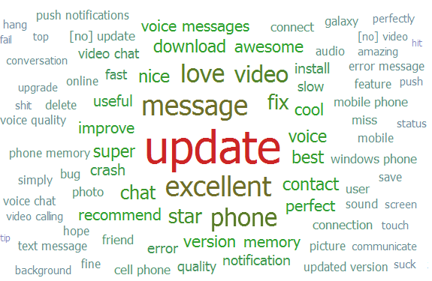
English Keywords

Slide 41
English Keywords
Top 5 English Keywords: update, message, excellent, phone, love

Slide 42
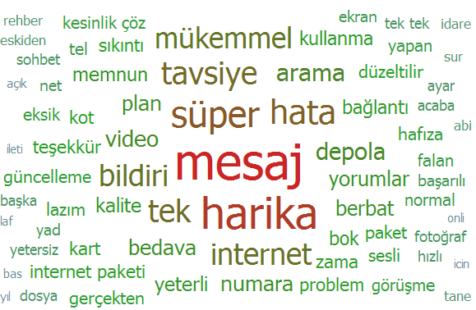
Turkish Keywords

Slide 43
Turkish Keywords
Top 5 Turkish Keywords: message, great, super, error, recommend

Slide 44
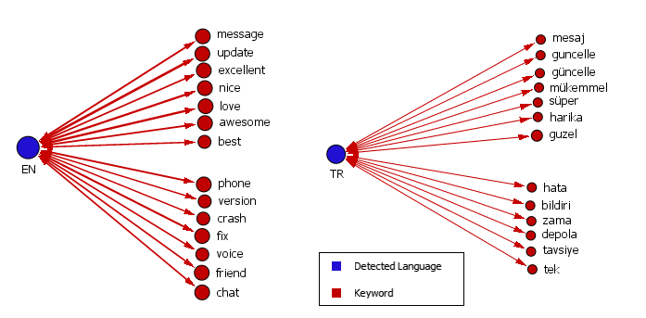
Keywords by Language

Slide 45
Keywords by Language
Common keywords across languages

Slide 46
Keywords by Language
Keywords Distinct to English: phone, version, crash, fix, voice, friend, chat

Slide 47
Keywords by Language
Keywords Distinct to Turkish: error, notification, time, storage, recommendation, single

Slide 48
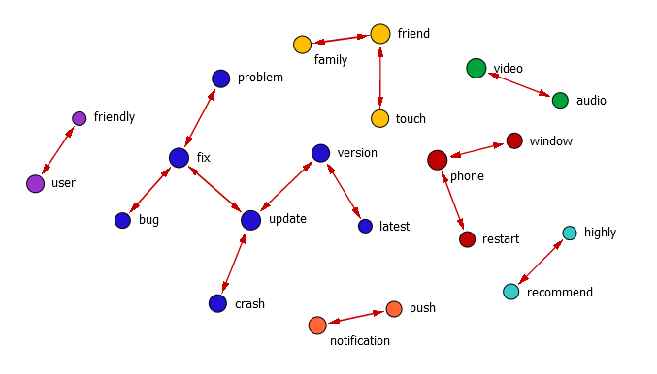
English Link Terms

Slide 49
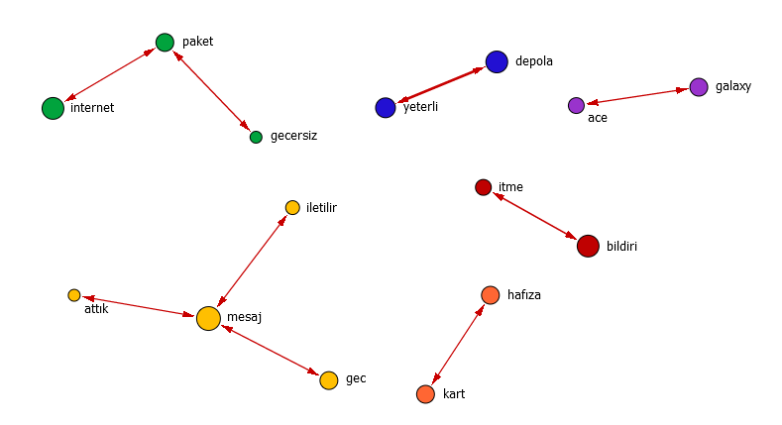
Turkish Link Terms
package
storage
internet
enough
invalid
push
deliver
notification
send
memory
message
late
card

Slide 50
End-to-end data analysis
Methodology
Data Loading
Data Cleansing
Data-Driven Analysis
Visualizations
Analyst-Driven Analysis

Slide 51
Outline
Analyst-Driven Taxonomy
For simultaneous highlighting in all languages:
Run taxonomy separately on each language-specific dataset
Merge scored results

Slide 52
Outline
Analyst-Driven Taxonomy
For simultaneous highlighting in all languages:
Run taxonomy separately on each language-specific dataset
  One multilingual taxonomy using <or>
  Separate language-specific taxonomies
Merge scored results

Slide 53
Outline
Analyst-Driven Taxonomy
For simultaneous highlighting in all languages:
Run taxonomy separately on each language-specific dataset
  One multilingual taxonomy using <or>
  Separate language-specific taxonomies
Merge scored results

Slide 54
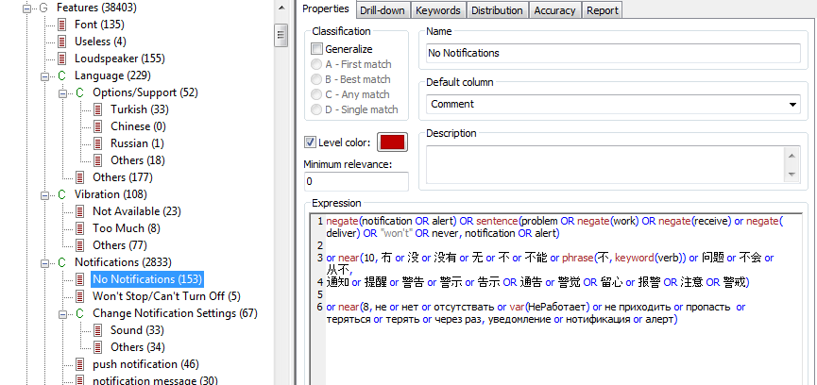
Multilingual Taxonomy

Slide 55
Multilingual Taxonomy
Can run analyses in English, Chinese, and Russian

Slide 56
Multilingual Taxonomy
Can run analyses in English, Chinese, and Russian

Slide 57
Multilingual Taxonomy
Can run analyses in English, Chinese, and Russian

Slide 58
Outline
Analyst-Driven Taxonomy
For simultaneous highlighting in all languages:
Run taxonomy separately on each language-specific dataset
  One multilingual taxonomy using <or>
  Separate language-specific taxonomies
Merge scored results

Slide 59
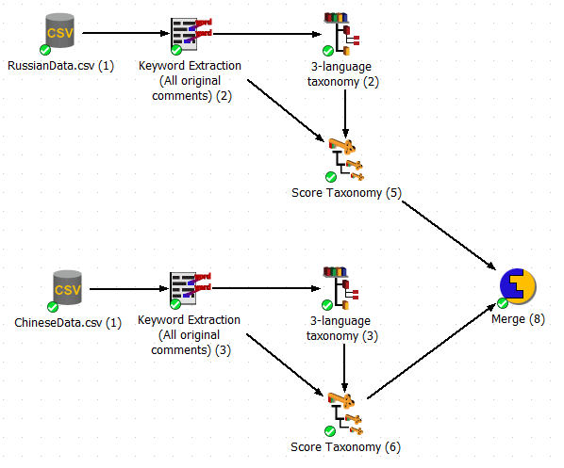
Merge Scored Results

Slide 60
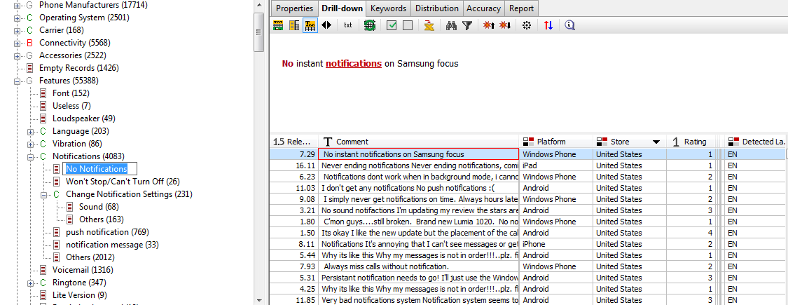
Multilingual Drill-Down
The drill-down contains matches in all 3 languages.
English example

Slide 61
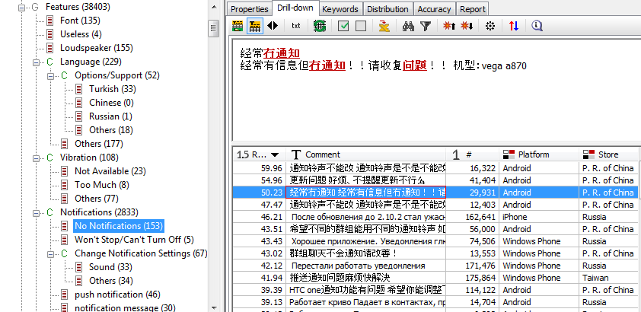
Multilingual Drill-Down
The drill-down contains matches in all 3 languages.
Chinese example

Slide 62
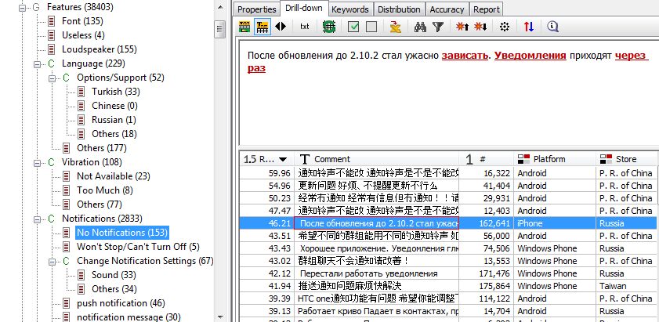
Multilingual Drill-Down
The drill-down contains matches in all 3 languages.
Russian example

Slide 63
End-to-end data analysis
Methodology
Data Loading
Data Cleansing
Data-Driven Analysis
Visualizations
Analyst-Driven Analysis

Slide 64
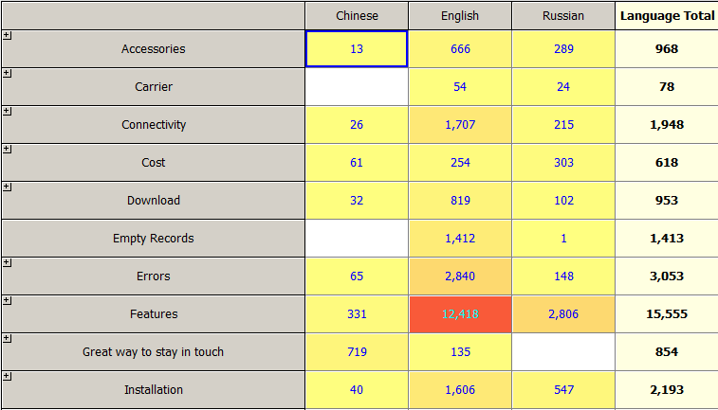
OLAP: Topics by Language

Slide 65
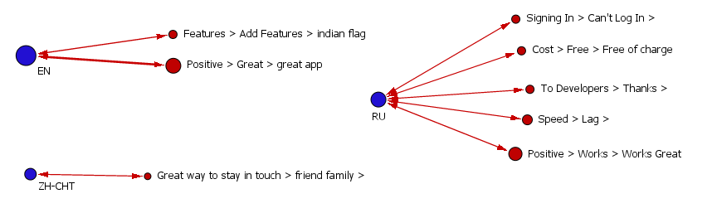
Link Analysis: Topics by Language

Slide 66
Outline
Conclusion
PolyAnalyst allows you to run multi-lingual analyses in original languages of data
Work with multilingual datasets
Work in 14 different languages
Identify language-specific characteristics
Get the most information out of the data
Less subjective; avoid errors in translation

Slide 67
Outline
Alternatives
Machine Translation API
Microsoft (current)
SDL (upcoming)

Slide 68
Contacting Megaputer
Questions?

