Slide 1

PolyAnalyst
Web Report Training
PolyAnalyst PDL
Megaputer Intelligence
megaputer.com
© 2014 Megaputer Intelligence Inc.
Notes:
Title page

Slide 2

Outline
Agenda
An overview of PDL
PDL bits and pieces

Slide 3
Outline
PDL Overview
What is PDL?
Pattern Definition Language.
What does PDL do?
Defines text patterns:
expressions matching the text that you are looking for.

Slide 4

Outline
PDL Overview
What does PDL do? (An example)
Data:
PDL expression:
Result:

Slide 5
Outline
PDL Overview
Why do we need PDL?
To match the right texts,
and only the right texts,
with a concise and intuitive syntax,
at a high speed.
Functionality
Accuracy
Simplicity
Efficiency

Slide 6

Outline
PDL Overview
Why do we need PDL?
PDL gets the job done accurately, easily, and efficiently.

Slide 7
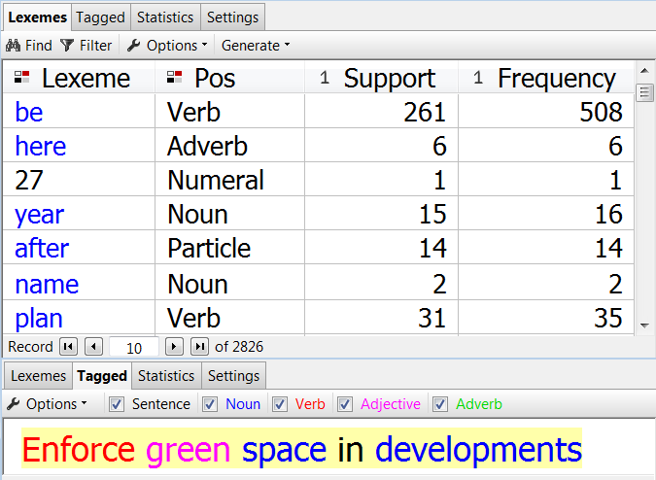
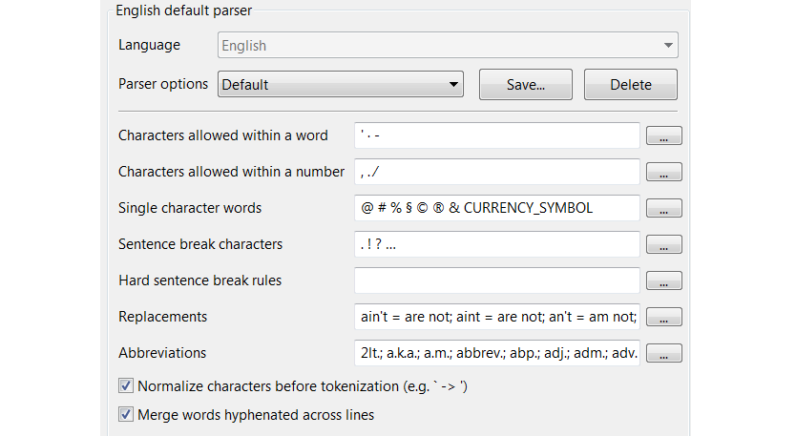
Outline
PDL Overview
How does PDL do it? 1: Indexing
  Splits texts into paragraphs, sentences, and words.
  Obtains the frequency and location info.
  Assigns POS tags.

Slide 8
Outline
PDL Overview
How does PDL do it? 1: Indexing
  The notion of tokens:
  A token is a sequence of indexed characters.
  It is the base unit on which the search engine works.

Slide 9
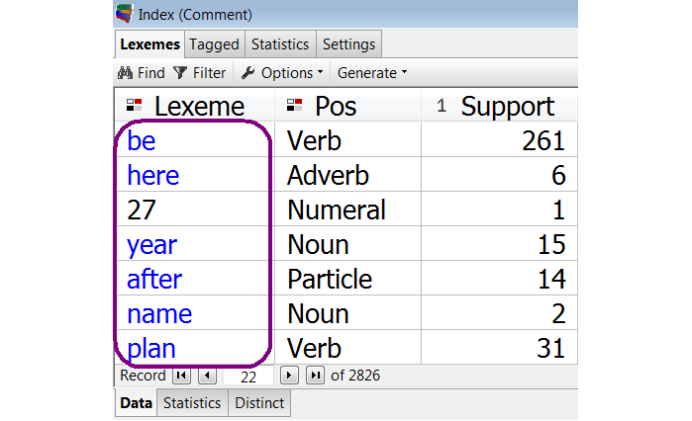
Outline
PDL Overview
How does PDL do it? 1: Indexing
  The notion of tokens:

Slide 10
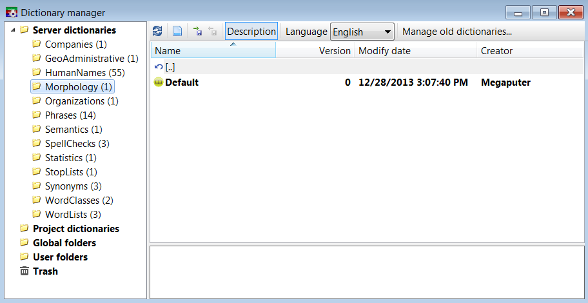
Outline
PDL Overview
How does PDL do it? 2: Dictionaries

Slide 11
Outline
PDL Overview
How does PDL do it? 2: Dictionaries
  Containers of lists of words, relations between words, and properties about the words and the relations.
  Language specific.
  Can use dictionaries to alter the results of text analysis nodes.

Slide 12
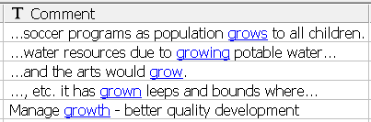



Outline
PDL Overview
How does PDL do it? 2: Dictionaries
Data:
PDL expression:
Regular expression:
Wildcard expression:

Slide 13

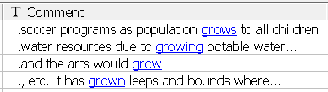





Outline
PDL Overview
How does PDL do it? 2: Dictionaries
Data:
PDL expression:
Regular expression:
Wildcard expression:

Slide 14
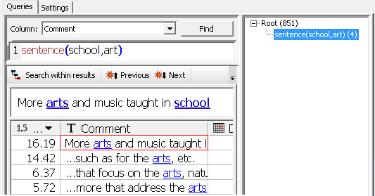
Outline
PDL Overview
Where is PDL used?
- Search Query
- Taxonomy
- Dim. Matrix
- Link Terms
Notes:
Where is PDL used?
- Search Query

Slide 15
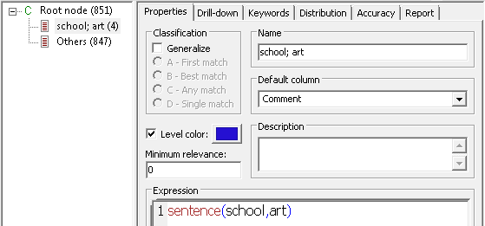
Outline
PDL Overview
Where is PDL used?
- Search Query
- Taxonomy
- Dim. Matrix
- Link Terms

Slide 16
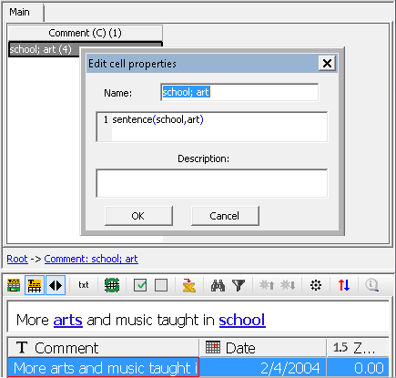
Outline
PDL Overview
Where is PDL used?
- Search Query
- Taxonomy
- Dim. Matrix
- Link Terms

Slide 17
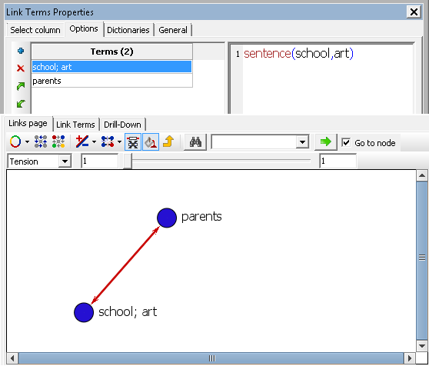
Outline
PDL Overview
Where is PDL used?
- Search Query
- Taxonomy
- Dim. Matrix
- Link Terms

Slide 18
Outline
PDL Overview
Two main types of PDL functions
Semantic functions
  Use dictionaries to generate sets of word forms.
  Language dependent.
Scoping functions
  Search for tokens within a given scope.

Slide 19
Outline
PDL Overview
Semantic functions
antonym()
associate()
entity()
generalize()
hold()
negate()
part()
possible()
thesaurus()
term()
related()
singleroot()
stem()

Slide 20
Outline
PDL Overview
Scoping functions
except()
follow()
header()
near()
paragraph()
pattern()
phrase()
position()
sentence()

Slide 21
Outline
PDL Overview
General forms of PDL functions
fn_name(term[,…])
fn_name(term,term2,term3,…)
negate(allow,available)
fn_name([N,]term[,…])
fn_name(N,term,term2,term3,…)
sentence(2,school,art)

Slide 22
Outline
PDL Overview
General forms of PDL functions
fn_name(term,term2,term3,…)
fn_name(N,term,term2,term3,…)
term: a function, or
a token, or
a seq. of functions or tokens,
w/ or w/o operators.
and xor or not & / |

Slide 23
Outline
PDL Overview
General forms of PDL functions
fn_name(term,term2,term3,…)
fn_name(N,term,term2,term3,…)
sentence(high,school,art)
sentence(2,phrase(high,school),art)
sentence(high,school,art or sport)

Slide 24
Outline
PDL Overview
PDL macros and variables
PDL macros
  Custom PDL functions
  To simplify functional forms
  E.g.: macro(snear3,term,term2)
      ≡ sentence(near(3,term,term2))

Slide 25
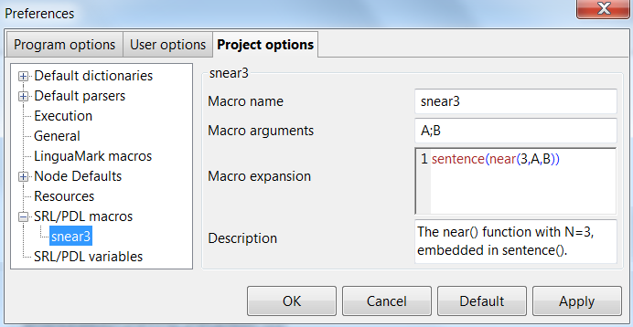
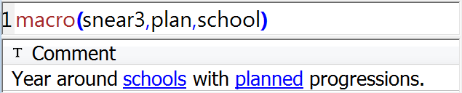
Outline
PDL Overview
PDL macros and variables

Slide 26
Outline
PDL Overview
PDL macros and variables
PDL variables
  Specific, long PDL expressions
  To simplify argument values
  E.g.: var(airbag)
  ≡ airbag or case(SIR)
    or phrase(air or side,bag)

Slide 27
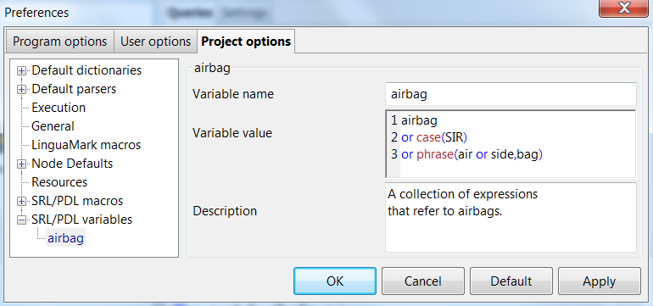
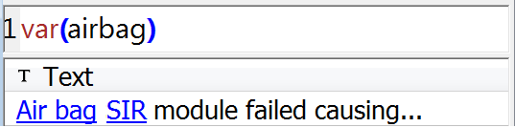
Outline
PDL Overview
PDL macros and variables

Slide 28
Outline
Agenda
An overview of PDL
PDL bits and pieces

Slide 29

Outline
PDL Bits 'n Pieces
So how do you feel about PDL?

Slide 30
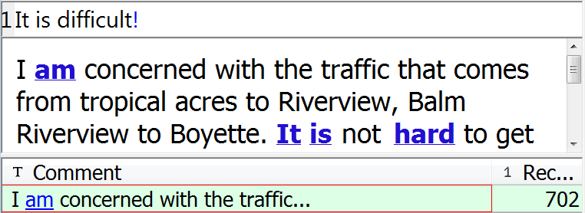
Outline
PDL Bits 'n Pieces
Is it really that bad?
Let’s polyanalyze it and see what others have to say…

Slide 31
Outline
PDL Bits 'n Pieces !
So It is difficult!
= stem(it) and stem(is) and thesaurus(difficult)
Three things to learn here:
  The search engine automatically does stemming on everything unless in [ ].
  The search engine automatically adds and in-between adjacent bare words.
  ! is a shorthand for thesaurus().

Slide 32
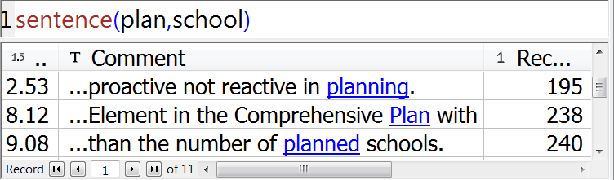
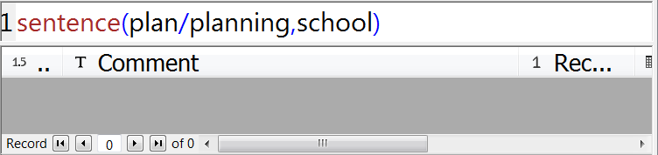
Outline
PDL Bits 'n Pieces /
We often say things like him/her.
What if we polyanalyze plan/planning?

Slide 33
Outline
PDL Bits 'n Pieces /
So plan is different from plan/planning?
Is this a bug to report at http://www.polyanalyst.com/mantis?
Not this time, because:
/ is a PDL operator that returns the difference between the arguments.

Slide 34
Outline
PDL Bits 'n Pieces /
That is, plan/planning looks for the complement of planning in plan.
Would that just be plan then? Why is there zero match?
The answer is stemming.
So we really need plan/[planning].

Slide 35
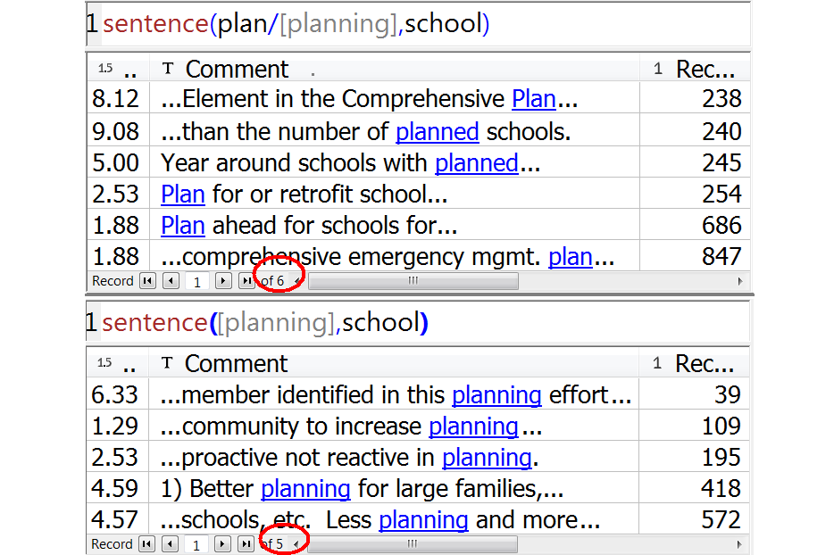
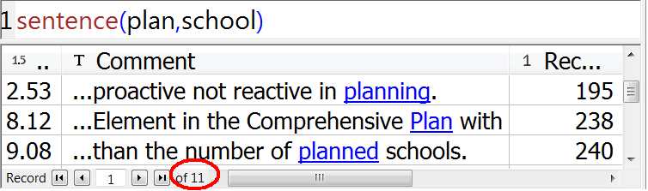
Outline
PDL Bits 'n Pieces /
A total of 11 records with both stem(plan) and school in a sentence:

Slide 36
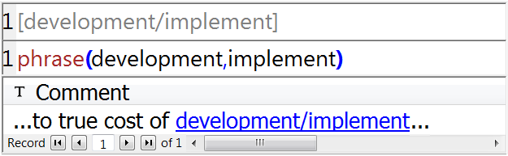
Outline
PDL Bits 'n Pieces /
What if the original text contains things like him/her and we are indeed looking for those?
* [A/B] is interpreted by the search engine as [A B].

Slide 37
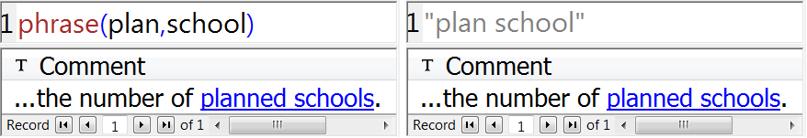
Outline
PDL Bits 'n Pieces phrase()
Love-hate relationship with phrase().
Any text in double quotes is always interpreted as a phrase: "A B" = phrase(A,B).

Slide 38
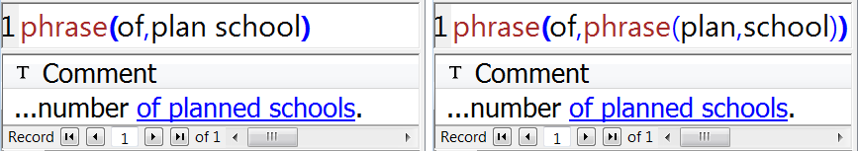
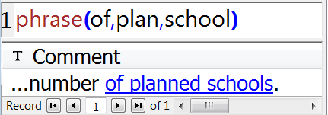
Outline
PDL Bits 'n Pieces phrase()
A B = A and B
phrase(A B,C) = phrase(phrase(A,B),C)
≠ phrase(A and B,C)
phrase(A B,C)
= phrase(A,B,C)

Slide 39
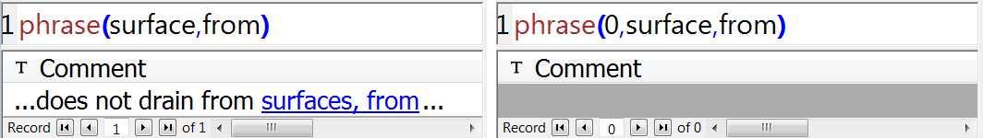
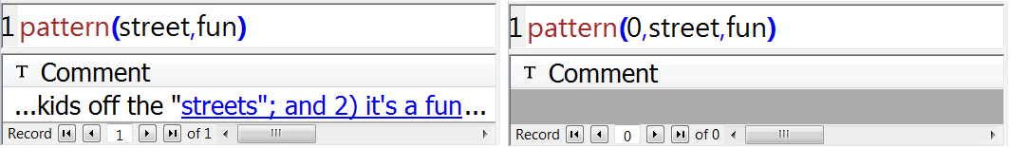
Outline
PDL Bits 'n Pieces phrase()
The search engine generally ignores punctuations, but phrase(0,…) and pattern(0,…) allow to exclude them.

Slide 40
Outline
PDL Bits 'n Pieces phrase()
phrase() vs. pattern()
  Base forms:
    phrase(A,B) vs. pattern(A,B)
    pattern() is almost the same as phrase(),
    except that
    pattern() allows stop words b/w arguments.

Slide 41
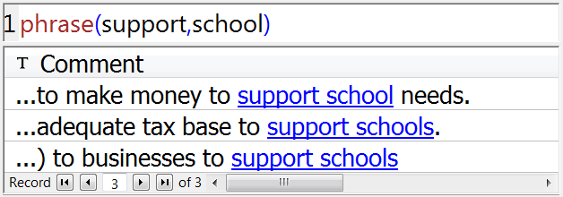
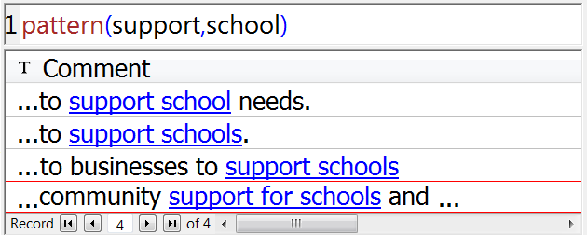
Outline
PDL Bits 'n Pieces phrase()
phrase() vs. pattern()

Slide 42
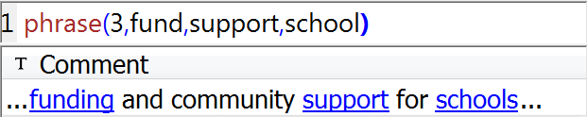
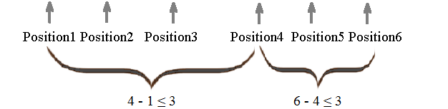
Outline
PDL Bits 'n Pieces phrase()
The Extended form of phrase() phrase(N,term1,term2,term3,…)
Matches text fragments that
  contain all the argument terms
  in the specified order
  in the same sentence, and
  where the difference between the positions of any adjacent pair of terms is no more than N.

Slide 43
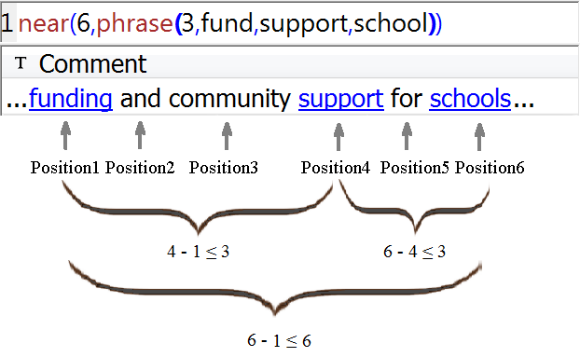
Outline
PDL Bits 'n Pieces phrase()
The Extended form of phrase()
To specify that the maximum position difference between any terms be N1, while the maximum position difference between neighboring terms be N2, one can use the following expression:
near(N1,phrase(N2,term1,term2,term3,…))

Slide 44
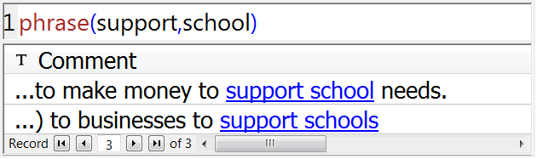
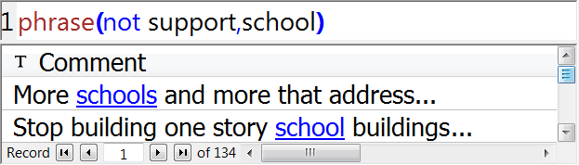
Outline
PDL Bits 'n Pieces phrase()
In phrase(), sentence(), near(), etc., "not" is only allowed at the beginning of an argument to mean "absence".

Slide 45
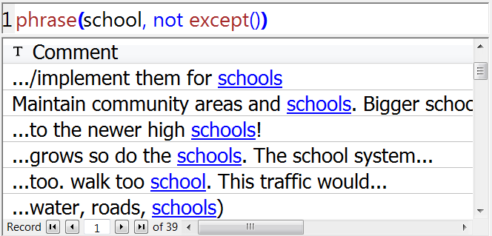
Outline
PDL Bits 'n Pieces phrase()
except() embedded in phrase():
phrase(school, not except()) means
phrase(school, <absence of all words>), i.e., the
match shouldn't contain a second argument.

Slide 46
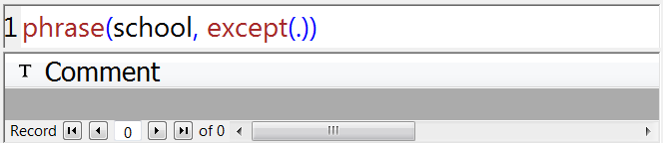
Outline
PDL Bits 'n Pieces phrase()
except() embedded in phrase():
phrase(school, except(.)) means
phrase(school, <any word, except all words>), i.e.,
the second argument must be in the match, but at
the same time it cannot be anything.

Slide 47
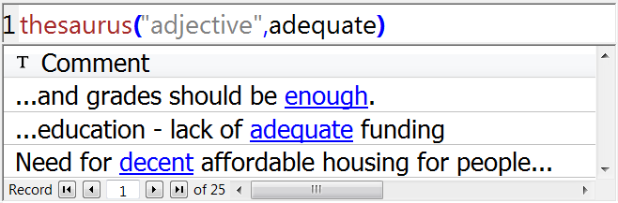
Outline
PDL Bits 'n Pieces thesaurus()
thesaurus(POS,term,term2,term3,…) Matches synonyms of any argument term. Can choose to restrict to certain part(s) of speech.

Slide 48
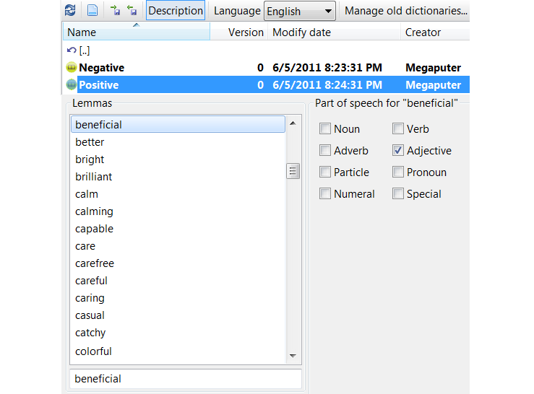
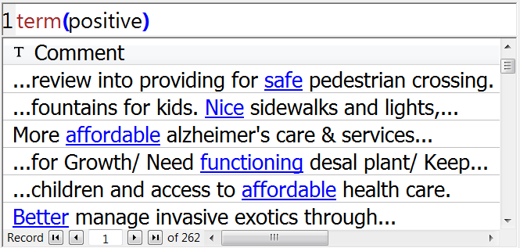
Outline
PDL Bits 'n Pieces term()
term(list,list2,list3,…) Matches all the words from the argument word list(s).

Slide 49
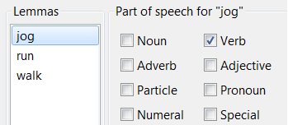
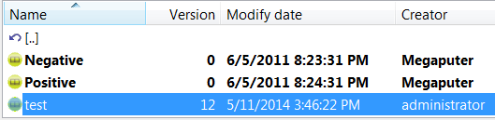
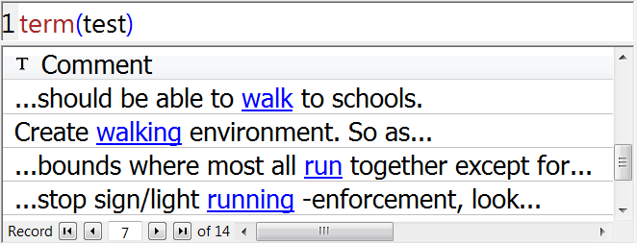
Outline
PDL Bits 'n Pieces term()
term() matches the stemmed forms of any given word from the list(s).

Slide 50
Outline
PDL Bits 'n Pieces stem()
singleroot() vs. stem()
singleroot() matches word forms with the same root as the term.
stem() matches word forms with the same stem as the term.

Slide 51
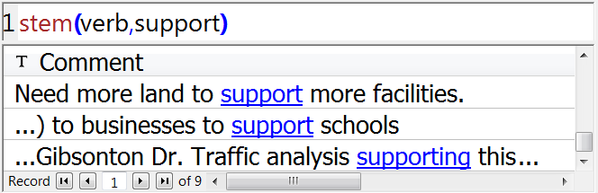
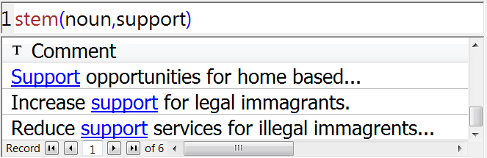
Outline
PDL Bits 'n Pieces stem()
Can specify POS in stem() as well.

Slide 52

Outline
PDL Bits 'n Pieces Vs. SRL
SRL: Symbolic Rule Language.
For data manipulation and calc.
In column and row operations.
For example:
date([Release Time Raw],"DT;24;YYYYMMDD")

Slide 53
Outline
PDL Bits 'n Pieces Vs. LinguaMark
PolyAnalyst LinguaMark®
Used to define language constructions associated with entities, evaluations, and sentiments.
‘Director’ <,GF(OF)> <$Company>:@ ‘is’ <$Person>
matches “Director of Microsoft Corp. is Bill Gates”

Slide 54

Outline
PDL Bits 'n Pieces Vs. LinguaMark
PolyAnalyst LinguaMark®
“Custom Entity Extraction
with PolyAnalyst’s
LinguaMark Language”
Date: Thursday, May 15
Time: 8:45 – 9:25 am

Slide 55
Contacting Megaputer
Questions?
Megaputer Intelligence
megaputer.com

