Slide 1

POLYANALYST
for
CUSTOMER SERVICE PERFORMANCE MONITORING
A Case Study
Megaputer Intelligence
www.megaputer.com

Slide 2

INTRODUCTION
Client is a financial services provider firm
The firm performs financial market transactions on customers’ behalf
Associates of the firm interact with customers online
Customer interactions need to be monitored regularly for compliance with Quality Standards
Dip in service quality needs to be identified and addressed
REQUEST
RETURNED/
HELD/
FORWARDED?
CUSTOMER LODGES TRANSACTION REQUEST OVER ONLINE CHAT
ASSOCIATE RESPONSE
NO
REQUEST PROCESSED AND CLOSED
YES
CUSTOMER COMMENT

Slide 3


EXAMPLE: CUSTOMER INTERACTION
Customer:
Not completed as requested - Sebastian, We are close on this but still not 100% correct. I have attached a spreadsheet of how the cost should read so it should be fairly easy for you guys. Please adjust.
Associate:
Thank you for your inquiry. I apologize for the inconvenience. Please note that we have updated the shares today. I am placing this request on hold to verify that it reflects properly. If you need this request to be escalated on Monday, please feel free to contact your Customer Service Team. Thank you, and have a great day.

Slide 4
OBJECTIVES
Broad objective of service performance monitoring is to maintain satisfactory quality of service over time and across the organization. To this end, Megaputer devised following objectives for the proposed performance monitoring system:
AUTOMATED COMMENT ANALYSIS
Automated analysis of customer interactions
Performance scoring
REPORTING
Performance summary of associates and organization
Auto-updating, interactive web-based reports
Web access to underlying data
AUTOMATED ISSUE DISCOVERY AND MANAGEMENT
Identifying emerging customer service quality issues
Notifying concerned personnel
Tracking and managing issues

Slide 5
OVERVIEW
Megaputer created an integrated solution incorporating text analytics, web-based reporting, and issue discovery and management. The solution analyzes customer interactions and generates performance scorecards for associates and organizational entities. Scorecards are published online. The solution has a built-in issue discovery and management system, also accessible over the web.
Platform
PolyAnalyst 6.5™
User interface
Interactive web-based reports; Issue management portal
Users
60+ management users
Organizational scope
400+ associates
50 teams
12 departments
Data
Customer interaction data provided weekly
1.2 million+ records per year
Data processing frequency
Weekly
Implementation time
6 months, 1 analyst

Slide 6
USING THE SYSTEM
ACCESSIBILITY
Scorecards are accessed via interactive web-based reports
Scorecards are generated for 4 levels of organizational hierarchy. Users can interactively drill-down to scorecards for lower levels of the hierarchy.
Managers can review associate scores and compare scores across the organization
TRACTABILITY
Users can drill-down to underlying data to review the causes of low scores
Users can identify cases of incorrect scoring and demand corrections
Users can view historical results
ISSUE MANAGEMENT
Emerging issues of low service quality are automatically identified
Concerned personnel are alerted about the issue
Web portal for managing and tracking issues
SERVICE QUALITY CONTROL
Managers can identify and address specific causes of service quality issues
EMPLOYEE COMPENSATION
Performance scores are used in salary and bonus decisions

Slide 7
COMPARISON WITH PREVIOUS SYSTEM
 | PREVIOUS SYSTEM | POLYANALYST
Analysis method | Analysts manually read comments | Automated text analysis
Data size | 6 comments per month per associate (~2400 comments per month) | Full dataset (~100k comments per month)
Processing frequency | Monthly | Weekly
Cost |  | 45% cost saving
Accuracy and uniformity | Analysis subject to manual errors and subjective analysis. Analysis not uniform over time and across organization. | No manual errors or subjective analysis. Uniform analysis.
Sensitivity to changes in Quality Standards | Low | High
Transparency | Users cannot access or review analysis details | Users can review analysis and demand corrections
Reporting | Spreadsheets circulated via email | Interactive, web-based reports
Issue discovery | Manual | Automated
Issue management | Ad hoc | Issue management portal

Slide 8
AUTOMATED COMMENT ANALYSIS

Slide 9
AUTOMATED COMMENT ANALYSIS STAGES
STAGE 1
Define Quality Standards
Broad standards to which all customer interactions should adhere
E.g. “Professionalism”, “Correct Structure” etc.
STAGE 2
Define Compliance Criteria
Specific behaviors that satisfy the Quality Standards
E.g. “Correct Structure” >> “Using customer’s name”, “Correct spelling”, “Correct grammar”
STAGE 3
Define Scorable Criteria
Criteria which can be verified by automated text analysis
E.g. “Using customer’s name” >> “A person’s name within first 4 words of a comment”
STAGE 4
Create analysis script and analyze comments
Create PolyAnalyst script to verify scorable criteria and run comment dataset through the script
STAGE 5
Score comments
STAGE 6
Aggregate comment scores by organizational hierarchy

Slide 10
AUTOMATED COMMENT ANALYSIS STAGES 1-4
STAGE 1
DEFINE QUALITY STANDARDS
STAGE 2
DEFINE COMPLIANCE REQUIREMENTS
STAGE 3
DEFINE SCORABLE CRITERIA
STAGE 4
CHECK COMMENTS FOR COMPLIANCE
EXAMPLE:
STRUCTURE
EMOTION
PROFESSIONALISM
CORRECT RESPONSE
If transaction request was sent to incorrect department, associate should direct it to correct department and express pleasantries to the customer and the next department
Associate should not use casual tone
Associate should not make technical notes relating to company processes
Associate should address customer correctly
Associate should not make inappropriate remarks
Was the request forwarded to incorrect department?
Did associate mention customer’s name?
If yes, did associate express pleasantry?
Did associate mention next department?
If yes, did associate express pleasantry?
1.1) Mention of comment forwarded to incorrect department
OR
Mention of another department that normally handles such requests
2.1) Mention of customers name (or a diminutive of the name)
2.2) Pleasantry addressed to the customer
3.1) Mention of department to which the request is being forwarded
3.2) Pleasantry addressed to next department

Slide 11
EXAMPLE: Checking comments for compliance
STAGE 4
CHECK COMMENTS FOR COMPLIANCE
Greg, I am forwarding this item to the correct department for processing.
Accounting, upon processing, please advise Greg of the correct path for similar requests. Thank you and have a nice day!
1.1) Mention of comment forwarded to incorrect department
OR
Mention of another department that normally handles such requests
2.1) Mention of customers name (or a diminutive of the name)
2.2) Pleasantry addressed to the customer
3.1) Mention of department to which the request is being forwarded
3.2) Pleasantry addressed to next department

Slide 12
EXAMPLE: Checking comments for compliance
STAGE 4
CHECK COMMENTS FOR COMPLIANCE
Request sent to incorrect Department
Greg, I am forwarding this item to the correct department for processing.
Accounting, upon processing, please advise Greg of the correct path for similar requests. Thank you and have a nice day!
1.1) Mention of comment forwarded to incorrect department
OR
Mention of another department that normally handles such requests
2.1) Mention of customers name (or a diminutive of the name)
2.2) Pleasantry addressed to the customer
3.1) Mention of department to which the request is being forwarded
3.2) Pleasantry addressed to next department

Slide 13
EXAMPLE: Checking comments for compliance
STAGE 4
CHECK COMMENTS FOR COMPLIANCE
Mentioned customer’s name
Request sent to incorrect Department
Greg, I am forwarding this item to the correct department for processing.
Accounting, upon processing, please advise Greg of the correct path for similar requests. Thank you and have a nice day!
1.1) Mention of comment forwarded to incorrect department
OR
Mention of another department that normally handles such requests
2.1) Mention of customers name (or a diminutive of the name)
2.2) Pleasantry addressed to the customer
3.1) Mention of department to which the request is being forwarded
3.2) Pleasantry addressed to next department

Slide 14
EXAMPLE: Checking comments for compliance
STAGE 4
CHECK COMMENTS FOR COMPLIANCE
Mentioned customer’s name
Request sent to incorrect Department
Greg, I am forwarding this item to the correct department for processing.
Accounting, upon processing, please advise Greg of the correct path for similar requests. Thank you and have a nice day!
1.1) Mention of comment forwarded to incorrect department
OR
Mention of another department that normally handles such requests
2.1) Mention of customers name (or a diminutive of the name)
2.2) Pleasantry addressed to the customer
3.1) Mention of department to which the request is being forwarded
3.2) Pleasantry addressed to next department
Failed to express pleasantry to the customer

Slide 15
EXAMPLE: Checking comments for compliance
STAGE 4
CHECK COMMENTS FOR COMPLIANCE
Mentioned customer’s name
Request sent to incorrect Department
Greg, I am forwarding this item to the correct department for processing.
Accounting, upon processing, please advise Greg of the correct path for similar requests. Thank you and have a nice day!
1.1) Mention of comment forwarded to incorrect department
OR
Mention of another department that normally handles such requests
2.1) Mention of customers name (or a diminutive of the name)
2.2) Pleasantry addressed to the customer
3.1) Mention of department to which the request is being forwarded
3.2) Pleasantry addressed to next department
Failed to express pleasantry to the customer
Mentioned next department

Slide 16
EXAMPLE: Checking comments for compliance
STAGE 4
CHECK COMMENTS FOR COMPLIANCE
Mentioned customer’s name
Request sent to incorrect Department
Greg, I am forwarding this item to the correct department for processing.
Accounting, upon processing, please advise Greg of the correct path for similar requests. Thank you and have a nice day!
1.1) Mention of comment forwarded to incorrect department
OR
Mention of another department that normally handles such requests
2.1) Mention of customers name (or a diminutive of the name)
2.2) Pleasantry addressed to the customer
3.1) Mention of department to which the request is being forwarded
3.2) Pleasantry addressed to next department
Failed to express pleasantry to the customer
Mentioned next department
Pleasantry to next department

Slide 17
EXAMPLE: Checking comments for compliance
STAGE 4
CHECK COMMENTS FOR COMPLIANCE
Mentioned customer’s name
Request sent to incorrect Department
Greg, I am forwarding this item to the correct department for processing.
Accounting, upon processing, please advise Greg of the correct path for similar requests. Thank you and have a nice day!
1.1) Mention of comment forwarded to incorrect department
OR
Mention of another department that normally handles such requests
2.1) Mention of customers name (or a diminutive of the name)
2.2) Pleasantry addressed to the customer
3.1) Mention of department to which the request is being forwarded
3.2) Pleasantry addressed to next department
Failed to express pleasantry to the customer
Mentioned next department
Pleasantry to next department

Slide 18
EXAMPLE: Comment scoring
STAGE 5
SCORE COMMENTS
Mentioned customer’s name
Request sent to incorrect Department
Greg, I am forwarding this item to the correct department for processing.
Accounting, upon processing, please advise Greg of the correct path for similar requests. Thank you and have a nice day!
Comments are scored as “POSITIVE”, “NEGATIVE” OR “NEUTRAL”
Only positive attributes: POSITIVE
Only negative attributes: NEGATIVE
Both positive and negative attributes OR neither: NEUTRAL
Failed to express pleasantry to the customer
Mentioned next department
Pleasantry to next department
COMMENT HAS POSITIVE AND NEGATIVE ATTRIBUTES.
HENCE, COMMENT SCORE FOR “PROFESSIONALISM”: NEUTRAL

Slide 19
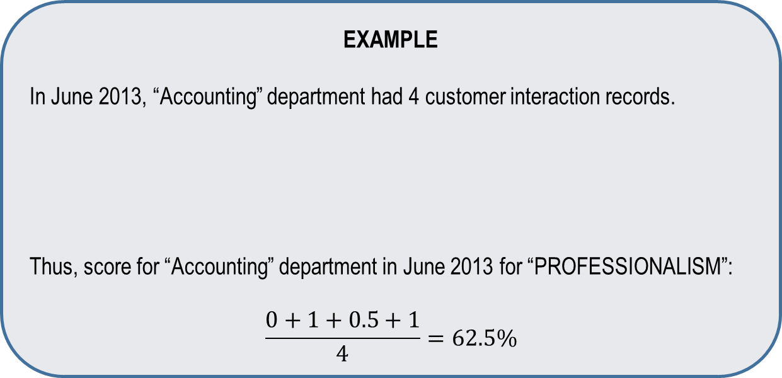
STAGE 6: AGGREGATE COMMENT SCORES
Comment scores are aggregated for each Month and Quality Standard
by organizational units and Transaction IDs
Company
Departments
Process Teams
Associates
Transaction IDs
EXAMPLE
In June 2013, “Accounting” department had 4 customer interaction records.
Thus, score for “Accounting” department in June 2013 for “PROFESSIONALISM”:
$$\frac{0+1+0.5+1}{4}=62.5\%$$
 | Comment 1 | Comment 2 | Comment 3 | Comment 4
PROFESSIONALISM | NEGATIVE (0) | POSITIVE (1) | NEUTRAL (0.5) | POSITIVE (1)

Slide 20
WEB-BASED REPORTING

Slide 21
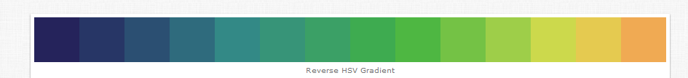
WEB-BASED REPORTING
Web reports display aggregated scores in the form of interactive scorecards
Web reports automatically update after weekly analysis
Web report users can drill-down from higher level scorecards to lower level
Company Scorecard
Department Scorecard
Team Scorecard
Associate Scorecard
Associate Scorecard
Transaction Scorecard
Scored Data

Slide 22
WEB-BASED REPORTING
COMPANY SCORECARD
DEPARTMENT 3 SCORECARD
QUALITY STANDARD | SCORE
STRUCTURE | 93
PROFESSIONALISM | 85
…….
AGGREGATE SCORE | 90
QUALITY STANDARD | SCORE
STRUCTURE | 93
PROFESSIONALISM | 85
…….
AGGREGATE SCORE | 90
DEPARTMENT PERFORMANCE
ALL
Department 1
Department 2
Department 3
…….
Department 9
TEAM PERFORMANCE
ALL
Team 1
Team 2
Team 3
…….
Team 12

Slide 23
AUTOMATED ISSUE DISCOVERY AND
ISSUE MANAGEMENT

Slide 24
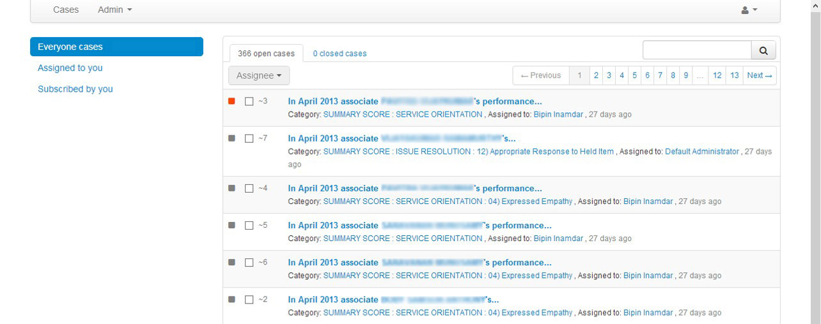
AUTOMATED ISSUE DISCOVERY AND ISSUE MANAGEMENT
The system detects downward trends in service quality and generates issues
Personnel in charge of issue management are alerted via email
Users can track progress of issue resolution via issue management web portal

Slide 25
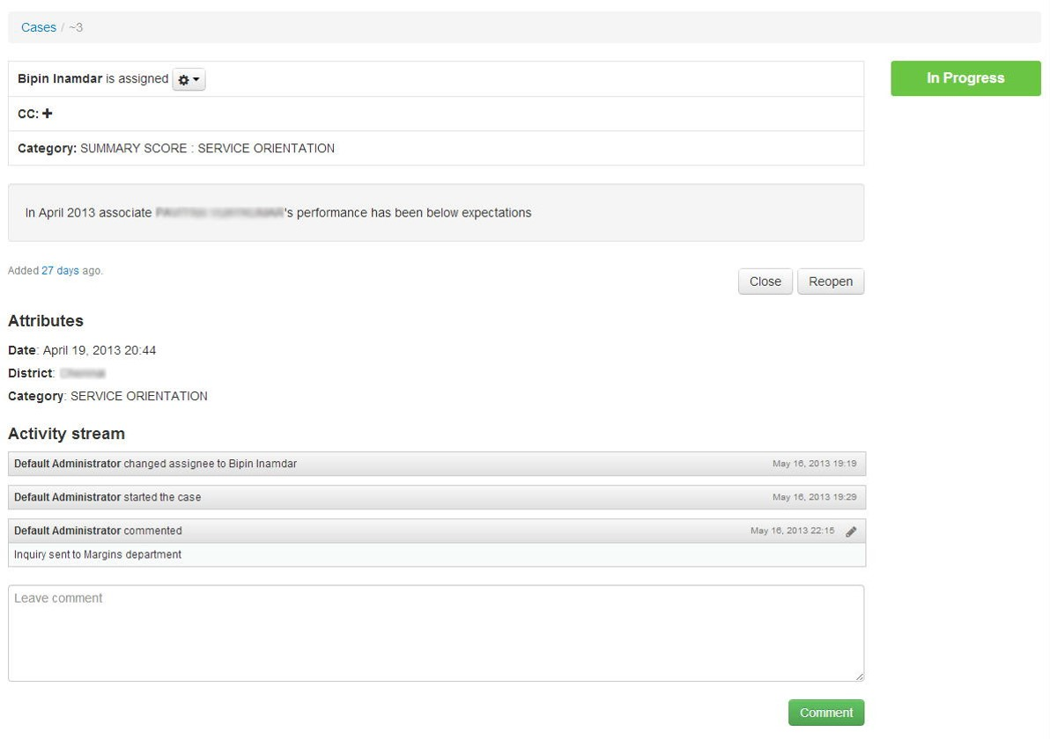
AUTOMATED ISSUE DISCOVERY AND ISSUE MANAGEMENT
ISSUE DETAILS

Slide 26
SUMMARY
Megaputer’s service performance monitoring system offers following benefits over previous system:
45% cost saving
Results based on 100% data
Greater accuracy and uniformity
Greater accountability
Reduction in manual effort through automation
Enhanced reporting
Greater accessibility
Automated issue discovery
Web-based issue management

