Slide 1

e-Discovery through Text Mining
Fraud Detection example
Sergei Ananyan, Ph.D.
Megaputer Intelligence Inc.

Slide 2
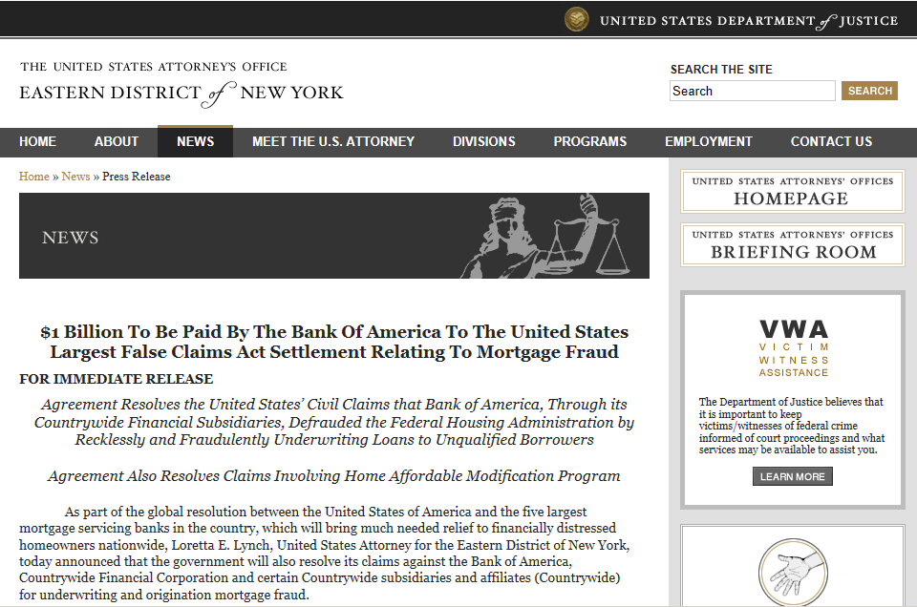

Slide 3









What is e-Discovery?
Electronic Discovery is the process when electronic data is sought, located, secured, and searched with the intent of using it as evidence in a legal case

Slide 4
Electronic evidence
Documents are increasingly produced and stored electronically
Corporate litigations involve the production and analysis of electronic evidence
Litigations might involve different parties:
  Company vs. Company
  Government vs. Company
  Person vs. Company

Slide 5
Who uses e-Discovery systems?
Document Analyst
Opposing Legal Team
E-Discovery System
Litigation Support Manager
Court
Attorney

Slide 6
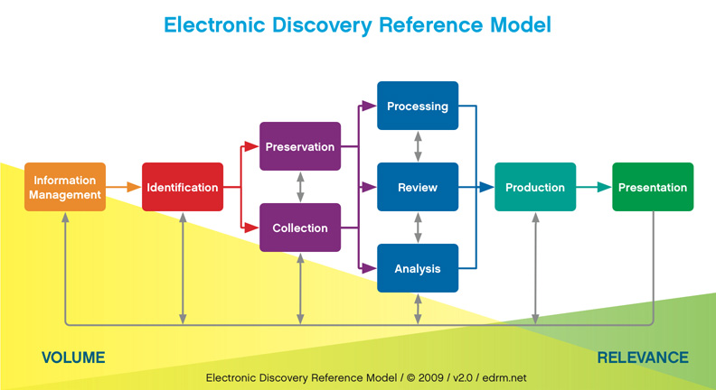
Text Mining
Analytics & Reporting

Slide 7
Old approach to text analysis
Data analysts perform searches based on:
  Key words and phrases with proximity
  Date ranges
  Known relevant documents – seeking similar documents

Slide 8
Typical example
US federal agency is investigating a mortgage fraud case against a major bank
Subpoenas all documents matching words:
  Apprais* w/25: correct*, target, increas*, chang*, second, …
  Pric* w/25: change*, increas*, rais*, …
Receives over 3,000,000 matching documents
This agency division has 4 data analysts and 3 attorneys to work on the case

Slide 9
Time for document analysis
3 million docs
3 min per document
20 docs per hour
Text
Mining
2 month – one analyst
Manual
Analysis
40K docs per year
75 years to check 3M docs
DONE!
Text Mining delivers results 450 times faster!

Slide 10
Encountered challenges
Overwhelming # of documents
Primarily irrelevant documents
Repetitive documents
Numerous typos
Missing information about communicating parties

Slide 11
Where Text Mining can help?
Data normalization
  Parsing and aggregating data from disparate formats
  Cleansing data
Feature extraction
Data analysis
  Deep linguistic parsing (context based)
  Searching for patterns

Slide 12
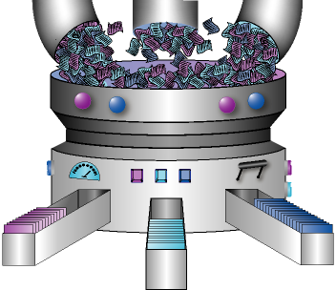
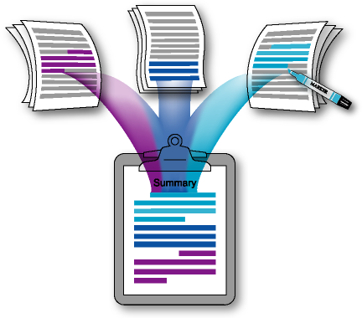
Use text/data mining techniques
Language detection
Spell-checking / correction
Deep linguistic parsing
  Part of speech detection – context based
  Chunker: detect noun phrases, verb phrases, etc.
Semantic dictionaries
Auto-categorization (Pattern Detection Language)
Entity Extraction
Clustering
Latent Semantic Analysis
De-duplication
Inverse frequency analysis
Social Network Analysis

Slide 13
Possible Analysis Scenarios
Let us consider different scenarios:
  We can formulate patterns we are searching for
  We have a collection of documents with relevant evidence
  We have a list of relevant custodians
  We know only the time interval when the problem occurred
  We don’t know anything except the keywords documents should contain

Slide 14
If we know relevant patterns
Write patterns in a special language – capture:
  Proximity (terms, sentences and paragraphs)
  Part of speech information
  Semantic similarities
  Negations
  Density of terms

Slide 15
If we know relevant documents
Need to search for similar documents
  Use Latent Semantic Analysis or similar techniques
Identify custodians associated with relevant documents
Find additional features of potential interest associated with these custodians

Slide 16
Know only custodians & time range
Search for unique features of their communications with others
  Train the system on all available data
  Reveal anomalous terms & phrases
Example: “fruit language”
  Lemon – kickback:
    “For this property we received from XYZ a lemon worth over 3M.”
    “They gave us significant lemons on both these transactions.”

Slide 17
Know only the problem time range
Look for spikes in communications for all people
Sudden changes in topics discussed
Spikes in unusual lexicon terms

Slide 18
Know only theme & keywords
Clustering of topics
Analysis of pairwise communications
  Unusual clusters & lexicon
Group pairs of people with similar lexicon
Gather ideas for further investigation

Slide 19
Data preparation
Remove definitely irrelevant documents
  Junk mail
  Mass broadcasts
  Magazine articles (post-factum documents)
Split email chains into individual messages
Eliminate full and near duplicates
Reconstruct email addresses
Find and adaptively correct misspells

Slide 20
Reconstruct & extract features
Extract fields of interest:
  Date
  To, From, CC and BCC
  Subject
  Names of people, companies and organizations
  Addresses
  Telephone numbers
  Custom entities: SSN, drug names with dosage, frequency, application mode, etc.

Slide 21
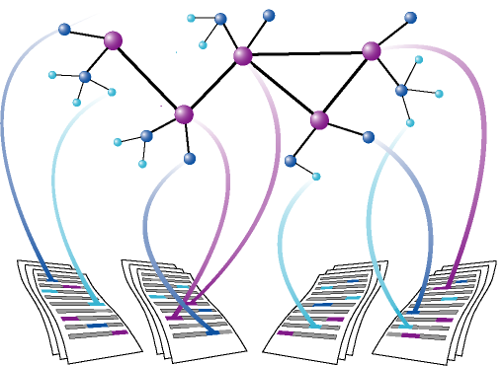
Networks of related custodians
Reveal & graphically present networks of people exchanging relevant documents
Social Network Analysis performed on email communications

Slide 22
Present selected documents
Obtain a small collection of highly relevant documents
Summarize key findings in easy to comprehend interactive web reports
Provide drill-down to original documents
Have important patterns in text highlighted in the drill-down documents
Export collections of marked-up relevant documents

Slide 23
Case Description
Data: 3,000,000 documents from a mortgage company, primarily email notes
Objectives:
  Detect signatures of potential fraud and abuse
  Identify and visualize involved individuals

Slide 24
E-Discovery Methodology
Step 1. Prepare and normalize data
Step 2. Cleanse data
Step 3. Extract entities of interest: $ amounts, loan #s, postal addresses, etc.
Step 4. Pattern Analysis: search for text patterns representing fraud and abuse
Step 5. Who is involved? Visualize networks of communications of identified suspects

Slide 25
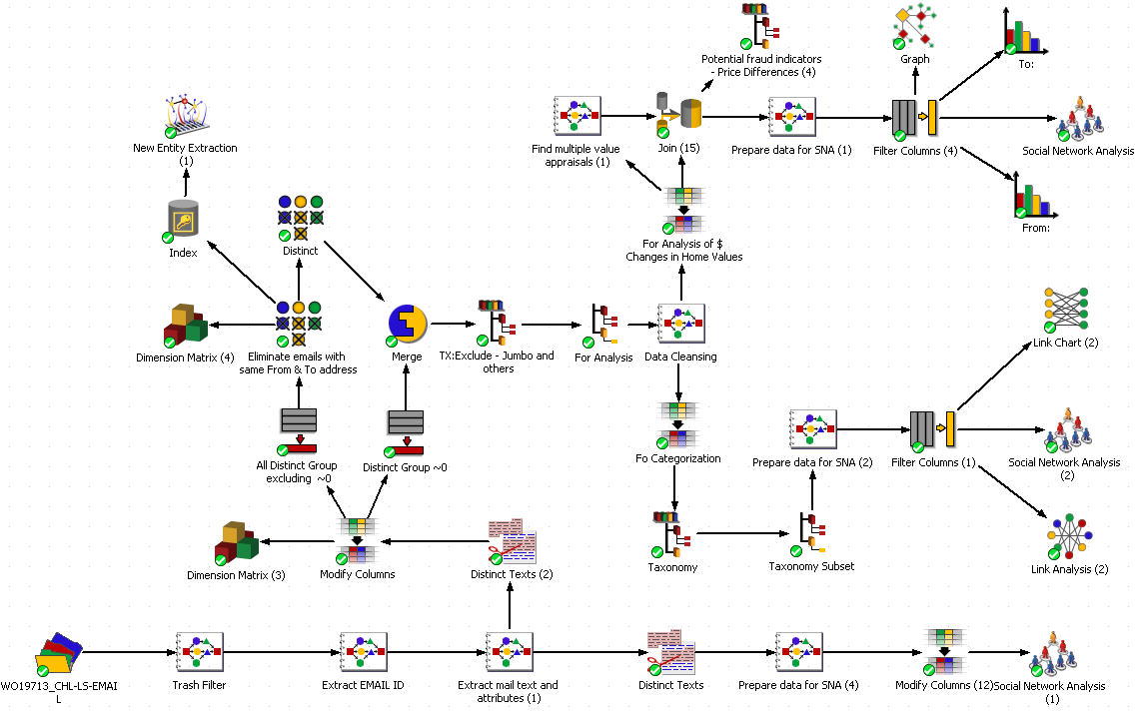
Data analysis scenario

Slide 26
Step 1. Data Preparation and Normalization

Slide 27
Data Preparation Objectives
Remove non-email documents
Reconstruct email addresses
Convert chains of email responses found in one email letter into collections of individual letters
Parse documents into structured fields:
  From, To, CC, BCC
  Subject
  Date
  Email body

Slide 28
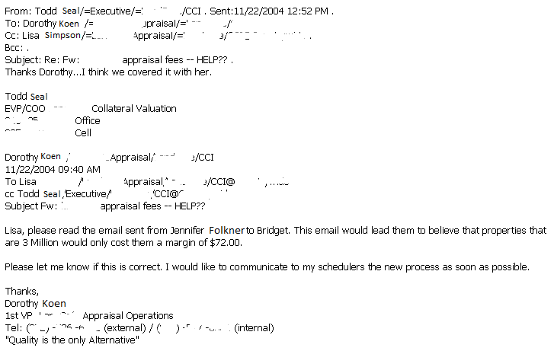
Parsing Original Documents
Email 1
Todd.Seal@homesite.com
Dorothy.Koen@homesite.com
Lisa.Simpson@homesite.com
Email 2
Dorothy.Koen@homesite.com
Lisa.Simpson@homesite.com
Todd.Seal@homesite.com
Email 3+
…

Slide 29
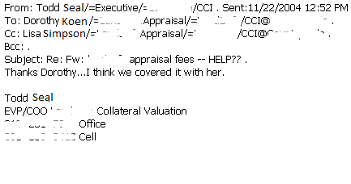
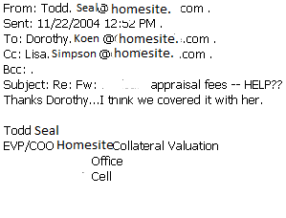
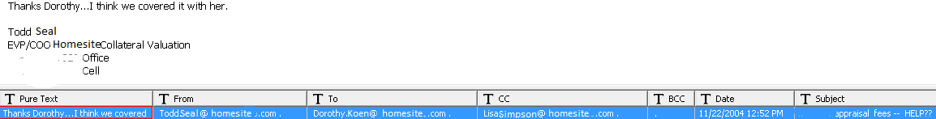
Reconstructing and Parsing

Slide 30
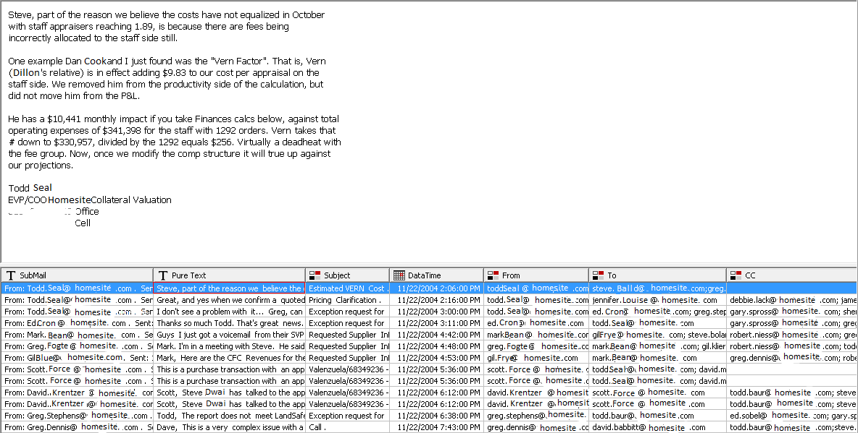
3M Chains Parsed into 5.6M Emails

Slide 31
Step 2. Data Cleansing

Slide 32
Data Cleansing Objectives
Identify and correct misspells
Identify duplicates and near duplicates
Remove magazine articles

Slide 33
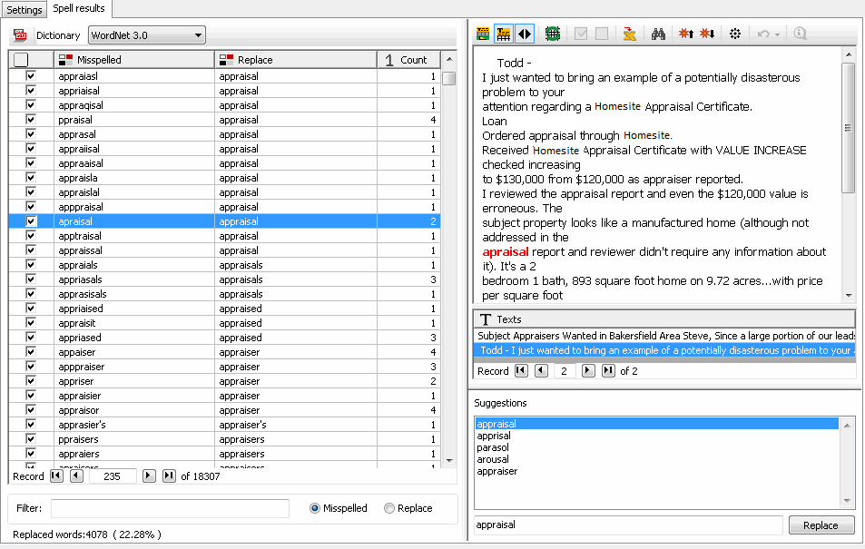
Auto-SpellChecker – misspelled words
Automatically identified & corrected over 600,000 misspells

Slide 34
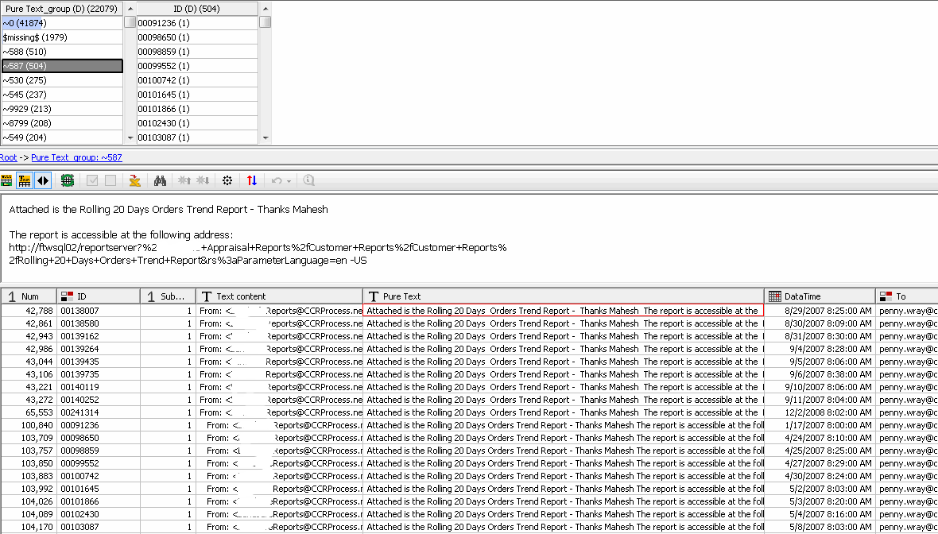
Detect Duplicates and Near-duplicates
Automatically eliminated over 1,000,000 duplicates

Slide 35
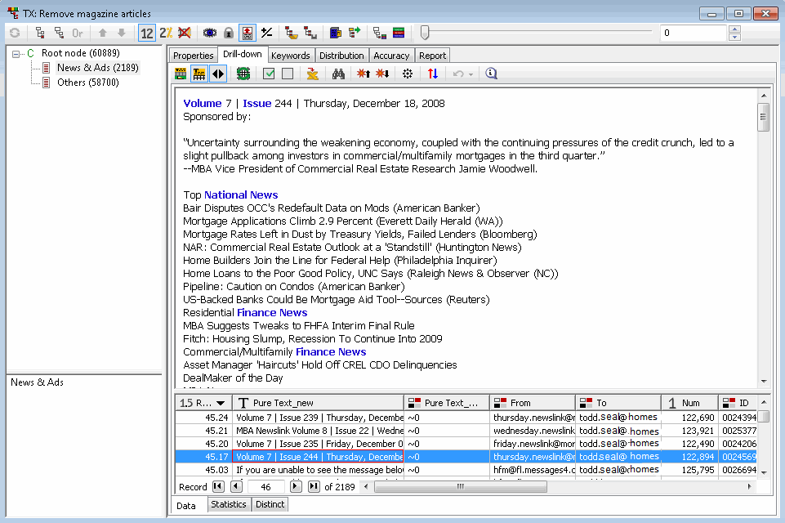
Remove Magazine Articles

Slide 36
Step 3. Extract Entities:
Multiple Valuation Homes?

Slide 37
Entity Extraction Objectives
Extract standard and custom entities of potential interest
  Names of People and Companies
  Postal Addresses and Phones
  Currency amounts and Loan numbers, etc.
Find documents discussing different values of the same home
Remove discussions of revenue and salaries

Slide 38

Extract Names of People & Companies
Automatically extract standard entities

Slide 39
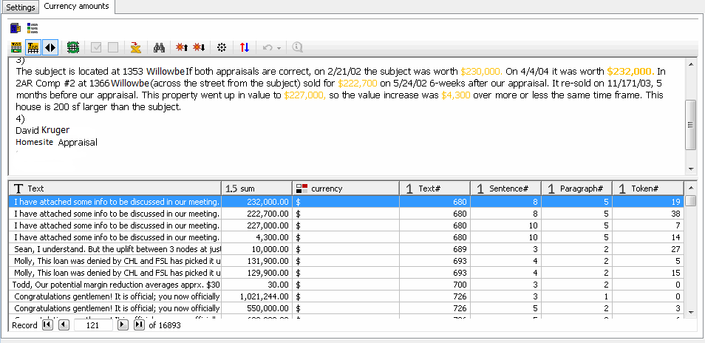
Extract $ Amounts and Loan #s
Extract standard and custom entities

Slide 40
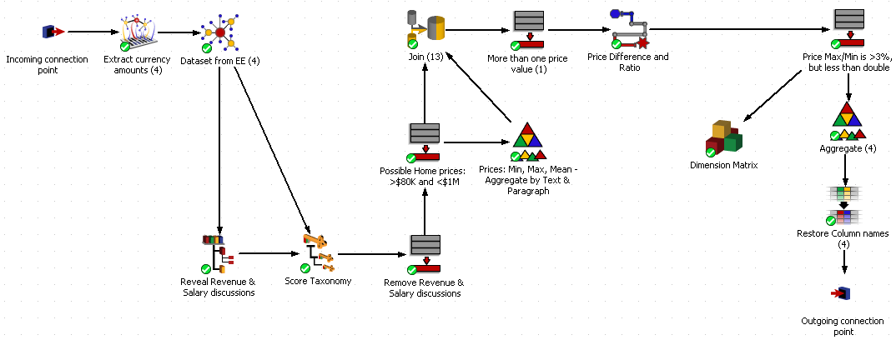
Extract Notes w/Multiple Home Prices

Slide 41
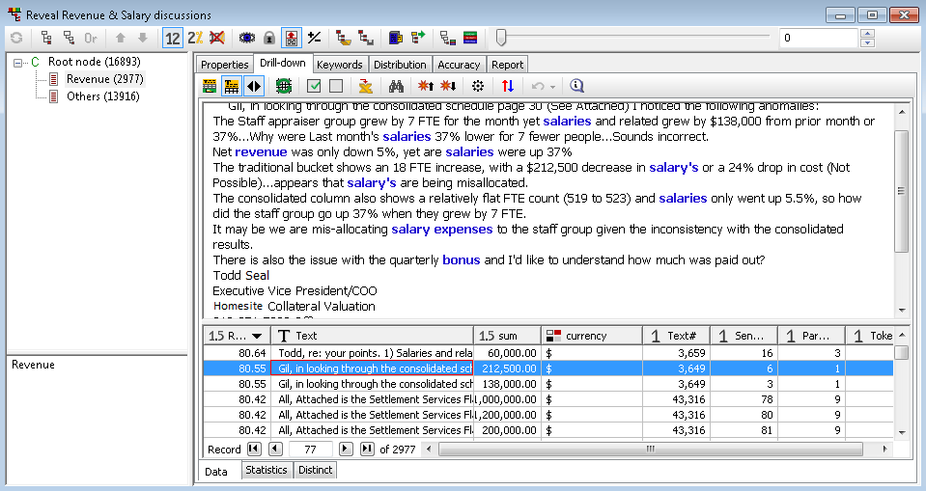
Remove Discussions of Revenue & Salary

Slide 42
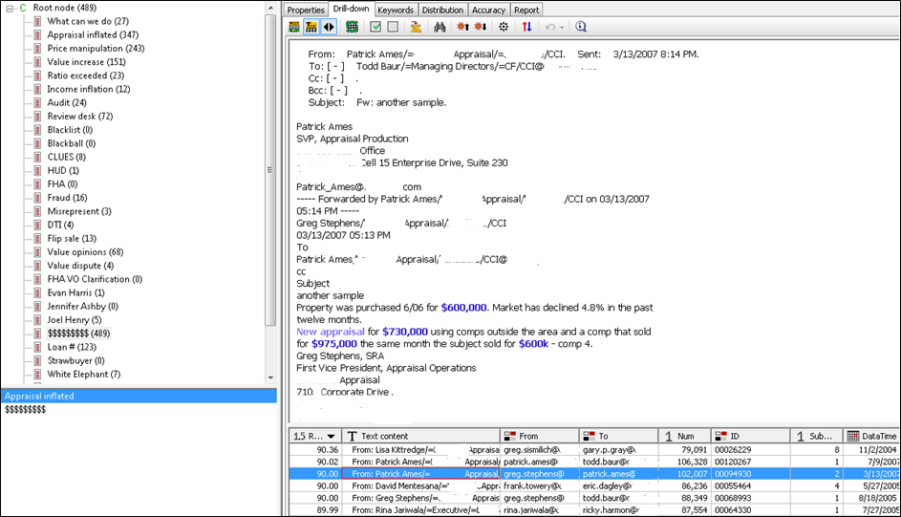
Different Valuations for the Same Home

Slide 43
Step 4. Discover Signatures of Fraud and Abuse

Slide 44
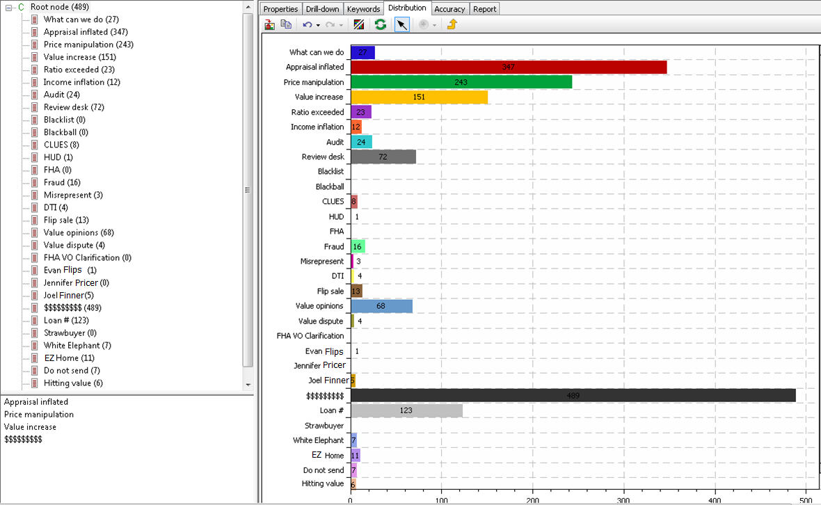
Taxonomy: Distribution of Topics

Slide 45
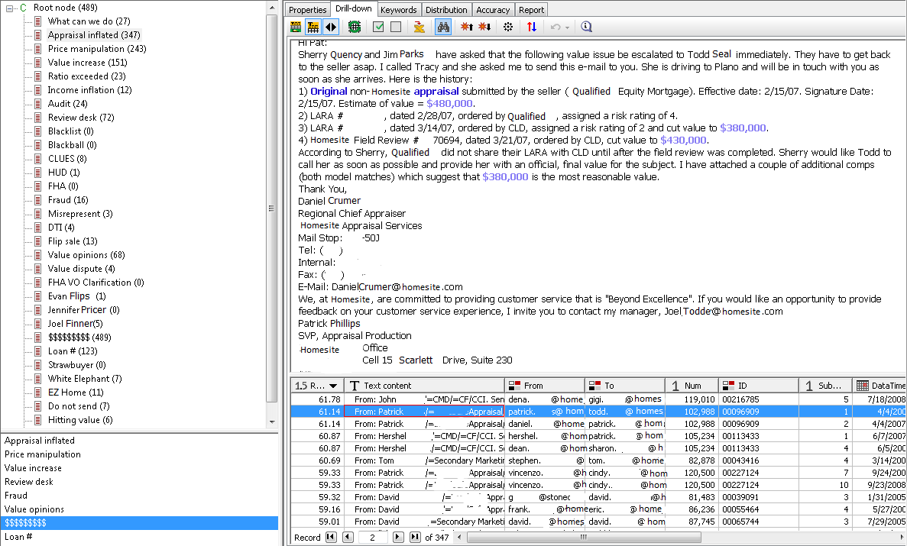
Taxonomy-based Categorization

Slide 46
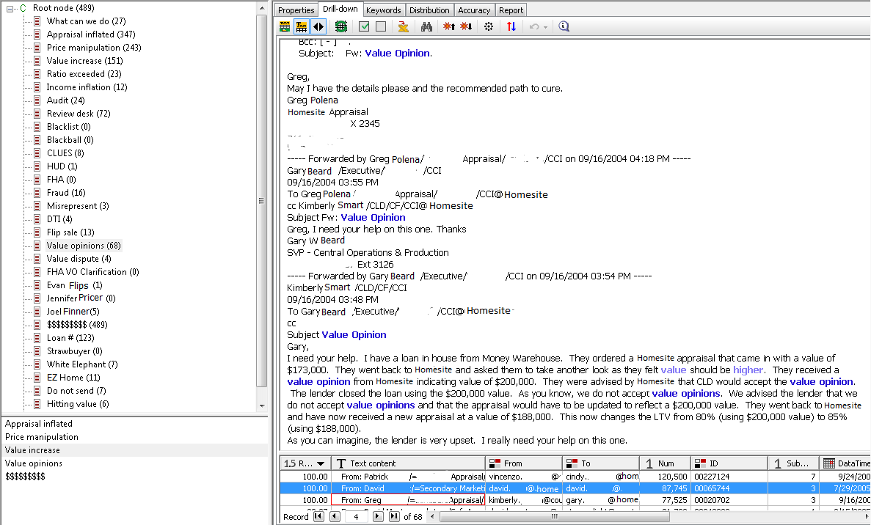
Taxonomy Results: Value Opinions

Slide 47
Step 5. Who is involved?
Social Network Analysis

Slide 48
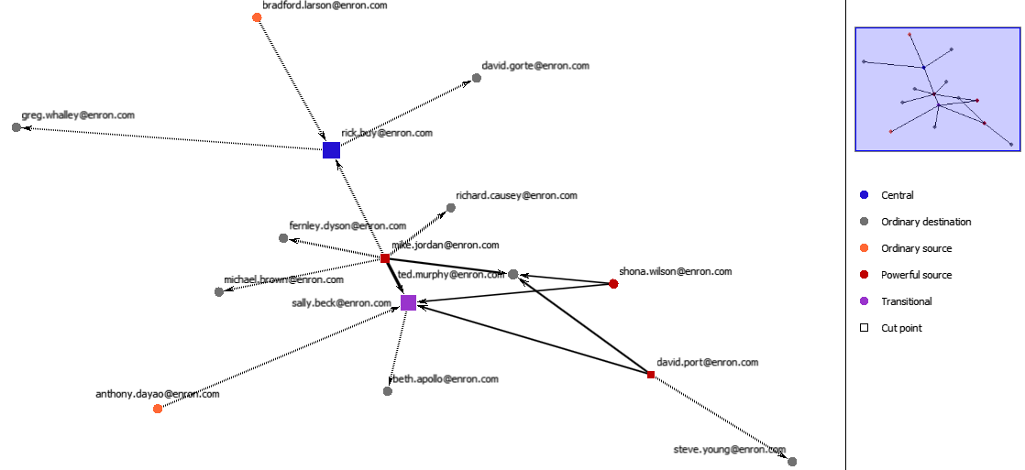
People Discussing Multiple Values of Homes

Slide 49
Benefits of Text Mining
Dramatic savings in time and resources
Smaller teams of investigators can complete large projects
Elimination of tedious manual work
Better precision: focus only on relevant documents
Increased recall: find unexpected patterns of terms
Convincing and consistent presentation of results
Stronger case / defense position
Preventative measures become possible

Slide 51

Questions?
Call
(812) 330-0110
or email
info@megaputer.com
1600 W Bloomfield Rd, Suite E
Bloomington, IN 47404 USA

