Slide 1

PolyAnalyst
Web Report Training
Visualizing Analysis Results with
PolyAnalyst Web Reports
Megaputer Intelligence
www.megaputer.com
© 2014 Megaputer Intelligence Inc.
Notes:
Esra just showed how to derive insights from data.
I’ll discuss why and how we can share those insights across the organization.
The means we use for creating and sharing reports are PolyAnalyst Web Reports.

Slide 2

Outline
Overview
Why Web Reports?
What exactly are PolyAnalyst Web Reports?
Web Report Components
Example Web Reports
Notes:
This presentation will address the following:
Why use web reports? What is the benefit of using web reports to present and share analysis results?

Slide 3
Outline
Overview
Why Web Reports?
What exactly are PolyAnalyst Web Reports?
Web Report Components
Example Web Reports
Notes:
2. What are PolyAnalyst Web Reports? For those who aren’t familiar, I’ll clarify what web reports are and what they enable users to do.

Slide 4
Outline
Overview
Why Web Reports?
What exactly are PolyAnalyst Web Reports?
Web Report Components
Example Web Reports
Notes:
3. Web Report Components –Without getting too technical, I’ll briefly discuss how reports are created and what makes up a web report so you can see how they fit into the overall process of data analysis.

Slide 5
Outline
Overview
Why Web Reports?
What exactly are PolyAnalyst Web Reports?
Web Report Components
Example Web Reports
Notes:
4. Finally, we’ll look at two different types of web reports – one a dashboard style report and another a scorecard rating system.

Slide 6
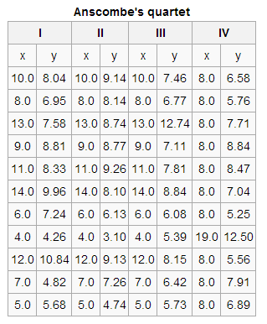
Outline
Why does it matter?
Similar descriptive statistics
Data Summary
Mean of x: | 9
Variance of x: | 11
Mean of y: | 7.50
Variance of y: | 4.1
Correlation(x,y): | 0.816
Linear regression line: | y = 3 + 0.5x
http://en.wikipedia.org/wiki/Anscombe%27s_quartet
Notes:
First, a motivation for even bothering to visualize analysis results.
Here we have 4 datasets, each with 11 x,y coordinates. All four datasets share a number of the same descriptive statistics. They have the same mean and variance of x and y, same correlation coefficient between x and y, and the same linear regression line running through all points.
At first glance, we might think these datasets are similar.

Slide 7
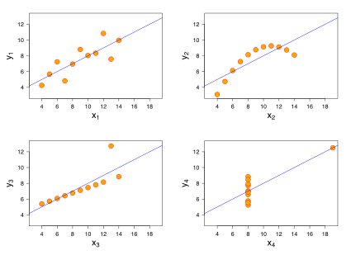
Outline
Why does it matter?
Graphing the datasets paints a different picture
I
II
III
IV
Notes:
But, the plot of each dataset paints a very different picture. We see they are actually very dissimilar.

Slide 8
Outline
It matters!
“Our brains are much more effective recognizing shapes, trends, and patterns than analyzing spreadsheets full of numbers.”
http://blog.strat-wise.com/2011/08/04/what-is-bi-30.aspx
Notes:
Pictures can give us information that spreadsheets alone can’t.

Slide 9
Outline
Question:
But can we do better than static images
Notes:
So, visualizations are better than data tables at communicating insights, but can we do better?
One of the drawbacks with static images and reports, such as powerpoints or pdfs, is that the flow of information is one way. The report viewer passively views the charts and graphs put in front of them, without really knowing where they came from.
Ideally, we’d like reports to be engaging and allow for further exploration of the data.

Slide 10
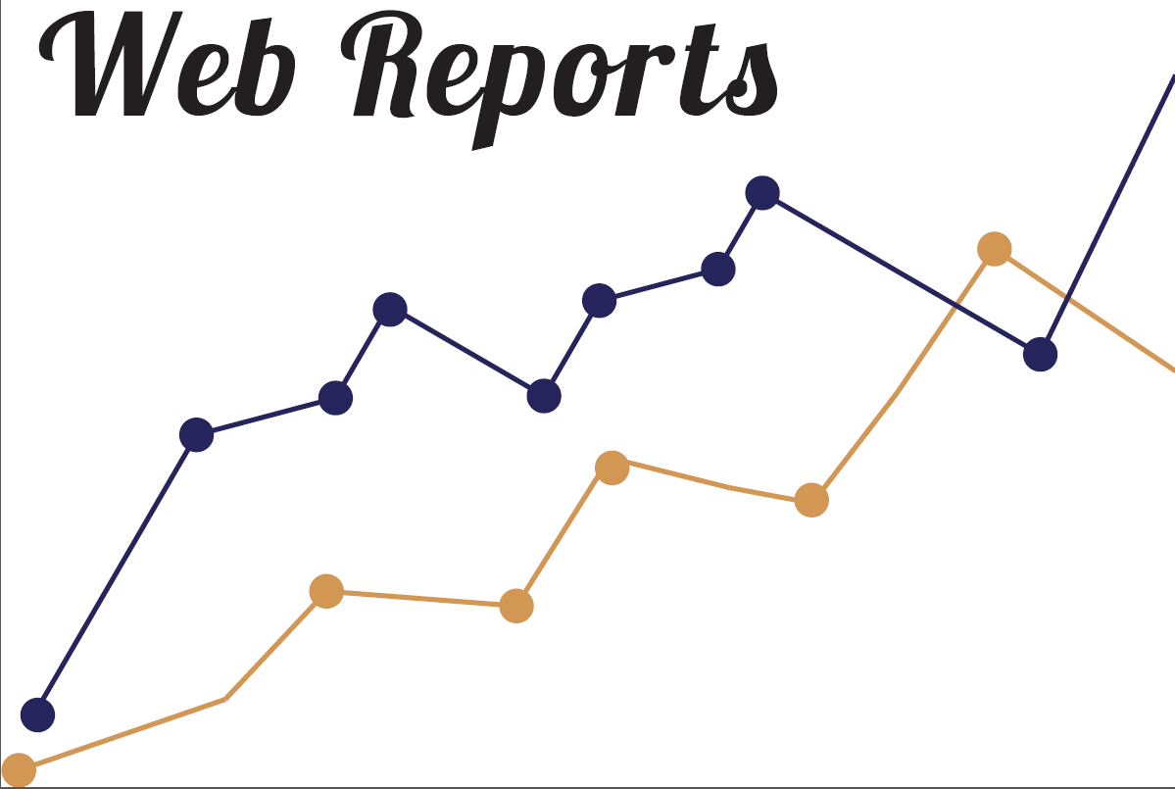
Outline
Answer: Yes
PolyAnalyst Web Reports
Notes:
PolyAnalyst Web Reports – the tool we use to present analysis results

Slide 11


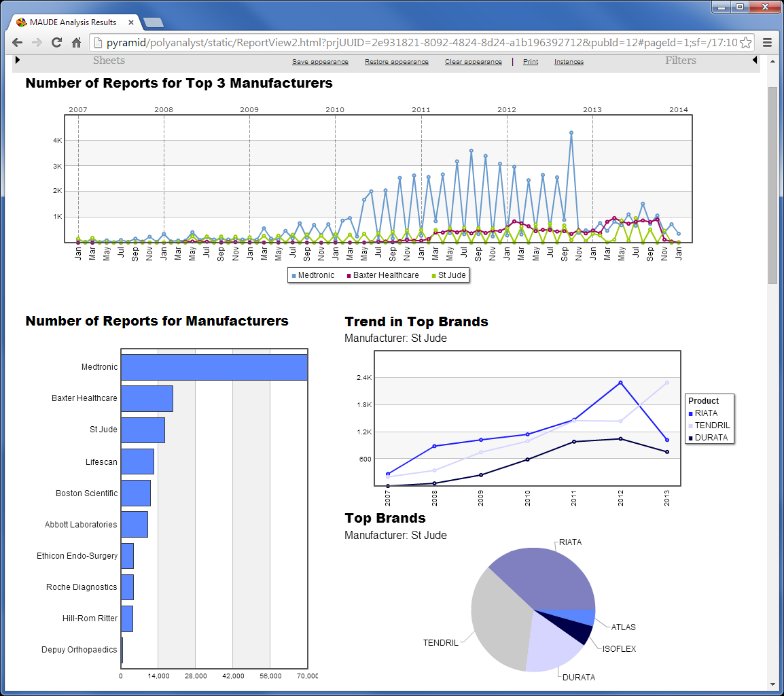
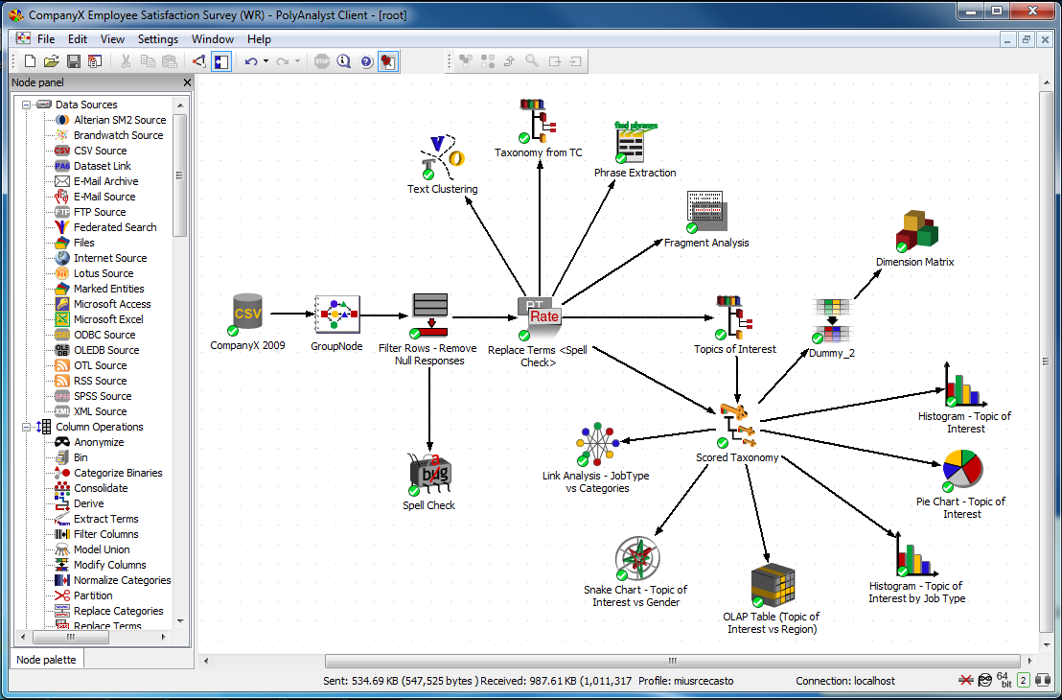
Outline
What are Web Reports?
A custom collection of interactive charts that summarize and present analysis results to data consumers
Data Analysts
Data Consumers
Notes:
Web reports help bridge the gap between data analysts and data consumers. End users can access analysis results while being shielded from the gritty details of the actual analysis. Perhaps even more importantly, they cannot interfere with the analysis.
Reports are customizable to address individual business objectives.
Reports are interactive – engaging viewing and allowing them to explore the data more fully.

Slide 12
Outline
Benefits
Analysis results accessible to non-technical users
Up-to-date results with project synchronization
Easily accessed from a standard web browser
Drill-down and filters enable data exploration and provide transparency
Notes:
Web Reports bridge the gap between data scientists and non-technical users.
It’s hard to get people excited about crunching data.
But show them a cool graph and you’ll get their attention.
They allow the analysts to summarize their findings and present them in an easy-to-understand format. To that end, they help bring analytics to a broader audience who may not be technically inclined, but can still draw insights from the analysis.

Slide 13
Outline
Benefits
Analysis results accessible to non-technical users
Up-to-date results with project synchronization
Easily accessed from a standard web browser
Drill-down and filters enable data exploration and provide transparency
Notes:
The convenience of web reports is that once they are created, they can be automatically updated when new analysis results are generated.
This increases the speed at which new information can be disseminated to users and eliminates a lot of time spent manually updating powerpoints or other reports.

Slide 14
Outline
Benefits
Analysis results accessible to non-technical users
Up-to-date results with project synchronization
Easily accessed from a standard web browser
Drill-down and filters enable data exploration and provide transparency
Notes:
Reports are viewed from a web browser, so users can access reports when convenient. Multiple users can view a report simultaneously without interrupting other users.
It is important to note here, that users never have to access PolyAnalyst projects. They don’t see the details of the project and, perhaps more importantly, they can’t interfere with it.

Slide 15
Outline
Benefits
Analysis results accessible to non-technical users
Up-to-date results with project synchronization
Easily accessed from a standard web browser
Drill-down and filters enable data exploration and provide transparency
Notes:
Users don’t just view charts, they can always drill down to the underlying data associated with a visualization. For example, a user looking at a pie chart of the top 5 topics of interest being discussed in an open-ended survey can click any piece of the pie to go to the results for that specific topic of interest. They can view the comments and see exactly why a comment was classified into that category. To that end, drill down brings integrity to the reports. Users don’t need to be suspicious of where the results are coming from.
Similarly, filters enable users to isolate subsets of interest. For example, when looking at a report of survey responses, the users may want to update the report to reflect the response from just females in a certain geographic location.
I’ll go into drill-down and filters in more detail in a bit.
Now, I’ll discuss a little how reports are created and updated.

Slide 16
Outline
Projects & Reports
Analysts create data analysis projects in the Analytical Client
Notes:
All projects start in the Analytical Client. As Esra showed, it is here that analysts work with the data and generate results.

Slide 17
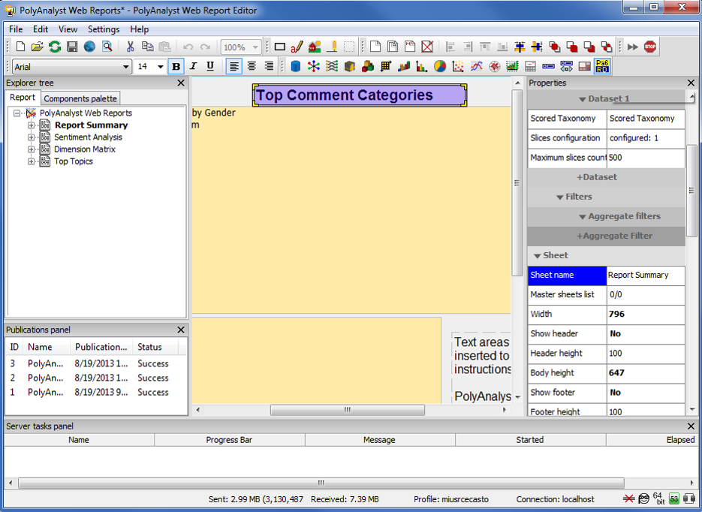
Outline
Projects & Reports
Report templates are designed and stored in the Web Report Editor
Notes:
The output of a project is the source of data and visualizations used in the reports. In the Web Report Editor, custom report templates are designed that dictate the placement of visualizations and configuration of colors and other design details. Templates are saved for re-use.

Slide 18
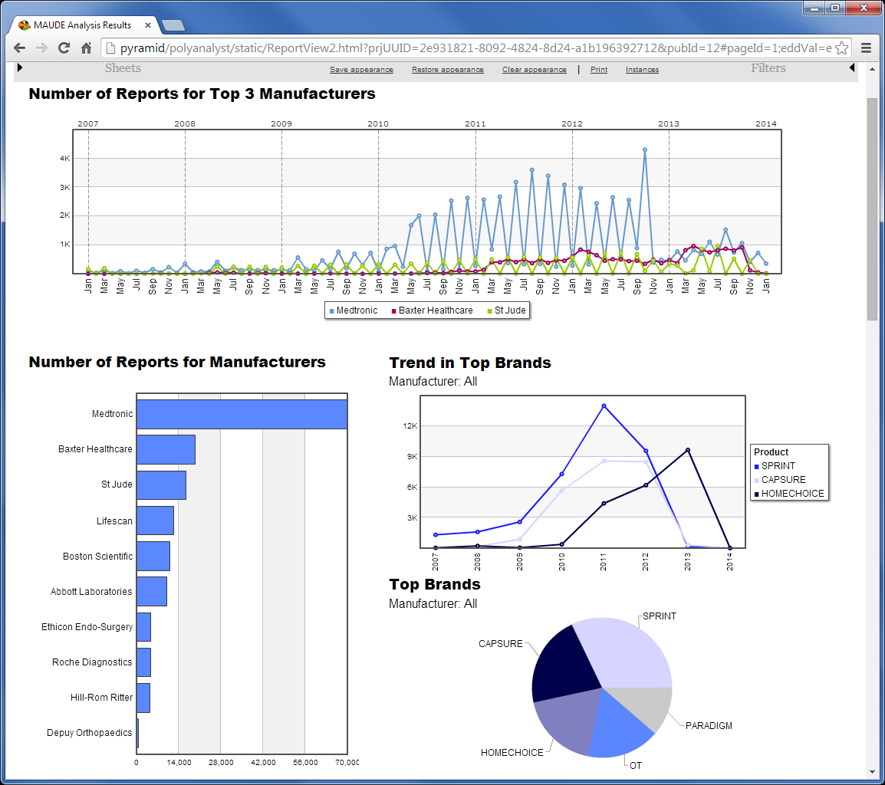
Outline
Projects & Reports
Published reports are accessed by data consumers from a web browser
Notes:
Once a template is made, the report is published. The published report is accessible from a web browser and displays the results of the underlying project.

Slide 19

Outline
Report Synchronization
Reports are updated to reflect the latest analysis results
Notes:
When a project is updated with new results, the saved report template is simply re-published. The report in the browser then always shows the most up to date results. New results are quickly disseminated to end-users and saves a lot of time.

Slide 20
Outline
Web Report Components
Charts and Graphs
Filters
Drill-down
  To data
  To charts (Enhanced Drill-down)

Slide 21
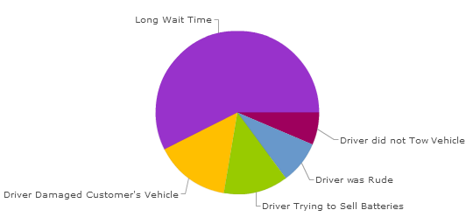
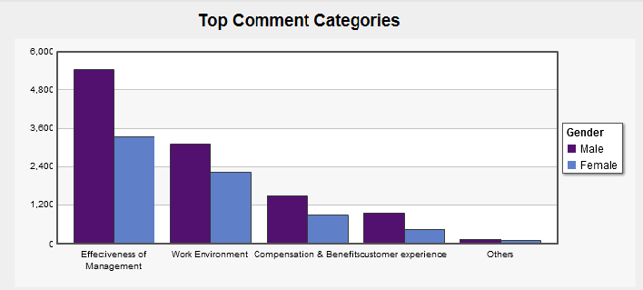
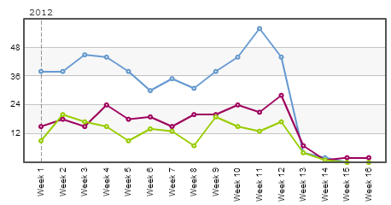
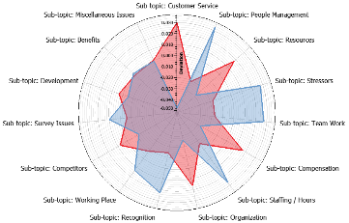
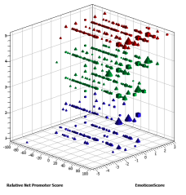
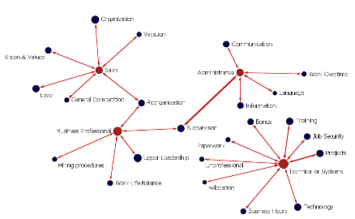
Outline
Charts and Graphs
  Pie Chart
  Bar Chart
  Histogram
  Trend Graph
  Parallel Coordinates
  Scatterplot
  Link Analysis

Slide 22
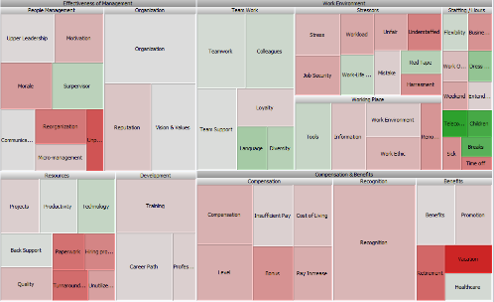
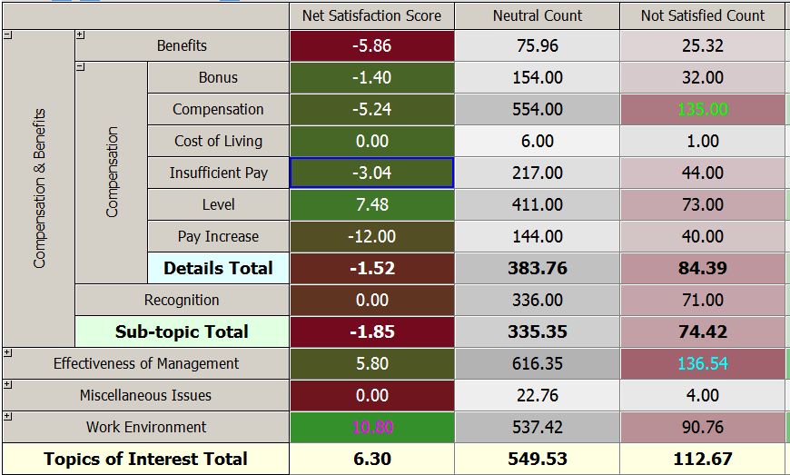
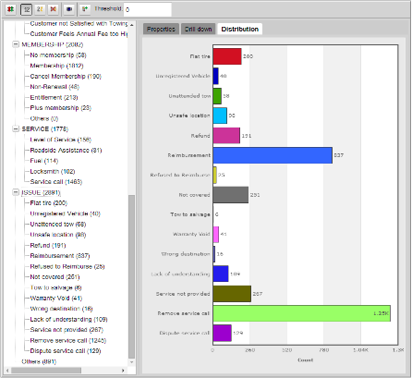
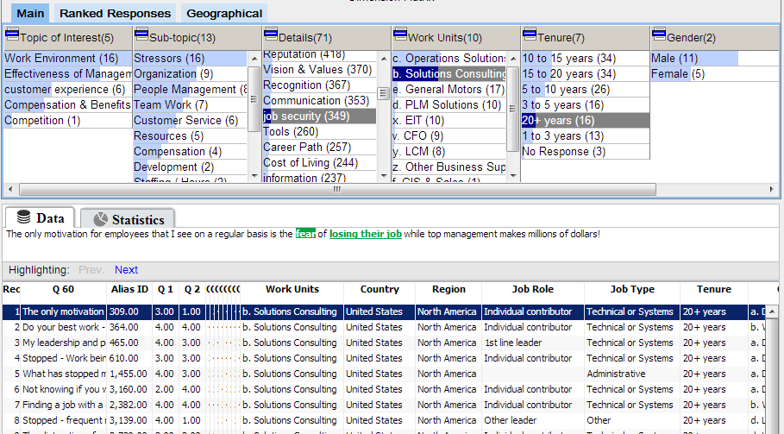
Outline
Charts and Graphs (cont’d)
  Treemap
  OLAP Table
  Dimension Matrix
  Taxonomy

Slide 23

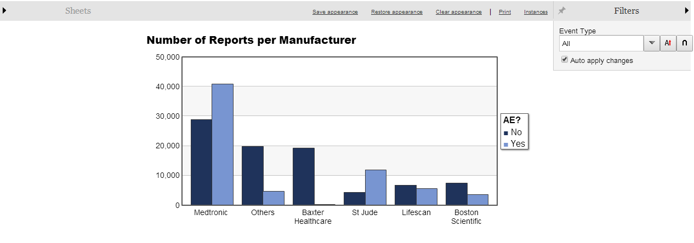
Outline
Filters
Notes:
Filters enable end users to update visualizations to reflect results from a subset of the data. For example, here we have a bar chart showing the number of incident reports relating to medical products produced by different manufacturers, split according to whether or not there was an adverse event as a result of the incident. In the dataset, there is also a column indicating the type of event the incident was.

Slide 24
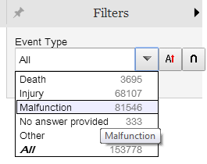

Outline
Filters
Notes:
Whether the event was death, injury, product malfunction, other or no answer. If a viewer wants to only look at the number of incidents for product malfunctions, they can select “Malfunction” from a drop down.

Slide 25
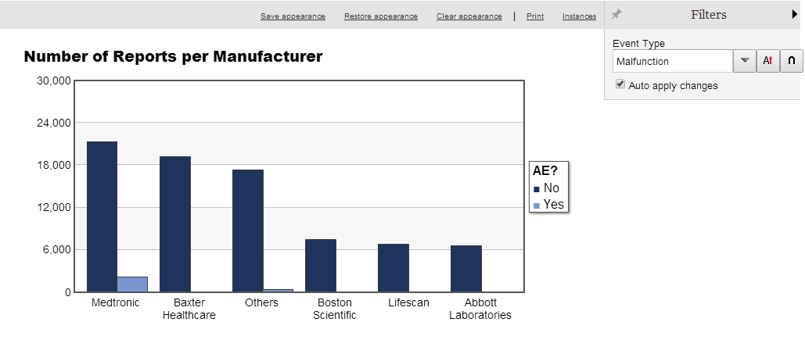
Outline
Filters
Zero in on specific segments
Notes:
And the graph is updated to reflect the new information for just product malfunctions. We see there are far fewer adverse events from product malfunctions than on average.
We can also add additional filters to look at more granular cross-sections of the data. For example, here I might add a filter for geographic location.

Slide 26
Outline
Drill-down to data
Clicking a section of a chart or graph…

Slide 27
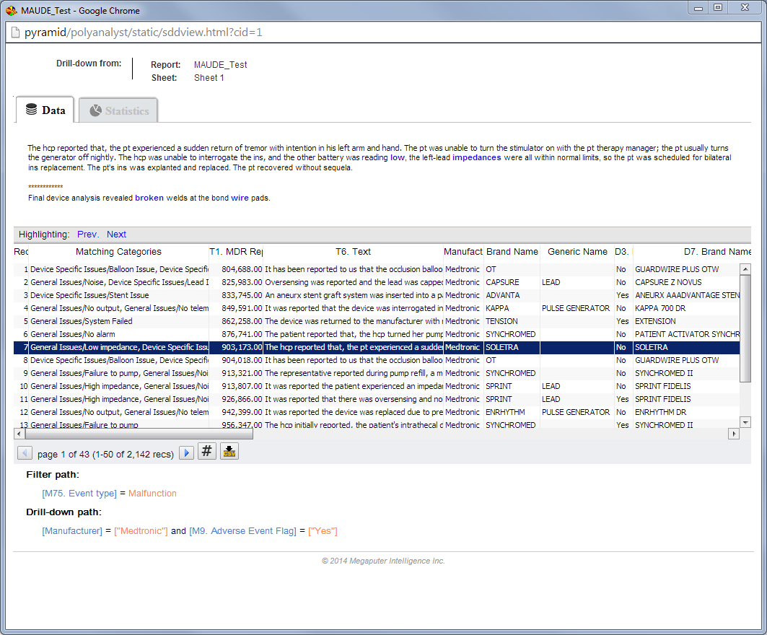
Outline
Drill-down to data
…drills down to the underlying dataset for closer examination
Notes:
For example, if I select Medtonic.

Slide 28

Outline
Drill-down to data
…drills down to the underlying dataset for closer examination
Export data to file

Slide 29
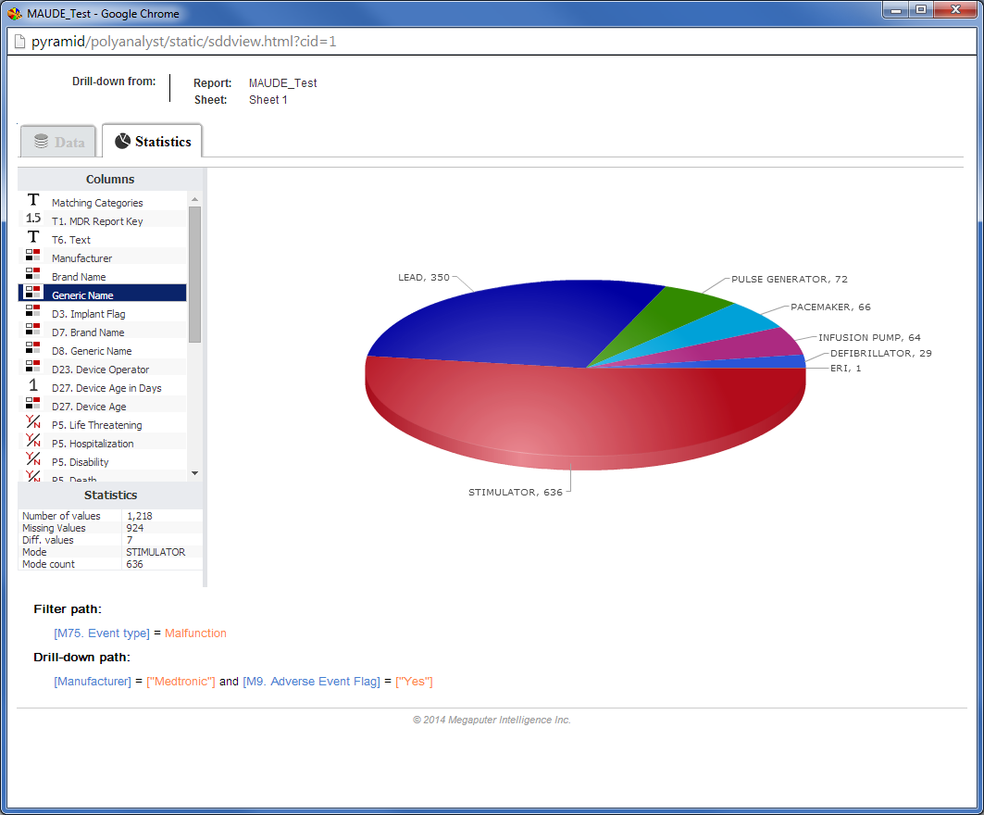
Outline
Drill-down to data
Explore data with Statistics tab
Notes:
Which Medtonic brands are represented in the data.

Slide 30
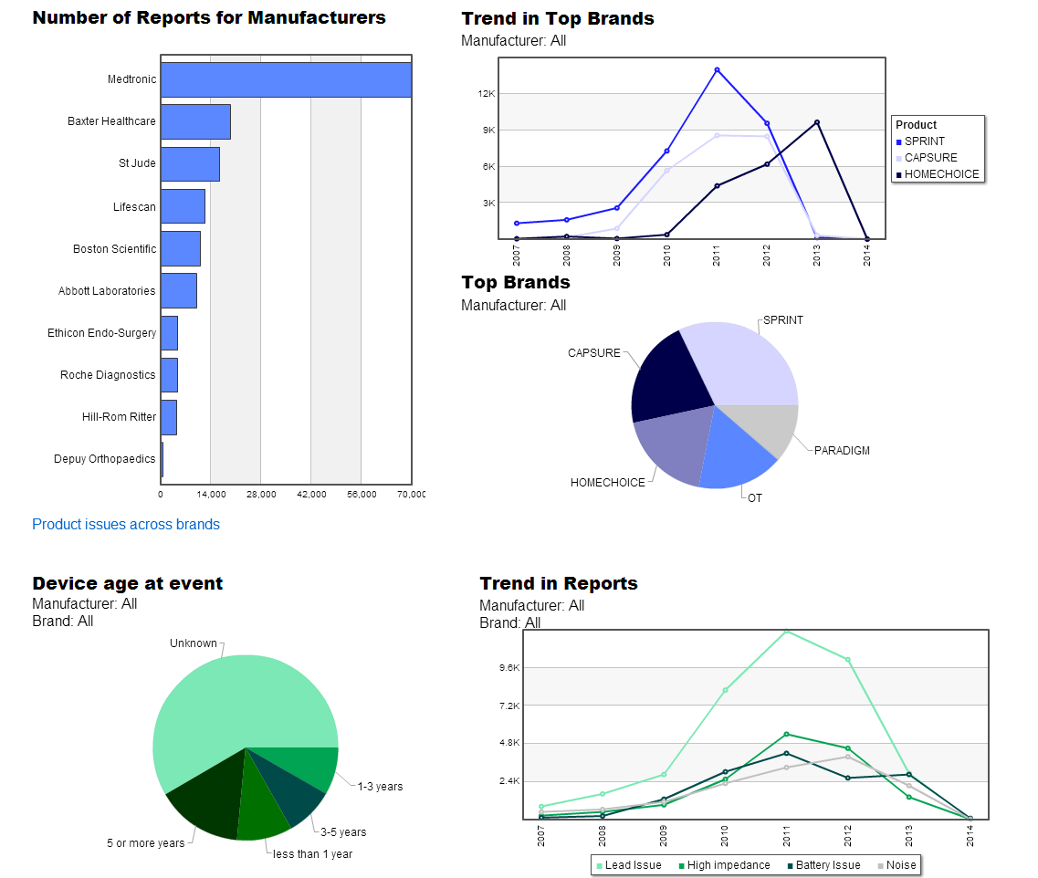
Outline
Drill-down to charts
Results from entire dataset
Notes:
Used primarily for dashboard style reports.

Slide 31

Outline
Drill-down to charts
Select subset of interest…
Notes:
Again, select a piece of the pie

Slide 32
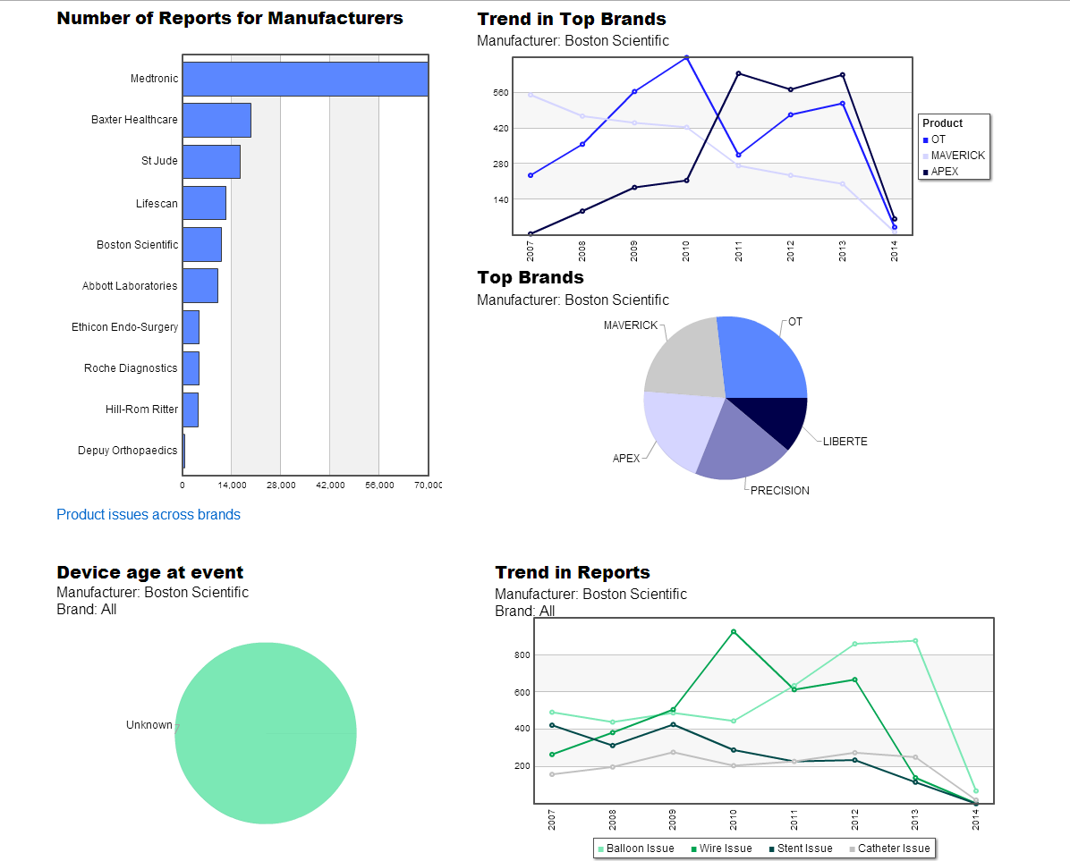
Outline
Drill-down to charts
…dependent charts and graphs are updated

Slide 33

Designing Interactive PolyAnalyst Web Reports
Contacting Megaputer
Technical Session
Date: May 15
Time: 11:10 – 11:50am

Slide 34
Outline
Example Reports
1. Report Dashboard
2. Report Scorecard

Slide 35
Contacting Megaputer
Questions?

