Slide 1

PolyAnalyst
Web Report Training
Designing Interactive PolyAnalyst Web Reports
Megaputer Intelligence
www.megaputer.com
© 2014 Megaputer Intelligence Inc.

Slide 2

Outline
In this session
Configuring:
    Charts
    Filters
    Enhanced Drill-down

Slide 3
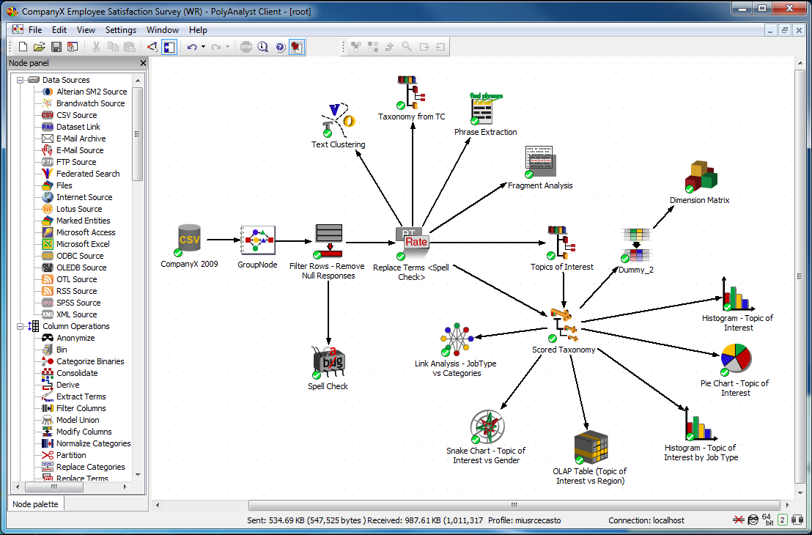
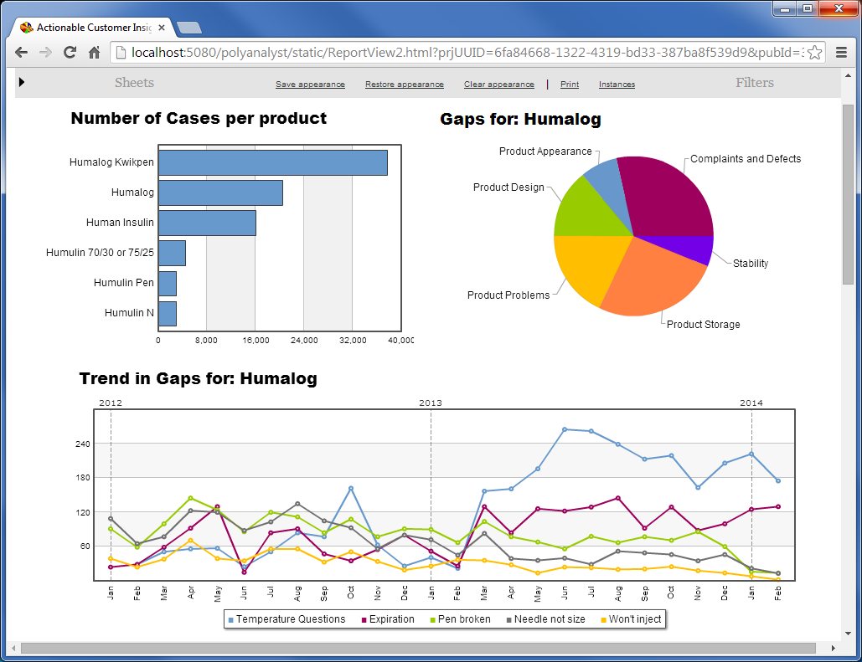
Outline
Report Integration
Every web report is based on a source project created in PolyAnalyst’s Analytical Client.
PolyAnalyst Analytical Client
PolyAnalyst Web Report

Slide 4
Outline
Report Integration
Web Reports are linked to source projects in the Analytical Client through:
  Dataset nodes
  Chart nodes

Slide 5
Outline
Creating Charts
Charts and graphs can be added to web reports in one of two ways:
  Insert a node from the source project
  Create new visualizations in the Web Report Editor linked to a dataset node in the source project

Slide 6
Outline
Creating Charts
The following objects can be inserted from PolyAnalyst projects or created in the Web Report Editor:
  The following object can be inserted only from source projects:
  Taxonomy
  Bar Chart
  Histogram
  Treemap
  Trend Graph
  Pie Chart
  OLAP Table
  Link Analysis
  Parallel Coordinates
  Scatterplot
  Link Chart
  Dimension Matrix

Slide 7
Outline
Creating Filters
Each column in a dataset can be a filter.
Each filter cuts the dataset into a number of slices.
Number of slices in the column = number of unique values in the column.
Total number of slices in the dataset = Π (# of slices in each filter)

Slide 8
Outline
Creating Filters
Two types of web report filters:
  1. Dataset filters
    Use for Enhanced Drill-down
  Aggregate filters
    Use for one filter shared across multiple datasets

Slide 9
Outline
Configuring Drill-down
Web reports drill-down to underlying data when viewers click on sections of charts and graphs.
By default, the data is displayed in a pop-window in the browser.

Slide 10
Outline
Configuring Drill-down
Two other types of drill-down:
  1. Drill-down placeholder
    Dataset displays directly on the report sheet
  Enhanced drill-down
    Triggers a filter that updates charts and graphs

Slide 11
Contacting Megaputer
Questions?

