Slide 1

PolyAnalyst
Web Report Training
The Benefits of Text Mining:
A Survey Analysis Case Study
Megaputer Intelligence
www.megaputer.com
© 2014 Megaputer Intelligence Inc.

Slide 2

PolyAnalyst
Data Overload
Amount of Data: 4.4 Zettabytes
Growth Rate:
Overall: 40% per year
Data-Intensive Industries: 120% per year
* according to the EMC Digital Universe 2014 report
Notes:
1 Zettabyte = 1 trillion Gigabytes → 4.4 ZB = 220 million years’ worth of DVD-quality video = 880 times all words ever spoken by all humans beings = the amount of memory in a stack of tablets 2/3rds of the way to the moon
Data-intensive Industries like Entertainment, Health Care, Legal, Insurance

Slide 3

PolyAnalyst
Data Overload
Text Data: about 90%
* according to Knowledge Discovery and Data Mining conference proceedings

Slide 4
Outline
Challenges of Manual Text Analysis
  Tedious & labor-intensive
  Time-consuming
  Subjective
  Inconsistent
  Error-prone
Notes:
Subjective/open to interpretation – my understanding of employee satisfaction
Not uniform across time or across organization

Slide 5




PolyAnalyst
Text Mining
Translate text data into easy-to-understand, actionable results
Data Overload
Useful Knowledge

Slide 6
Outline
Challenges of Text Mining
PolyAnalyst effectively handles:
  Spelling errors in verbatim text
  Industry or company-specific terminology
  Different wording used to express topic
  Several topics expressed in a single comment

Slide 7
Why PolyAnalyst?
Why PolyAnalyst?
Integrated analysis of structured and unstructured data
Scalability to large volumes of data
Automatic, objective, and consistent analysis
Timely analysis scenarios

Slide 8
Why PolyAnalyst?
Common Sources of Text
Surveys
Social Media
Web Pages
Warranty/Insurance Claims
Phone Call/Interview Transcripts
Email
Patents
Contracts
Medical Records

Slide 9

PolyAnalyst
Web Report Training
Case Study: Survey Analysis

Slide 10
PolyAnalyst
Web Report Training
Case Study: Survey Analysis
5,000 anonymized Employee Satisfaction surveys
Notes:
At a major IT firm/hypothetical company X

Slide 11
Outline
Case Study Data
Country: USA
Job Type: Sales
Tenure: 5 to 10 years
Hired: Transitioned Employee
Gender: Female
Ethnicity: White, Caucasian
Categorical Responses
Numerical Responses
On a scale of 1 to 5, how adequate are company resources? 3
On a scale of 1 to 5, how effective is your management? 4
10 Questions
Verbatim
Responses
What has helped or hindered your best work?
“COMPANYX no longer seems to place emphasis on rewarding it's staff for good performance. Instead what little rewards existed have been eroded. This has had a major impact on morale and motivation.”

Slide 12
Outline
Objectives
Identify employee concerns
  Extract relevant feedback from text
  Identify concentration of concerns across different employee segments
  Integrate unstructured and structured feedback for complete perspective
  Investigate relationships
  Predict satisfaction

Slide 13
End-to-end data analysis
Methodology
Data Loading
Data Cleansing
Data-Driven Analysis
Visualizations
Analyst-Driven Analysis

Slide 14
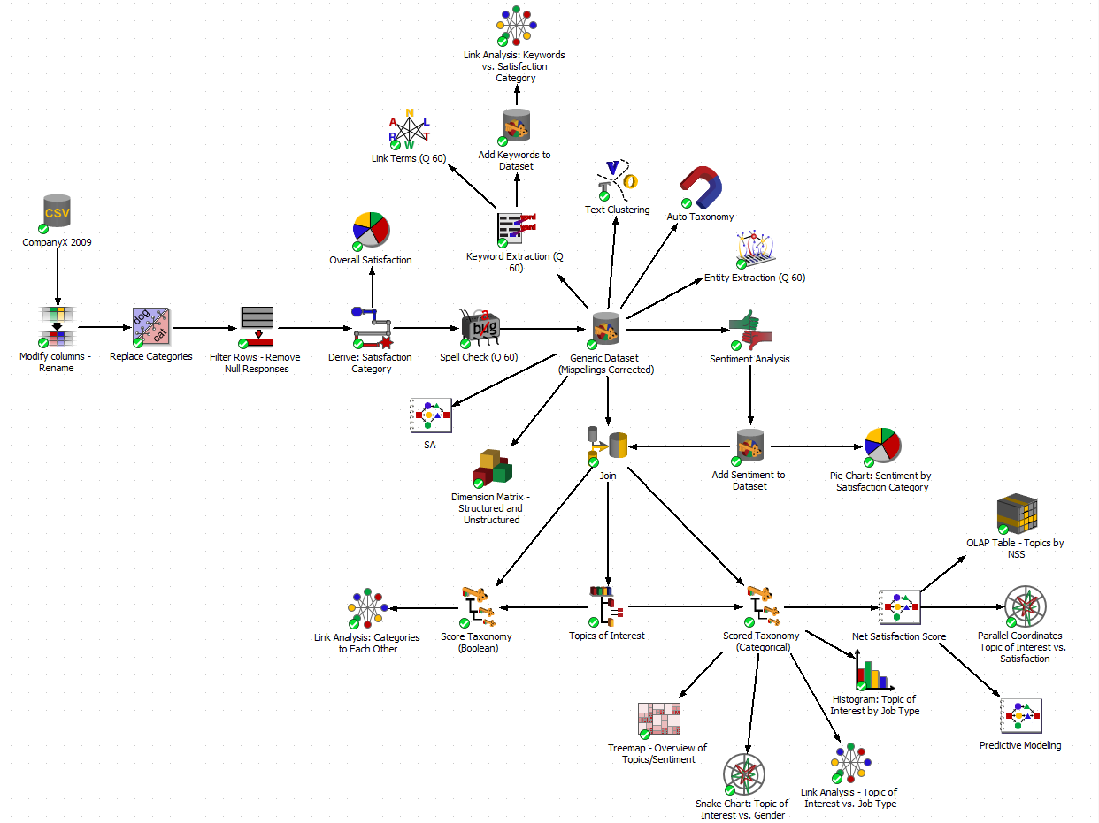
End-to-end data analysis
Analysis Script
Analysis scenarios are built in a drag-&-drop interface. Each node represents a step in the analysis process.

Slide 15
End-to-end data analysis
Methodology
Data Loading
Data Cleansing
Data-Driven Analysis
Visualizations
Analyst-Driven Analysis

Slide 16
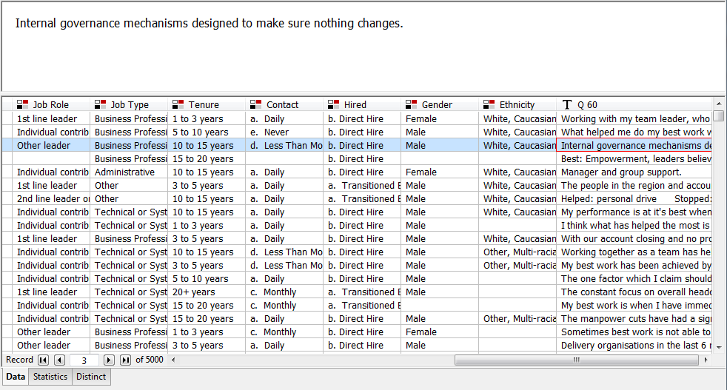
Data Loading
Structured attributes will be integrated with information extracted from open-ended comments for comprehensive analysis of feedback.

Slide 17


Data Loading
Summary statistics enable easy exploration of attributes

Slide 18
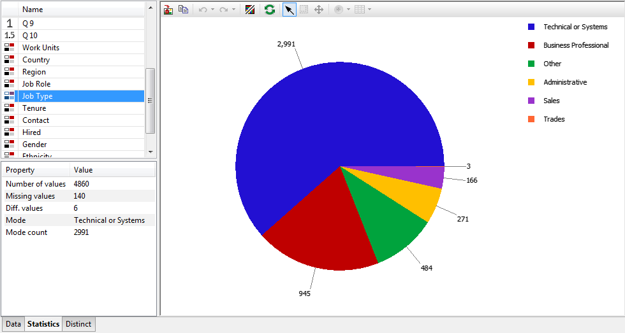
Data Loading
Column information can be summarized. Here, we quickly see the distribution of Job Types.

Slide 19
End-to-end data analysis
Methodology
Data Loading
Data Cleansing
Data-Driven Analysis
Visualizations
Analyst-Driven Analysis

Slide 20
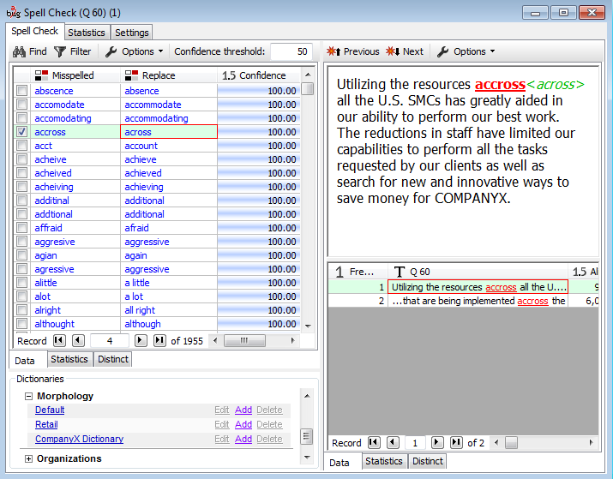
Outline
Spell Checking
Misspelled words are automatically detected…

Slide 21
Outline
Spell Checking
Misspelled words are automatically detected
and corrected.

Slide 22
Outline
Spell Checking
Customizable dictionaries allow for company and industry-specific analysis.

Slide 23
End-to-end data analysis
Methodology
Data Loading
Data Cleansing
Data-Driven Analysis
Visualizations
Analyst-Driven Analysis

Slide 24
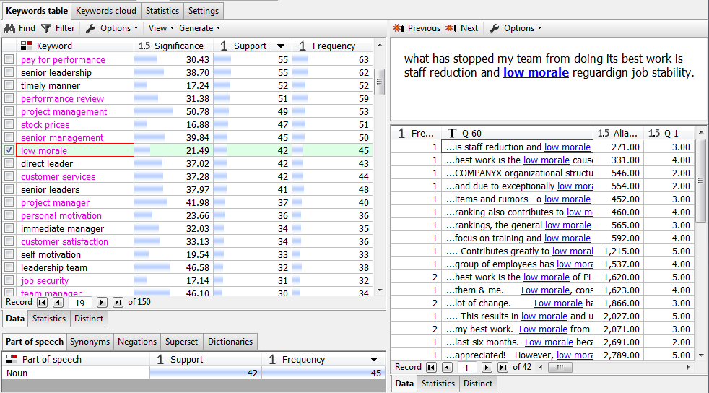
Outline
Keyword Extraction
Significant terms and phrases are automatically extracted from text.
Notes:
Focus on POS or direct vs. negated

Slide 25
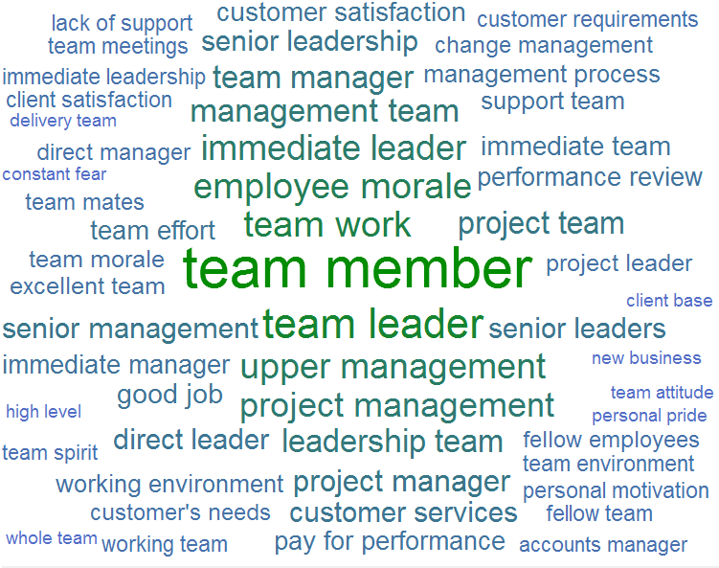
Outline
Keyword Extraction
Keyword cloud visually displays found keywords and phrases…

Slide 26
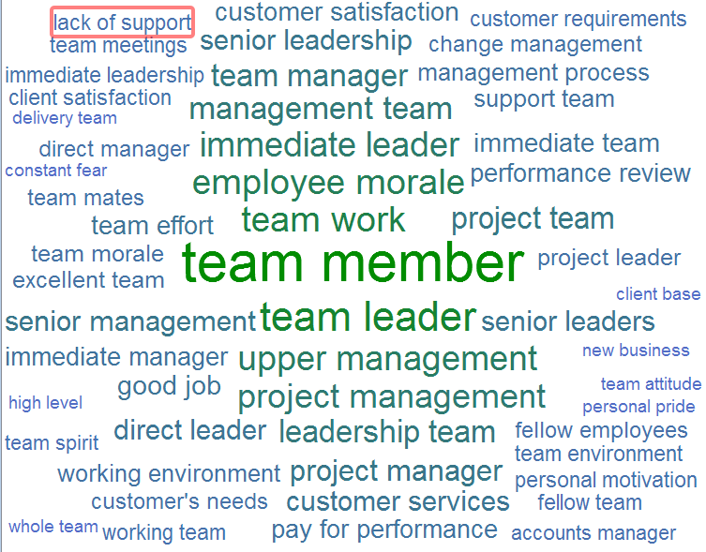
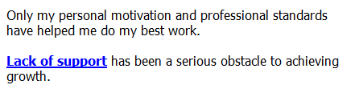
Outline
Keyword Extraction
…with drill-down to underlying records.

Slide 27
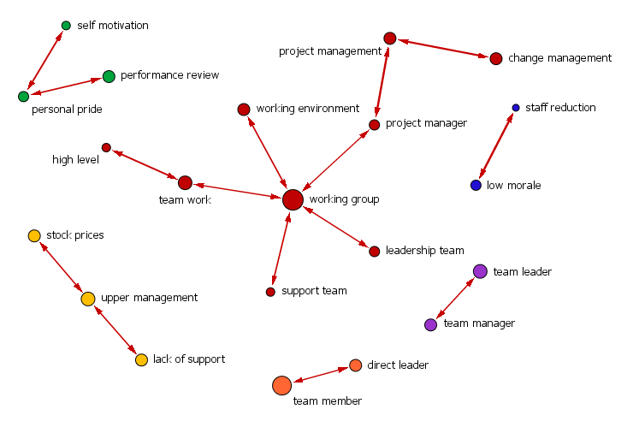
Outline
Link Terms
Links between co-occurring keywords illustrate concepts being discussed…

Slide 28
Outline
Link Terms

Slide 29
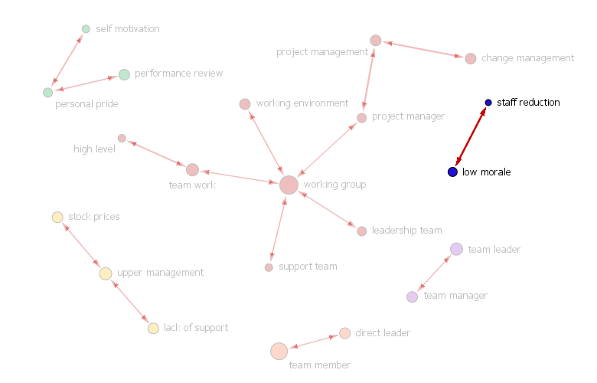
Outline
Link Terms
…such as staff reduction being related to low morale.

Slide 30
Outline
Link Terms
Can drill down to specific link.
Additionally, the battle against low morale as a result of the many staff reductions hinders my ability to focus on doing my best.

Slide 31
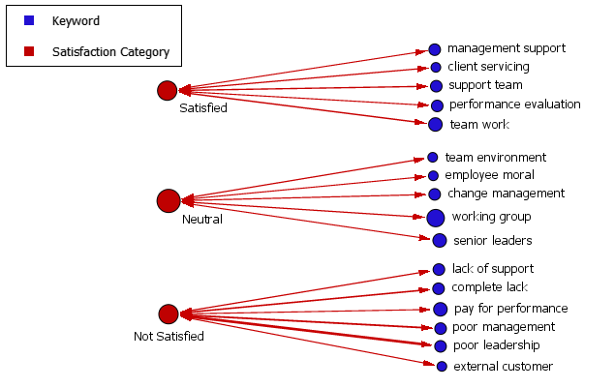
Outline
Links: Keywords vs. Satisfaction
Link Analysis shows correlations between categorical variables, with thicker links indicating a stronger correlation.

Slide 32
Outline
Links: Keywords vs. Satisfaction

Slide 33
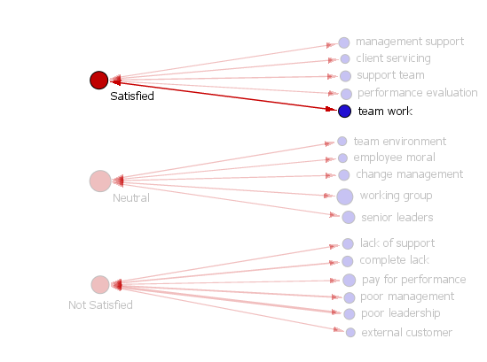
Outline
Links: Keywords vs. Satisfaction
Can drill down to specific links.

Slide 34
Outline
Links: Keywords vs. Satisfaction
Satisfied employees mention teamwork...
Collaboration and team work has helped me do my best work.

Slide 35
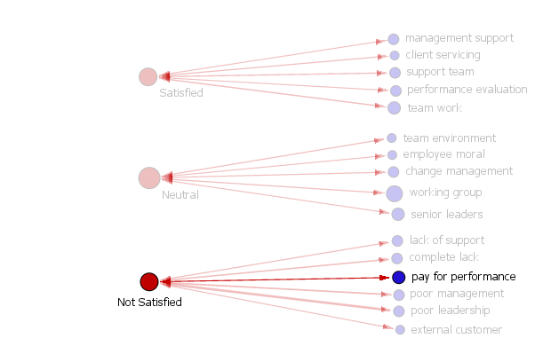
Outline
Links: Keywords vs. Satisfaction
…while dissatisfied employees mention “pay for performance.”
When employees ranked high in performance review only earn enough to cover cost of living, there is something seriously wrong with COMPANYX’s pay for performance.

Slide 36
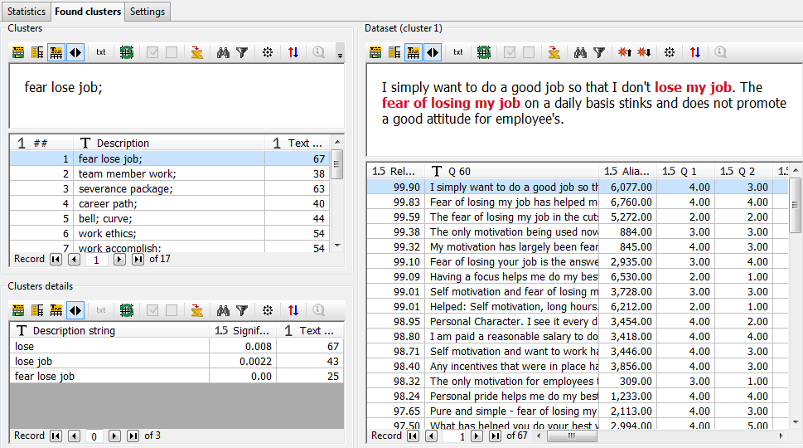
Text Clustering
A classification model is automatically generated according to the presence of groups or clusters of words within a text column.

Slide 37
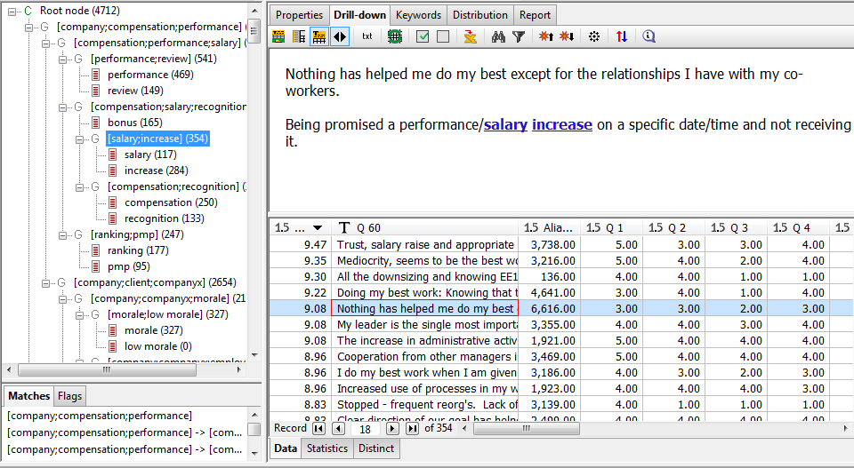
Outline
Auto Taxonomy
PolyAnalyst supports Automatic Taxonomy generation for pattern-based automatic hierarchical text classification.

Slide 38
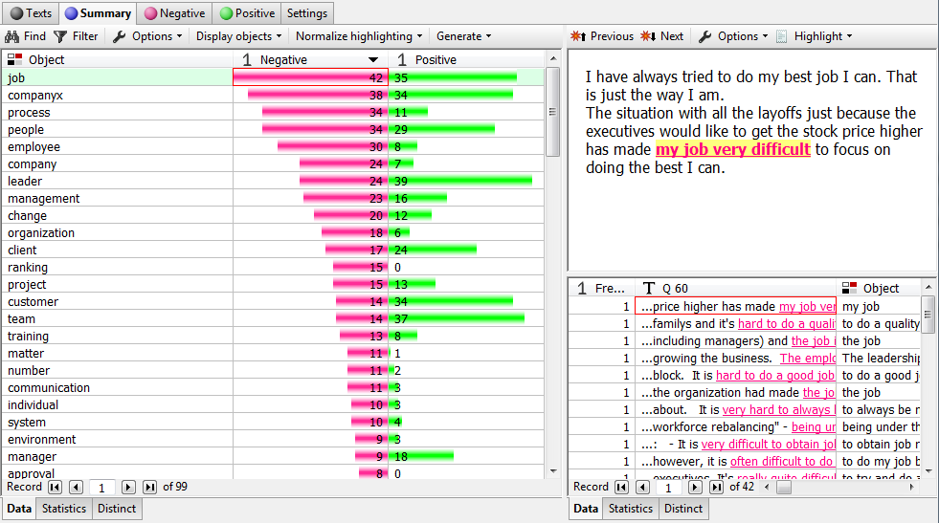
Outline
Sentiment Analysis
Positive and negative sentiment is automatically identified.
Notes:
Summary Tab → Objects of sentiment, i.e., things that sent. Is being expressed about. Most frequent neg → job

Slide 39
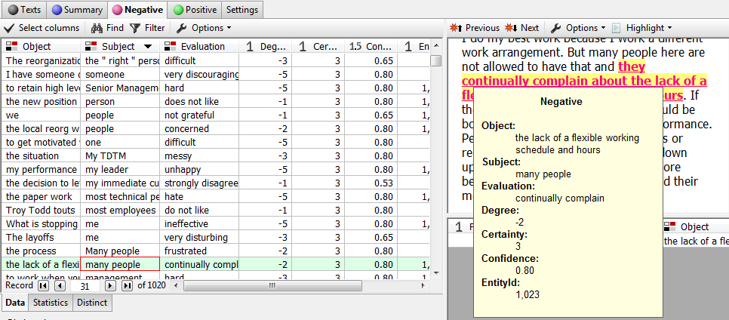
Outline
Sentiment Analysis
Along with object, subject, evaluation, and degree.
Notes:
ID “continually complain” as an expr. Of negative sent.

Slide 40
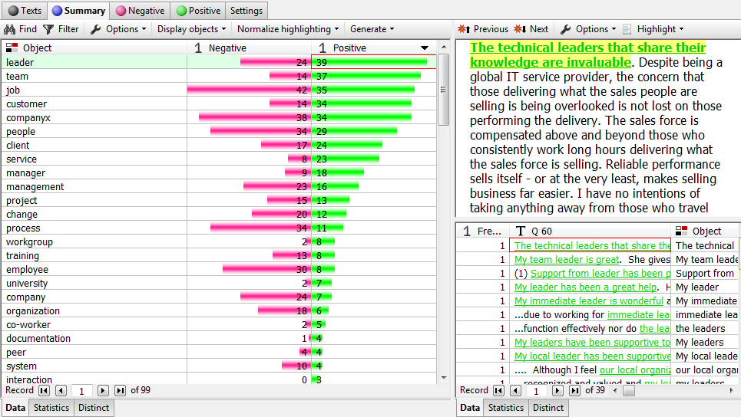
Outline
Sentiment Analysis

Slide 41
Outline
Sentiment Analysis

Slide 42
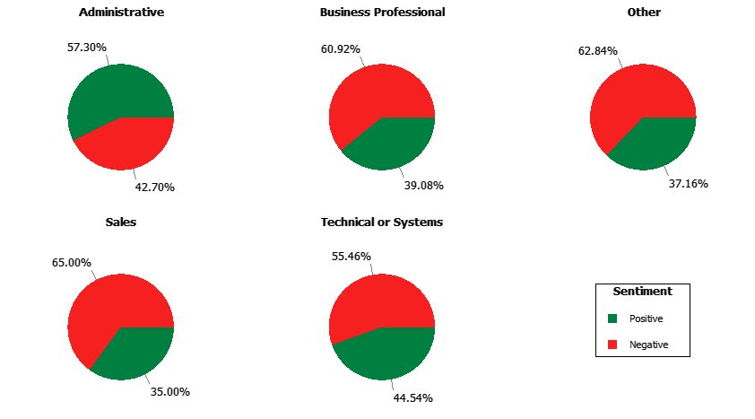
Outline
Sentiment by Job Type

Slide 43
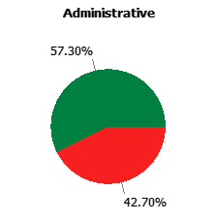
Outline
Sentiment by Job Type
Most positive job type is Administrative.

Slide 44
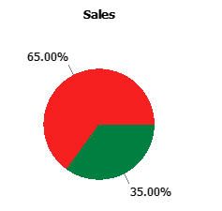
Outline
Sentiment by Job Type
Most negative job type is Sales.

Slide 45
End-to-end data analysis
Methodology
Data Loading
Data Cleansing
Data-Driven Analysis
Visualizations
Analyst-Driven Analysis

Slide 46
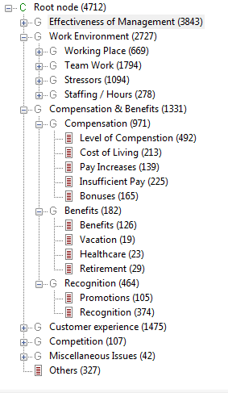
Outline
Analyst-Driven Categorization
Custom taxonomy categorize employee concerns expressed in verbatim responses

Slide 47
Analyst-Driven Categorization
Results of Exploratory Analyses
Taxonomy Categories

Slide 48
Analyst-Driven Categorization
Results of Exploratory Analyses:
  “staff reduction”
“fear of losing job”
“pay for performance”
“salary increase”
“low morale”
Main
Categories:
Job Security
Compensation
Motivation
Notes:
Staff red. From KE, fear of losing from TC

Slide 49
Outline
Analyst-Driven Categorization
Topics of Interest
Category
Sub-Category
Job Security
Management
Stressors
Fairness
Staffing/Hours
Work Environment
Work-Life Balance
Working Place
Understaffed
Compensation
Workload
Team Work
Harassment

Slide 50
Analyst-Driven Categorization
Results of Exploratory Analyses:
  “staff reduction”
“fear of losing job”
“pay for performance”
“salary increase”
“low morale”
Main
Categories:
Job Security
Compensation
Motivation
Notes:
Pfp in KE, salary increase in Auto

Slide 51
Outline
Analyst-Driven Categorization
Topics of Interest
Category
Sub-Category
Compensation
Management
Salary
Cost of Living
Work Environment
Benefits
Pay Increases
Compensation
Insufficient Pay
Recognition
Bonuses

Slide 52
Analyst-Driven Categorization
Results of Exploratory Analyses:
  “staff reduction”
“fear of losing job”
“pay for performance”
“salary increase”
“low morale”
Main
Categories:
Job Security
Compensation
Motivation
Notes:
Low morale from KE

Slide 53
Outline
Analyst-Driven Categorization
Topics of Interest
Category
Sub-Category
Motivation
Management
People
Management
Micromanagement
Organization
Work Environment
Communication
Development
Professionalism
Compensation
Supervisor
Resources
Upper Leadership

Slide 54
Outline
Analyst-Driven Categorization
Expressions query the data to assign records to categories

Slide 55
Outline
Analyst-Driven Categorization
Category Sub-Category Verbatim
Salary
Pay Increases
Cost of Living
"I was promoted to the next level but still did not get a raise."
“…only receive compensation enough to cover cost of living, there is something seriously wrong....”
“I have not had any salary increase for 20 months. "
“…a 3.5% raise over 2 years doesn’t even keep up with inflation.”
Notes:
Created by analyst. Access results of data-driven directly using, e.g., Keyword function, or search for patterns using other PDL functions → proximity constraints, direct vs. negated, semantic relationships

Slide 56
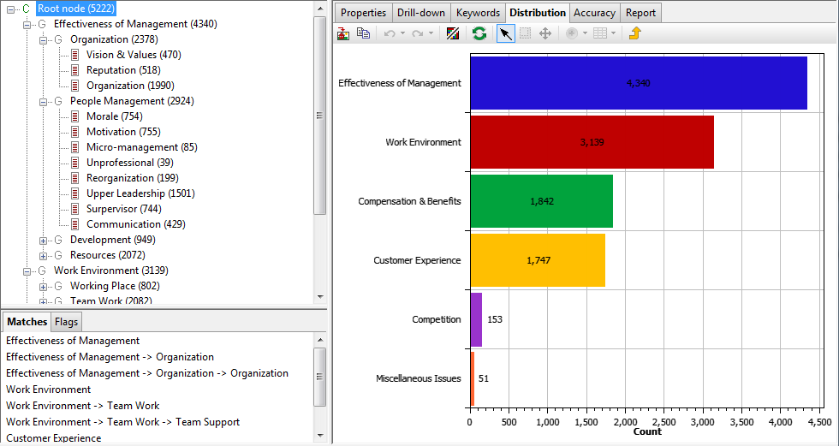
Outline
Analyst-Driven Categorization

Slide 57
End-to-end data analysis
Methodology
Data Loading
Data Cleansing
Data-Driven Analysis
Visualizations
Analyst-Driven Analysis

Slide 58
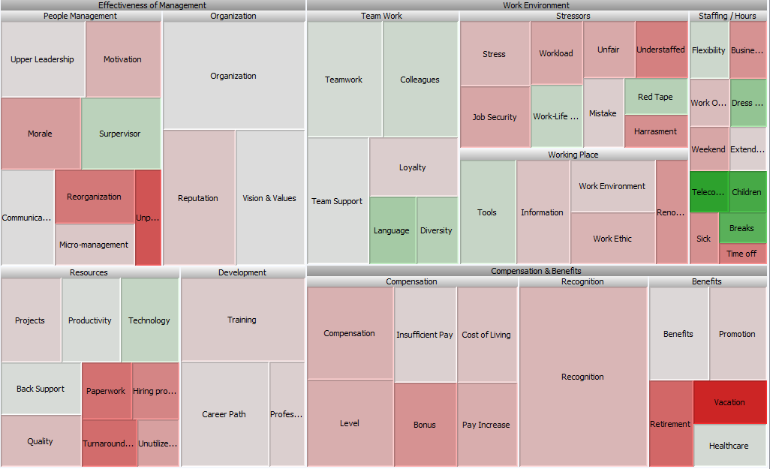
Outline
Overall Topics of Interest
Treemap: Topics of Interest by Degree of Sentiment
Negative
Positive

Slide 59
Outline
Overall Topics of Interest
Treemap: Topics of Interest by Degree of Sentiment
Negative
Positive
The treemap displays hierarchical data in nested rectangles.
Size is proportional to the number of employees expressing each concern, while color represents the degree of sentiment.

Slide 60
Outline
Overall Topics of Interest
Treemap: Topics of Interest by Degree of Sentiment
Negative
Positive
As a mother of 2 young children, being allowed to work a reduced work week and flexing my hours has helped me do my best work.

Slide 61
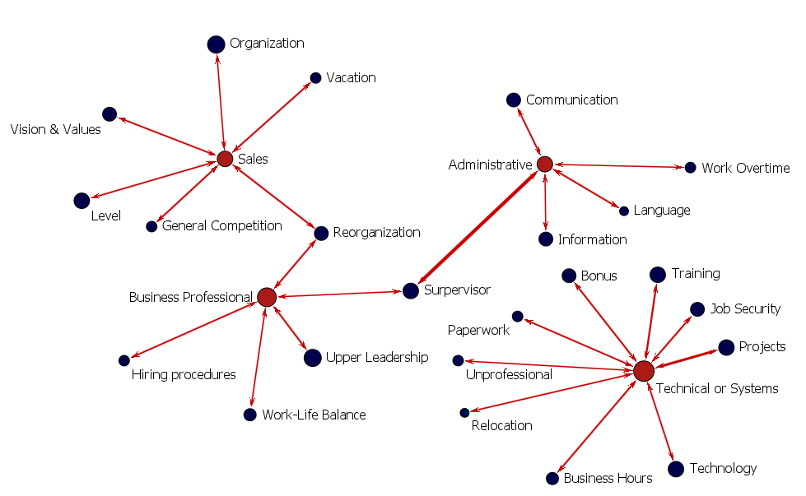
Outline
Topics of Interest by Job Type
Link Analysis: Topics of Interest by Job Type

Slide 62
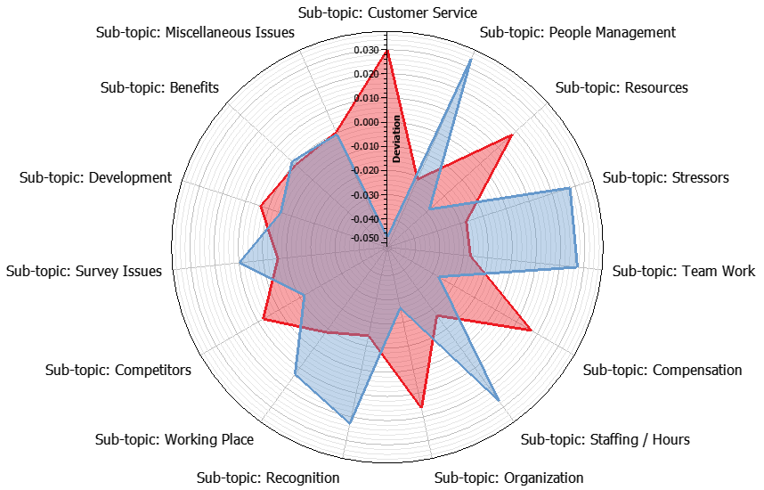
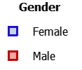
Outline
Topics of Interest by Gender
Parallel Coordinates: Topics of Interest by Gender
Shows deviations from the mean across gender. Points near the edge of the circle indicate that gender expressed that concern more frequently.

Slide 63
Outline
Employee Segmentation
Based on employees’ average responses to the ranking questions, they are classified into one of three satisfaction groups:
Average Response | Satisfaction Category
≤ 2.5 | Not Satisfied
2.5 < Average Response < 4 | Neutral
≥ 4 | Satisfied

Slide 64

Outline
Integrating Structured Responses
For each Taxonomy category, a relative net satisfaction score (NSS) was calculated as:
$$NSS$$
$$=\frac{Number of Satisfied −Number of Not Satisfied}{Total Number of Satisfied, Neutral, and Not Satisfied }×100$$
A positive NSS indicates there is a greater number of satisfied employees than not satisfied employees.
A negative NSS indicates there is a greater number of not satisfied employees than satisfied employees.

Slide 65
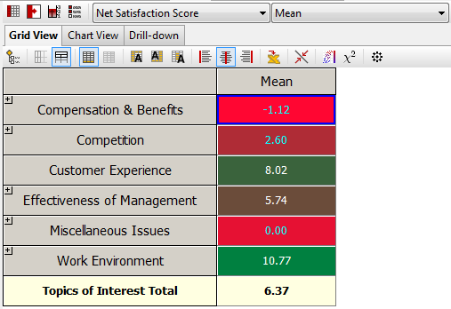
Outline
Mean Net Satisfaction Score
OLAP Table: Topics of Interest by NSS

Slide 66
Outline
Mean Net Satisfaction Score
OLAP Table: Topics of Interest by NSS

Slide 67
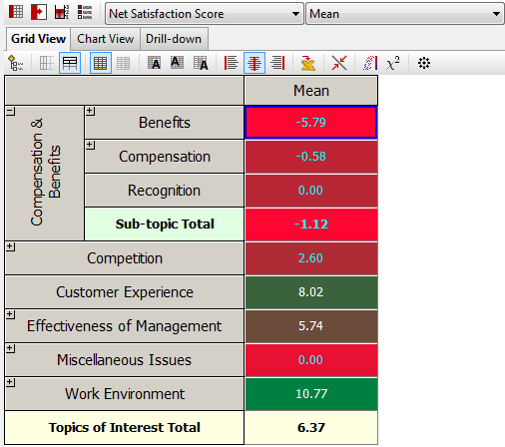
Outline
Mean Net Satisfaction Score
OLAP Table: Topics of Interest by NSS

Slide 68
Outline
Mean Net Satisfaction Score
OLAP Table: Topics of Interest by NSS

Slide 69
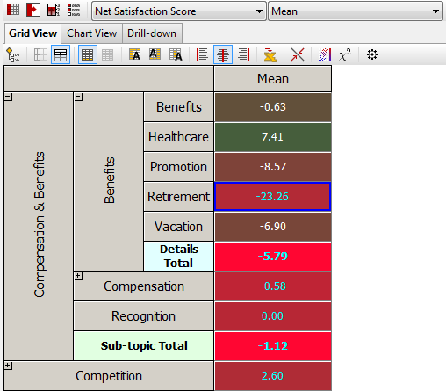
Outline
Mean Net Satisfaction Score
OLAP Table: Topics of Interest by NSS

Slide 70
Outline
Mean Net Satisfaction Score
OLAP Table: Topics of Interest by NSS
Drill down to specific records…

Slide 71
Outline
Mean Net Satisfaction Score
OLAP Table: Topics of Interest by NSS
I've seen too many good people forced out by this policy. I am forced to conclude that my chances of ever retiring from COMPANYX are slim.

Slide 72
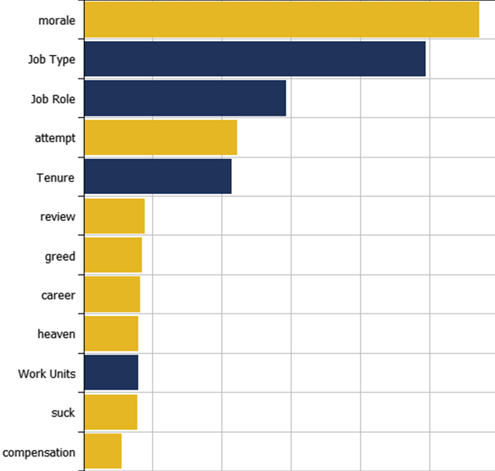
Predictive Modeling
Structured
Extracted from Text
Rank factors in order of predictive importance
Notes:
Improvement in accuracy which is equivalent 2% in predicting new loans

Slide 73
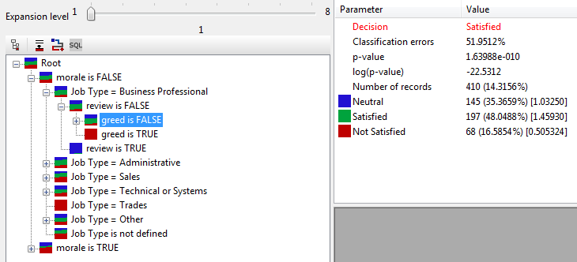
Predictive Modeling
Notes:
Improvement in accuracy which is equivalent 2% in predicting new loans

Slide 74
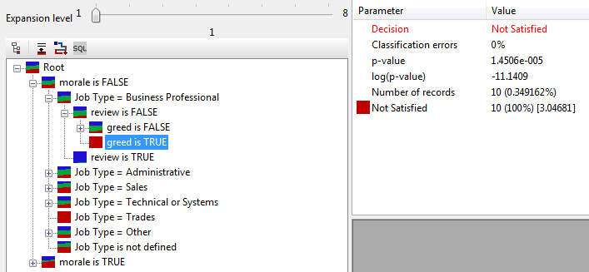
Predictive Modeling
Notes:
Improvement in accuracy which is equivalent 2% in predicting new loans

Slide 75
Conclusion
Decrease Turnover & Increase Productivity
Better Identify Employee Concerns
Improve Employee Satisfaction

Slide 76
Outline
Conclusion
PolyAnalyst derives actionable insights from verbatim survey comments

Slide 77

Contacting Megaputer
Questions?

