Slide 1

PolyAnalyst
Web Report Training
Visualization
in PolyAnalyst
Megaputer Intelligence
megaputer.com
© 2014 Megaputer Intelligence Inc.
Notes:
Title page

Slide 2

Outline
Agenda
Readily accessible visuals
Charts nodes
All the charts in PolyAnalyst provide the drill-down capability!

Slide 3
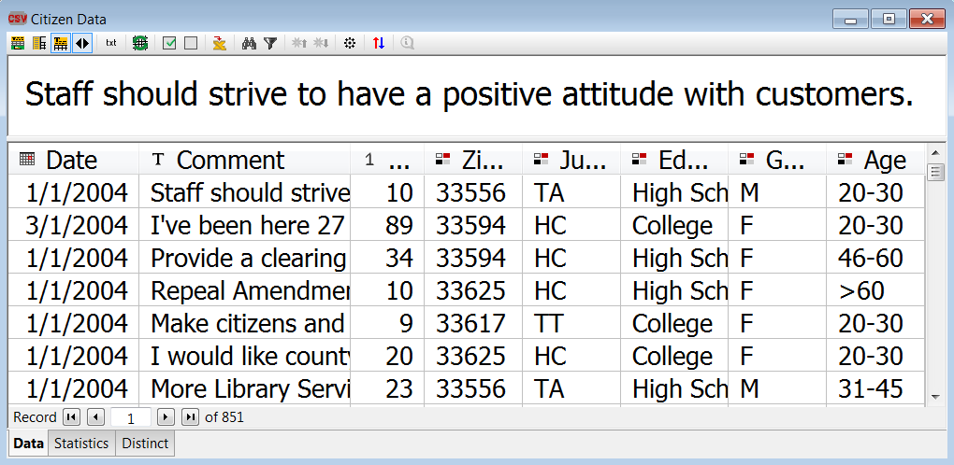
Outline
Handy Visuals – Data Grid
All the data grid views has a Statistics tab:

Slide 4
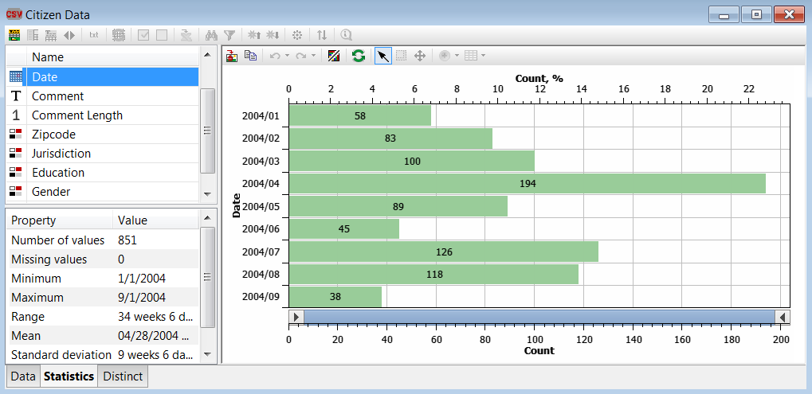
Outline
Handy Visuals – Data Grid
There are visuals right in the Statistics tab:

Slide 5
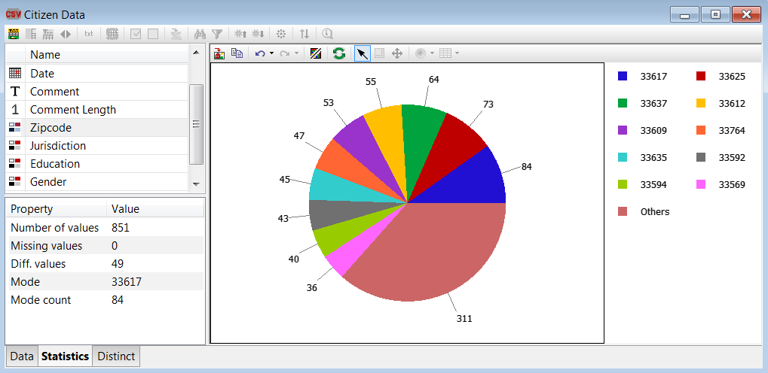
Outline
Handy Visuals – Data Grid
There are charts right in the Statistics tab:

Slide 6
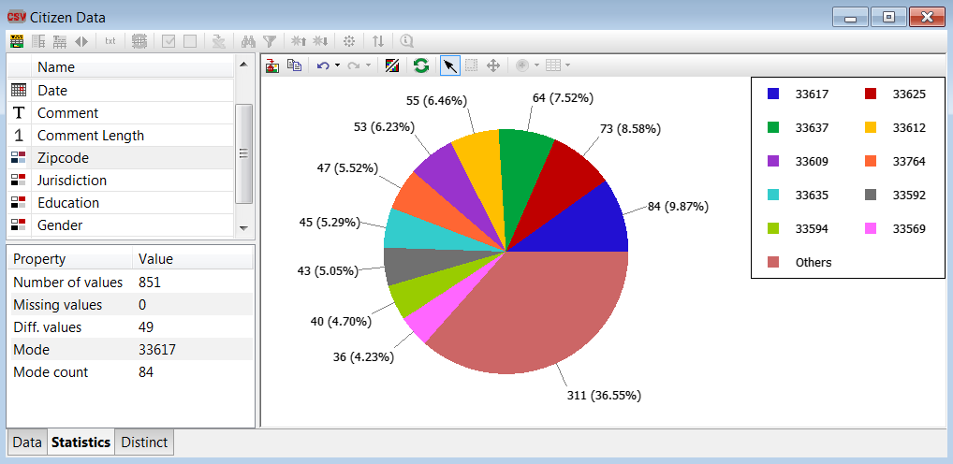
Outline
Handy Visuals – Data Grid
You can even configure the charts in the Statistics tab:

Slide 7
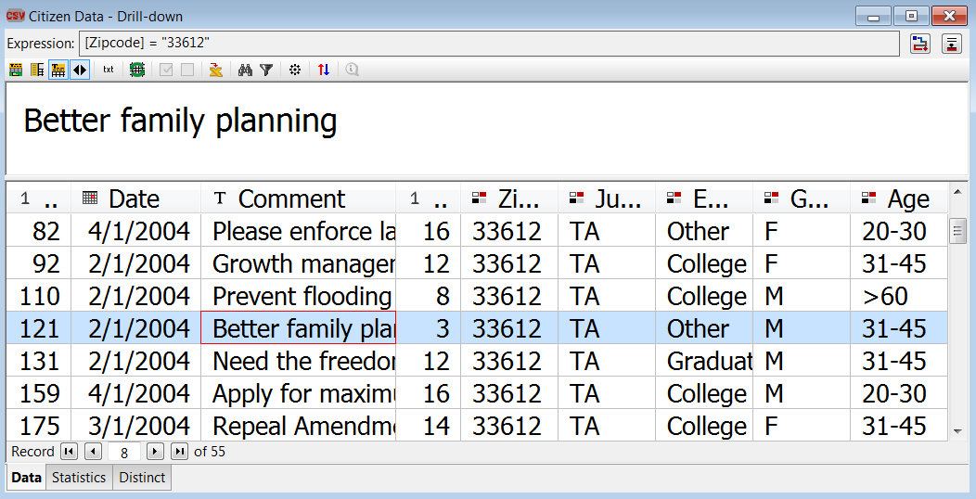
Outline
Handy Visuals – Data Grid
And sure enough, you can do drill-downs right from the Statistics tab:

Slide 8
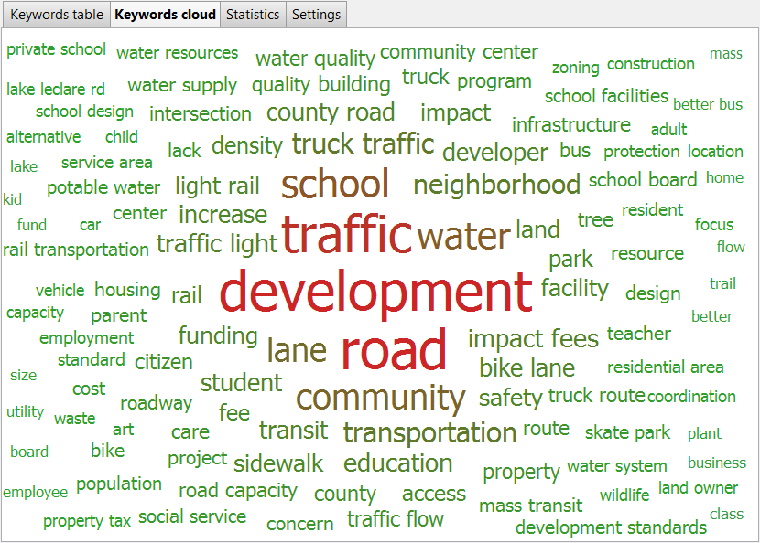
Outline
Handy Visuals – Keyword Extr.
Keywords Cloud in the Keyword Extraction view

Slide 9
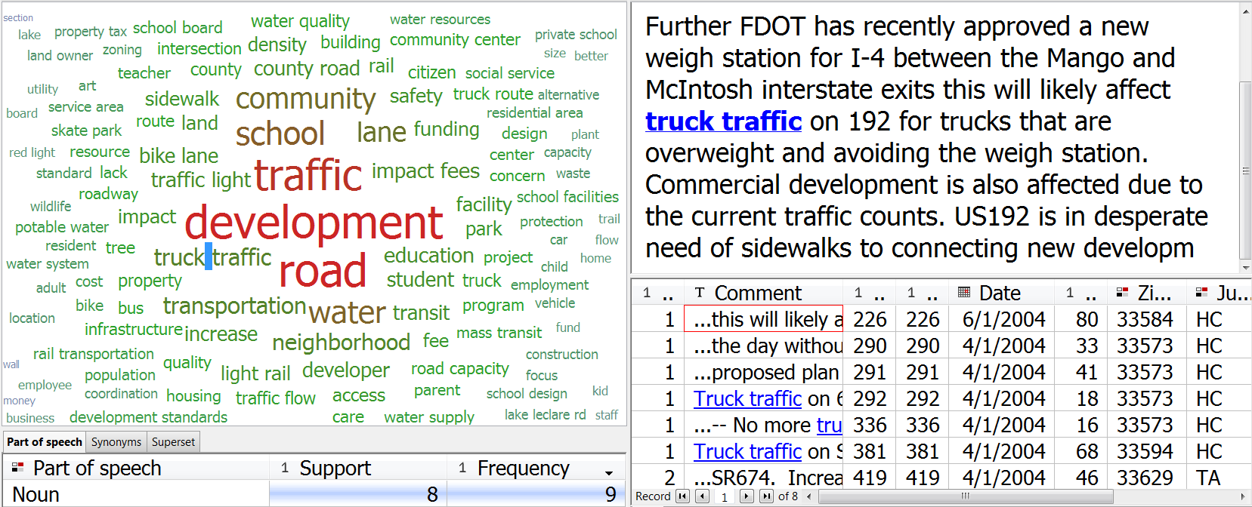
Outline
Handy Visuals – Keyword Extr.
Drill-down is available in the Keywords Cloud:

Slide 10
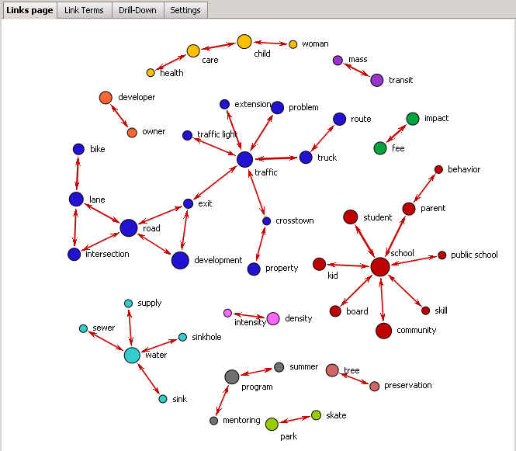
Outline
Handy Visuals – Keyword Extr.
Link Terms from KE:

Slide 11

Outline
Agenda
Readily accessible visuals
Charts nodes
All the charts in PolyAnalyst provide the drill-down capability!

Slide 12
Outline
Nodes – List
A list of charts nodes in PolyAnalyst
Area Chart
Bar Chart
Box & Whisker Plot
Graph
Histogram
Line Chart
Link Chart
Parallel Coordinates
Pie
Plot
Profile Graph
Scatterplots Matrix
Treemap
Trend Graph
Social Network Analysis
GIS

Slide 13
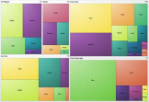
Outline
Nodes – Treemap
A treemap displays hierarchical data in nested rectangles.
  Great for showing levels of taxonomies.
  Each category is a rectangle.
  Subcategories are tiled as nested rectangles.
  Can use size and color to show structured values related to each category.

Slide 14
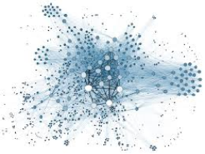
Outline
Nodes – Social Network
A social network chart displays relationships in social networks.
Central object has large centrality and betweenness. Thus it is connected to similar neighbors and serves as one of the links of many shortest paths between other objects;
Powerful object has large centrality but small betweenness;
Ordinary object has small centrality and betweenness;
Transitional object has small centrality but large betweenness. Thus it is not connected to many objects but serves as one of the links of many shortest paths between other objects;
Remote object has small centrality and betweenness like the ordinary object, plus is situated far away from the majority of other objects.

Slide 15
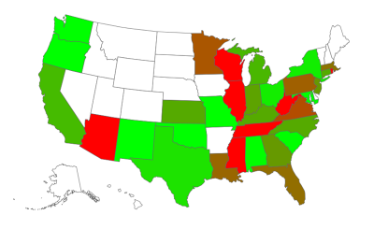
Outline
Nodes – GIS
A GIS System is used to Capture, Store, Manipulate, Analyze, Visualize Geographic Data.

Slide 16
Contacting Megaputer
Questions?
Megaputer Intelligence
megaputer.com

