Slide 1

PolyAnalyst
Web Report Training
Automating Analytics
In PolyAnalyst
Megaputer Intelligence
www.megaputer.com
© 2014 Megaputer Intelligence Inc.

Slide 2

Outline
TIMES ARE A-CHANGIN’
Automated Execution
Command line
Scheduler
  Server start
  Specified time
Alerts
Types of Alerts
Alert Modes
Email
Text message
Configuration
User Profile
SMTP server
Port availability

Slide 3
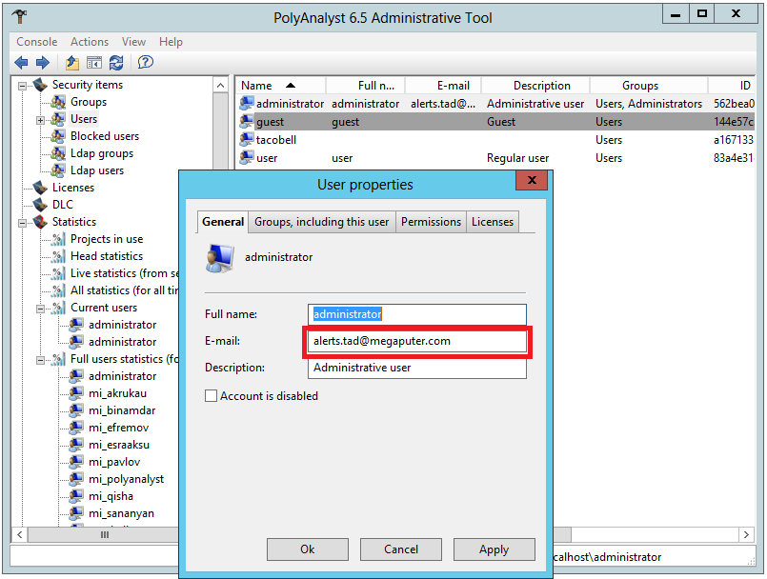
Outline
CONFIGURATION
There must be an email id specified for the user in the user profile

Slide 4
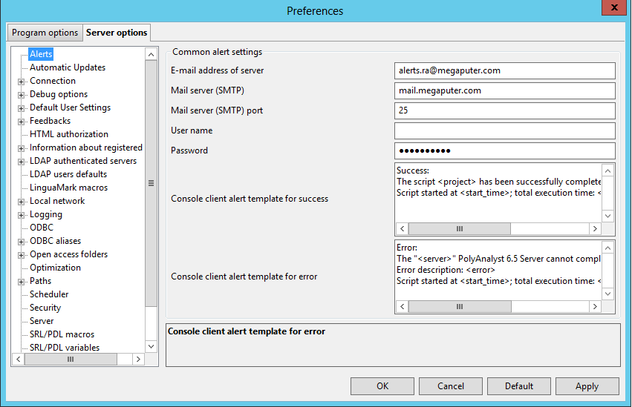
Outline
CONFIGURATION
Outgoing email (SMTP) server configuration

Slide 5
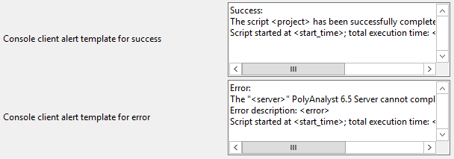
Outline
CONFIGURATION
Outgoing email (SMTP) server configuration
“From” email id
Does not need to be a real email ID!
Fields not required if SMTP server does not require authentication
MACROS
<project> - Project name
<server> - Server IP
<start_time> - Execution start time
<time> - Project execution period
Templates for execution success/failure emails

Slide 6
Outline
AUTOMATING EXECUTION
COMMAND LINE
1. Create execution XML
<?xml version="1.0" encoding="UTF-8" standalone="no" ?>
<Node>
<Server Server_name="localhost" Port="5063" User_name="administrator" Password="temp_pwd"></Server>
<Object Project_ID="b0e7565d-455b-478a-a9b7-65678655be77">
<Node_name>
<Node_name>CompanyX Employee Satisfaction Survey.csv</Node_name>
<Node_name>Tide-New Feed.csv</Node_name>
</Node_name>
</Object>
</Node>
* For publishing web-reports, leave out the portion in red

Slide 7

Outline
AUTOMATING EXECUTION
COMMAND LINE
1. Create execution XML
NOTE:
Only one project per XML file!
Save XML files in :
…\Megaputer Intelligence\PolyAnalyst 6.5\Bin (for 32-bit installation)
…\Megaputer Intelligence\PolyAnalyst 6.5 Client Applications\Bin (Client installation)
2. Run XML through Windows command line
* For executing a series of projects, create separate XMLs for each project and a batch file to execute the XMLs in sequence

Slide 8
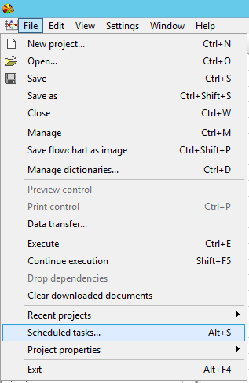
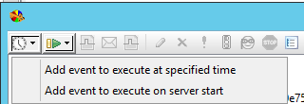
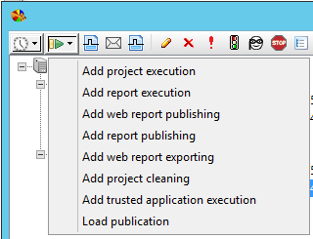
AUTOMATING EXECUTION
SCHEDULER
STEP 1:
Create scheduler event
Execute on server start
Execute at a specified time
STEP 2:
Assign tasks to be executed

Slide 9
ALERTS
In-project alerts
Used if a condition is satisfied during analysis of data in a project
Queue Completion alerts
    Used to indicate completion of a scheduler event
Success/failure alerts
    Used to indicate whether execution of a particular project/report succeeded or failed

Slide 10
ALERTS
In-project alerts
Used if a condition is satisfied during analysis of data in a project
Queue Completion alerts
    Used to indicate completion of a scheduler event
Success/failure alerts
    Used to indicate whether execution of a particular project/report succeeded or failed

Slide 11
ALERTS
In-project alerts
Used if a condition is satisfied during analysis of data in a project
Queue Completion alerts
    Used to indicate completion of a scheduler event
Success/failure alerts
    Used to indicate whether execution of a particular project/report succeeded or failed

Slide 12
Contacting Megaputer
Questions?

