Slide 1

PolyAnalyst
Web Report Training
Gaining Insights from Facebook Pages
Megaputer Intelligence
www.megaputer.com
© 2014 Megaputer Intelligence Inc.

Slide 2

Companies want to know what customers are saying about their products

Slide 3

Traditional Way – Survey

Slide 4

Drawbacks with Surveys
Only reaching a small population
Time consuming in creating questions
Costly
Usually anonymous
Unidirectional (Customers → Provider)
Cover only a period of time

Slide 5
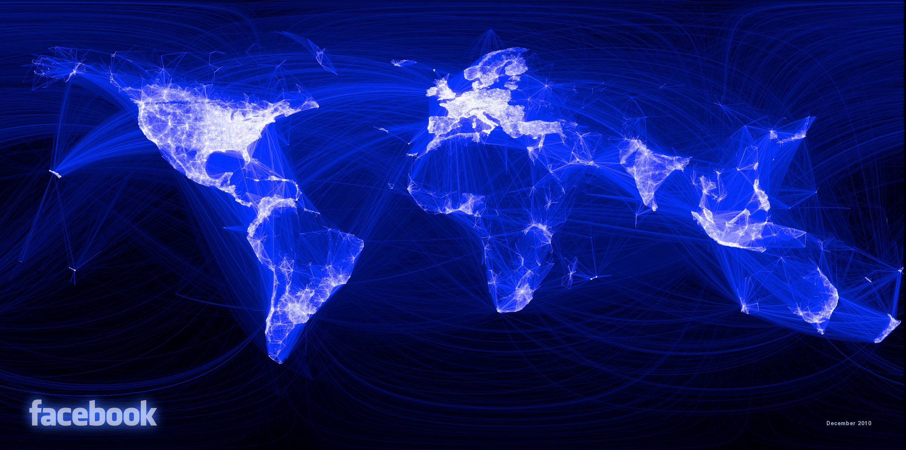
With development of technology and accessibility to World Wide Web come the
Social Media

Slide 6


Employing Social Media to help understand our customers and engage with them

Slide 7
Benefits of Social Media
Drawbacks with Surveys
Drawbacks with Surveys
Only reaching a small population
Time consuming in creating questions
Costly
Usually anonymous
Unidirectional (Customers → Provider)
Cover only a period of time
Only reaching a small population
Time consuming in creating questions
Costly
Usually anonymous
Unidirectional (Customers → Provider)
Cover only a period of time
Reach everyone using social media
No need to set up surveys
Minimal Charge
Check on user profiles
Engage with influential Users
  Back and forth communications
  Communication among customers
Update live

Slide 8

Results
Contacting Megaputer
An example with Facebook Pages
of Laundry Detergents

Slide 9

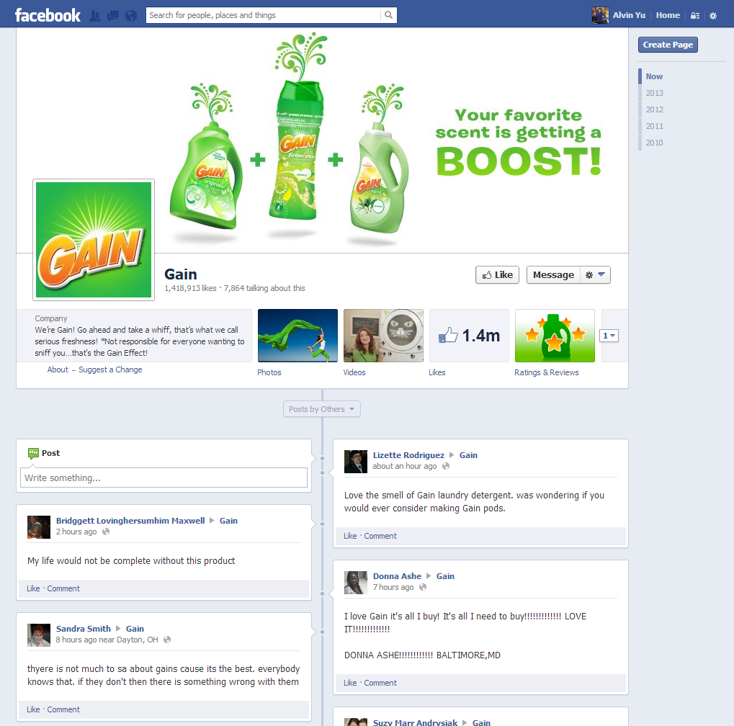
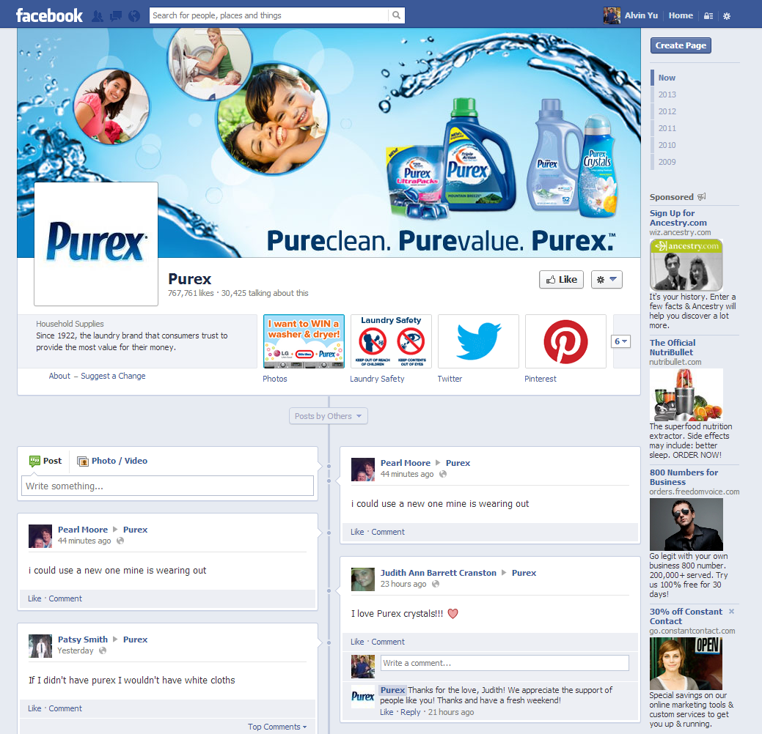
3 Brands of Laundry Detergent

Slide 10
Typical Task
Identify topics of interest
Monitor trends
Detect emerging issues
Analyze sentiment and determine key drivers of positive / negative sentiment
Visualize relations between topics and products, gender, regions, likes, etc.
Identify the most influential posters
Visualize the structure of the communication network

Slide 11
Typical Task
Identify topics of interest
Monitor trends
Detect emerging issues
Analyze sentiment and determine key drivers of positive / negative sentiment
Visualize relations between topics and products, gender, regions, likes, etc.
Identify the most influential posters
Visualize the structure of the communication network

Slide 12
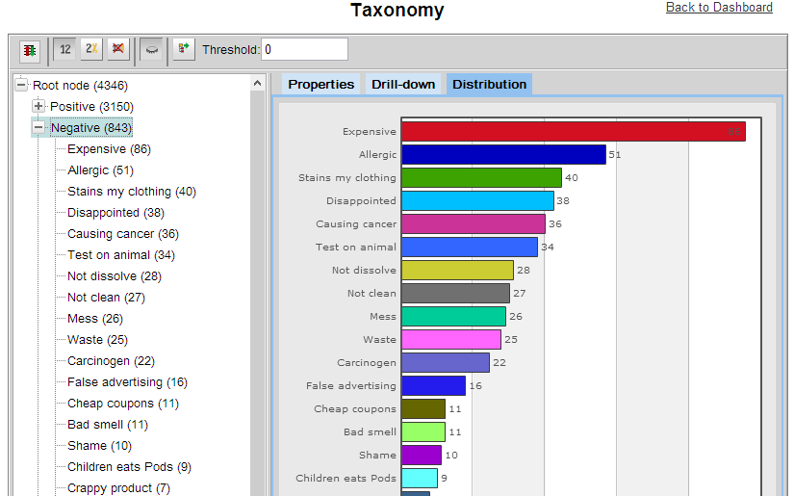
Popular Topics

Slide 13
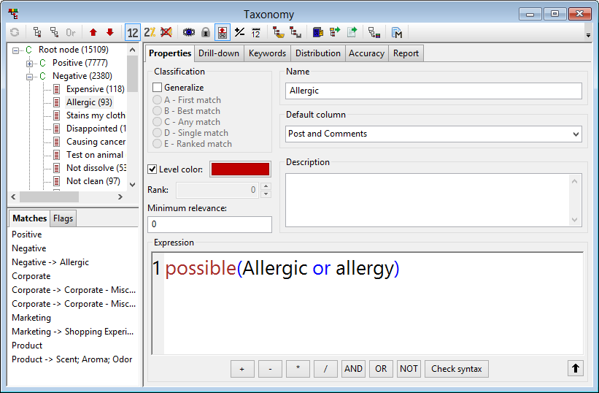
Popular Topics

Slide 14
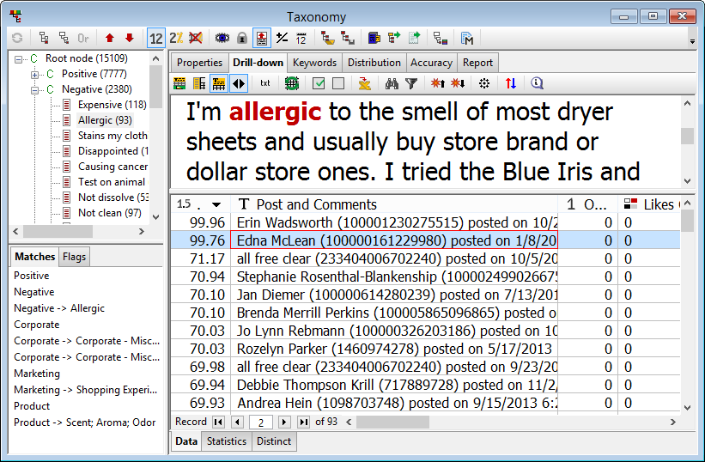
Popular Topics

Slide 15
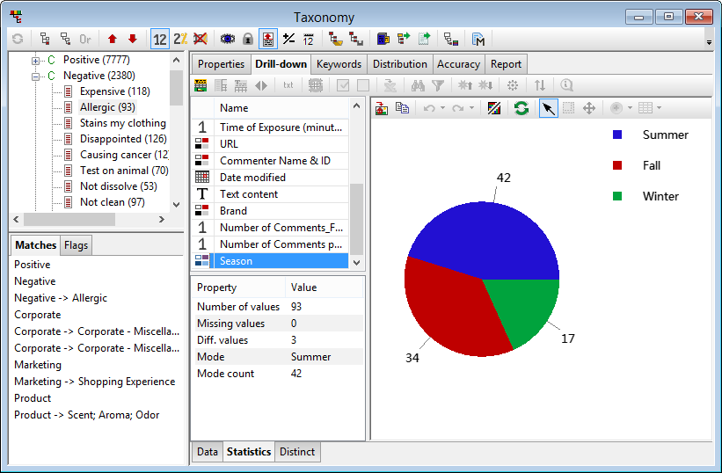
Popular Topics

Slide 16
Typical Task
Identify topics of interest
Monitor trends
Detect emerging issues
Analyze sentiment and determine key drivers of positive / negative sentiment
Visualize relations between topics and products, gender, regions, likes, etc.
Identify the most influential posters
Visualize the structure of the communication network

Slide 17
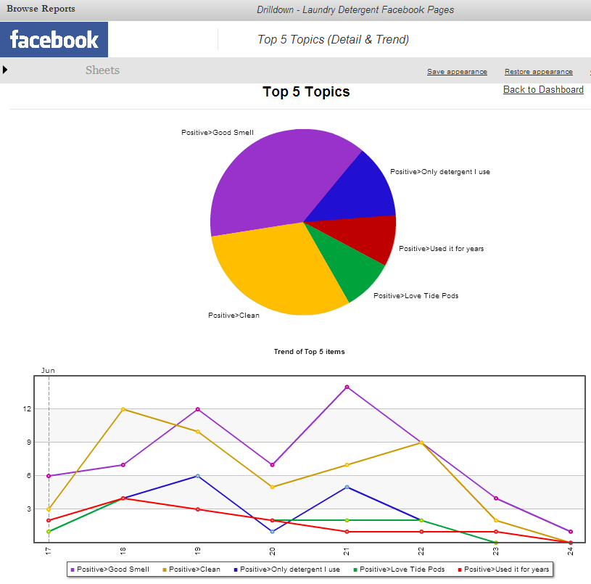
Topics and Trends

Slide 18
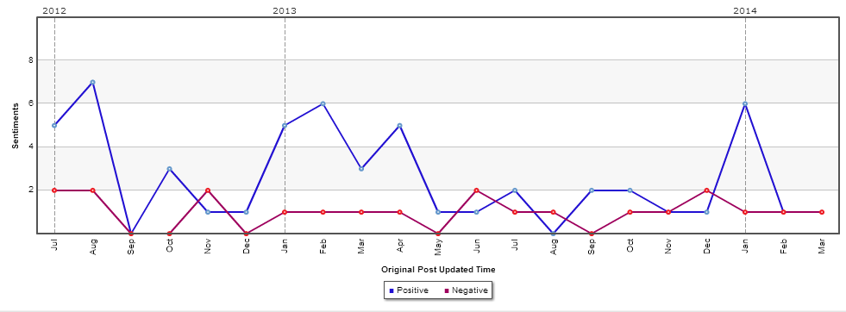
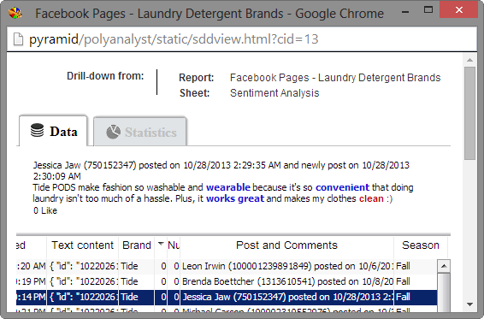
Sentiments and Trends

Slide 19
Typical Task
Identify topics of interest
Monitor trends
Detect emerging issues
Analyze sentiment and determine key drivers of positive / negative sentiment
Visualize relations between topics and products, gender, regions, likes, etc.
Identify the most influential posters
Visualize the structure of the communication network

Slide 20
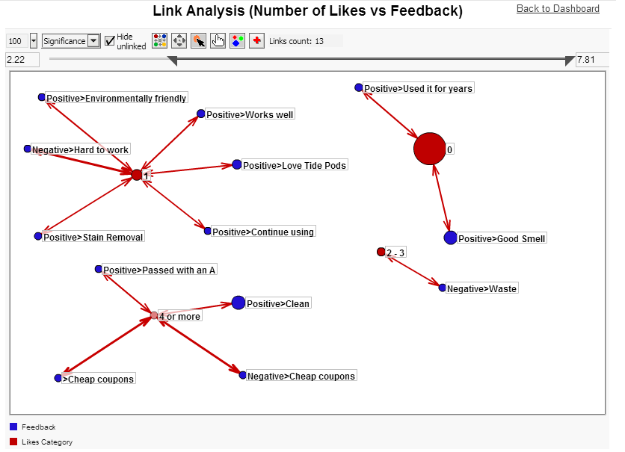
Number of Likes vs Feedback

Slide 21
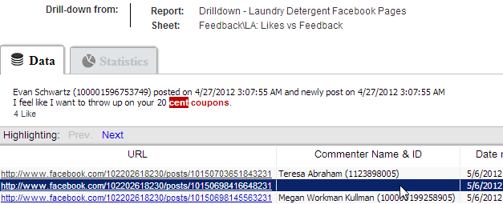
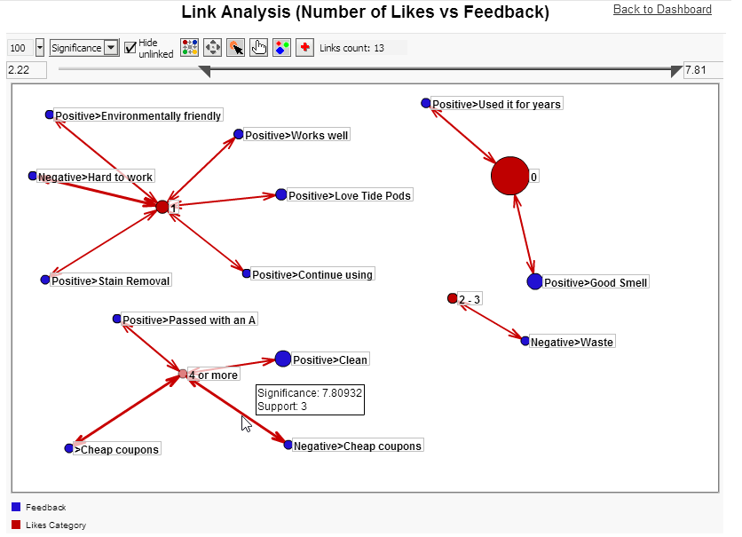
Number of Likes vs Feedback

Slide 22
Typical Task
Identify topics of interest
Monitor trends
Detect emerging issues
Analyze sentiment and determine key drivers of positive / negative sentiment
Visualize relations between topics and products, gender, regions, likes, etc.
Identify the most influential posters
Visualize the structure of the communication network

Slide 23
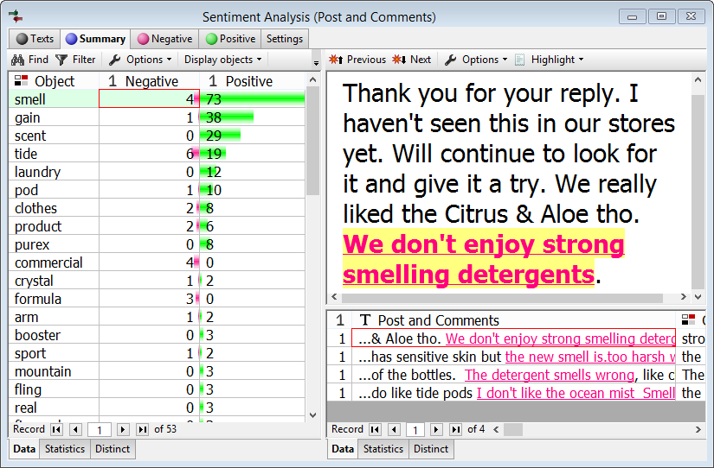
Sentiment Analysis Summary

Slide 24
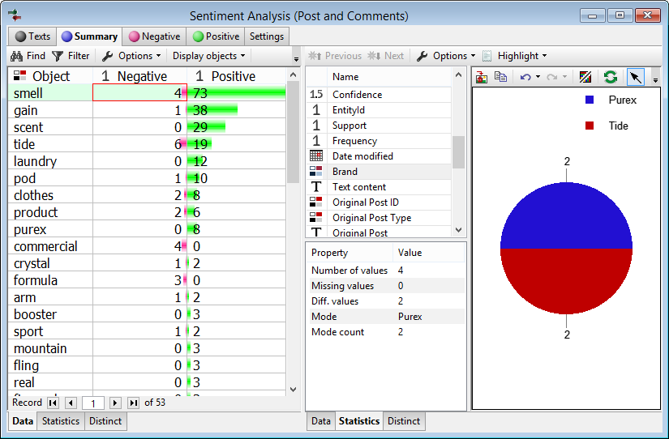
Sentiment Analysis Summary

Slide 25
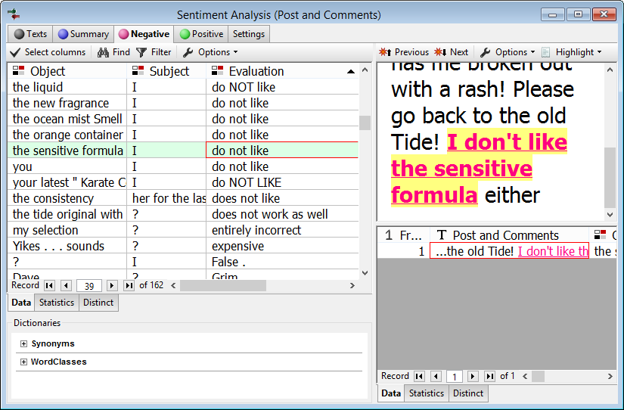
Sentiment Analysis Details

Slide 26
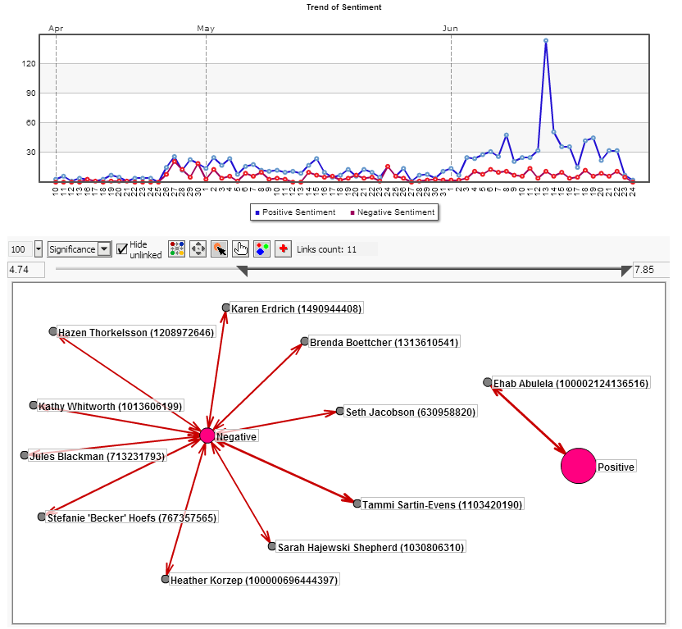
Users vs Sentiment

Slide 27
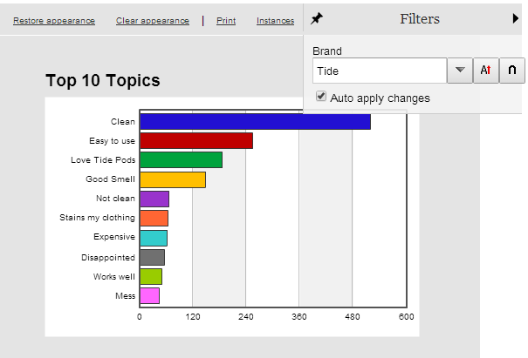
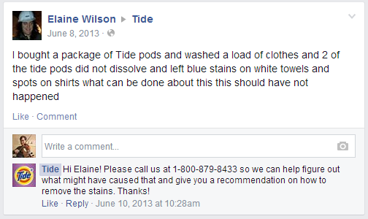
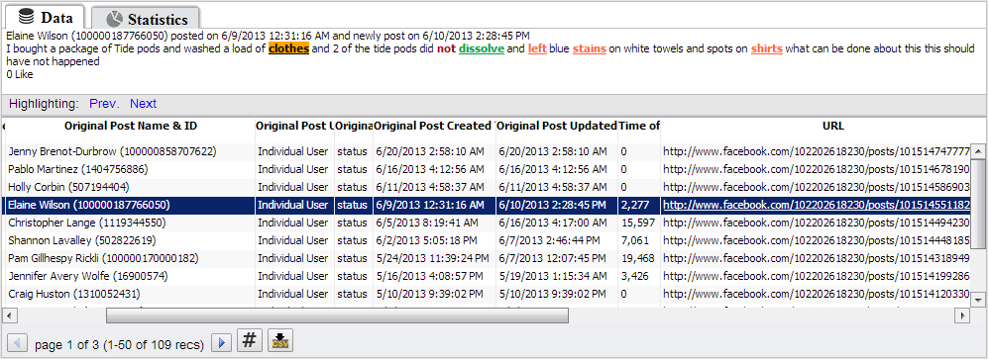
Engage with Negative Users

Slide 28
Typical Task
Identify topics of interest
Monitor trends
Detect emerging issues
Analyze sentiment and determine key drivers of positive / negative sentiment
Visualize relations between topics and products, gender, regions, likes, etc.
Identify the most influential posters
Visualize the structure of the communication network

Slide 29
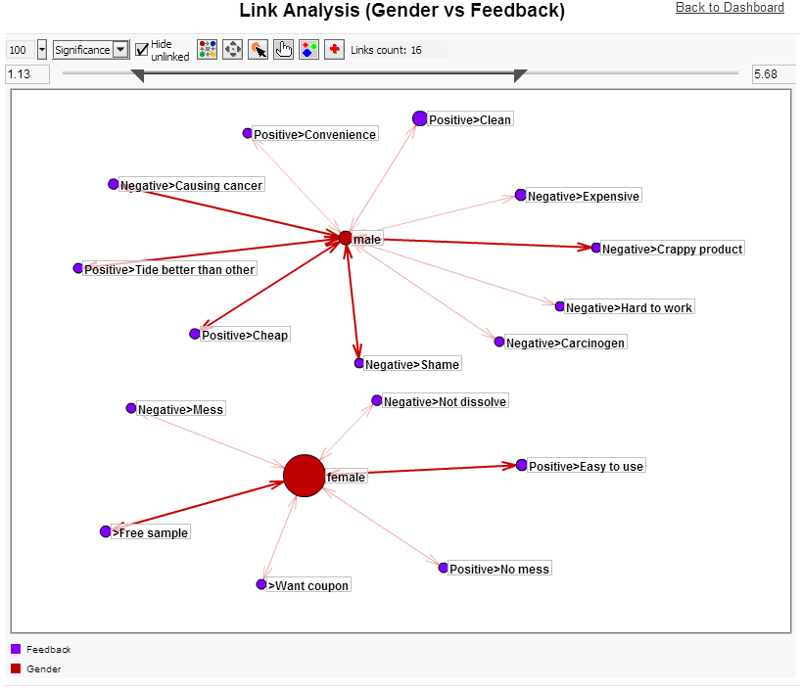
Gender vs Feedback

Slide 32
Typical Task
Identify topics of interest
Monitor trends
Detect emerging issues
Analyze sentiment and determine key drivers of positive / negative sentiment
Visualize relations between topics and products, gender, regions, likes, etc.
Identify the most influential posters
Visualize the structure of the communication network

Slide 33
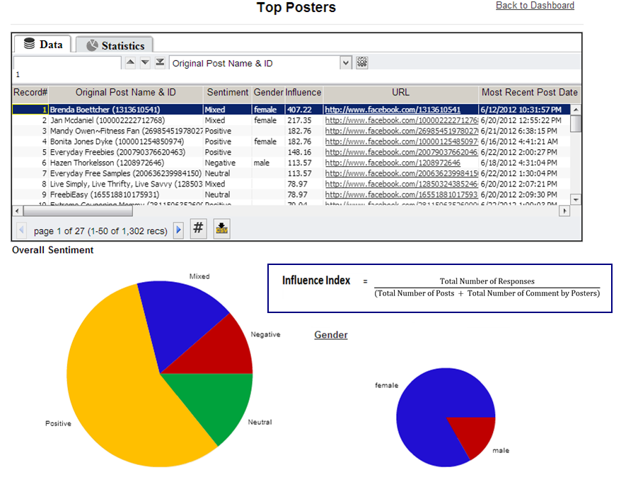

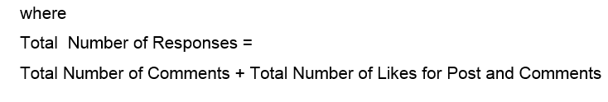
Top Posters

Slide 34
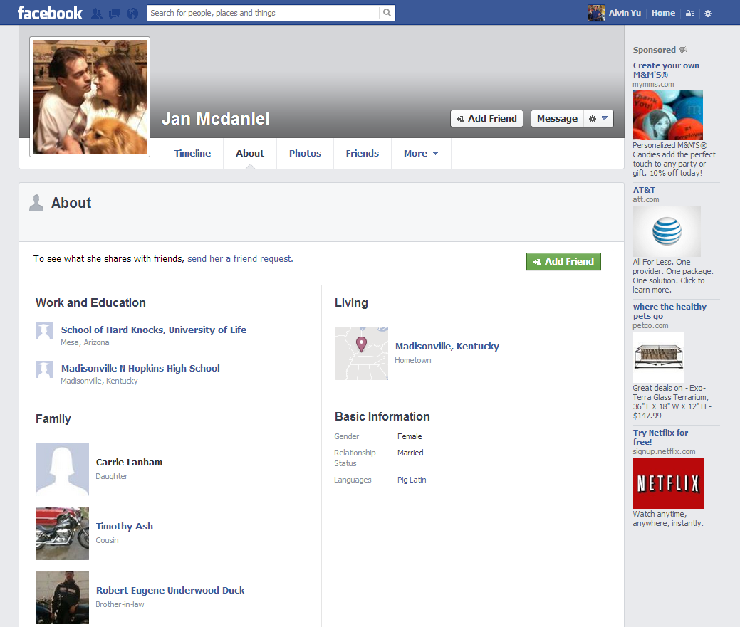
Top Posters
Top Posters

Slide 35
Typical Task
Identify topics of interest
Monitor trends
Detect emerging issues
Analyze sentiment and determine key drivers of positive / negative sentiment
Visualize relations between topics and products, gender, regions, likes, etc.
Identify the most influential posters
Visualize the structure of the communication network

Slide 36
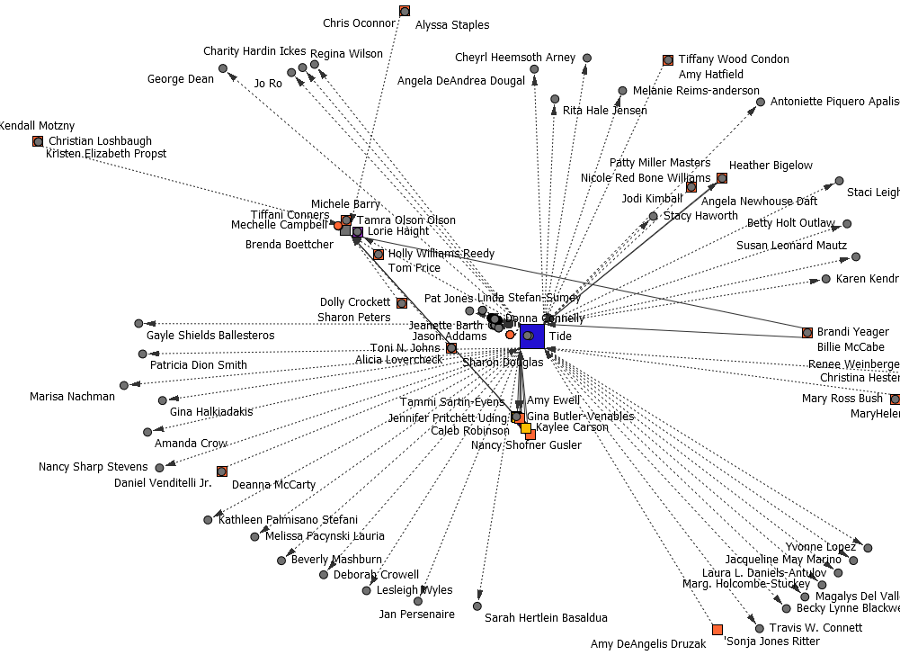
Tide Page’s Social Network

Slide 37
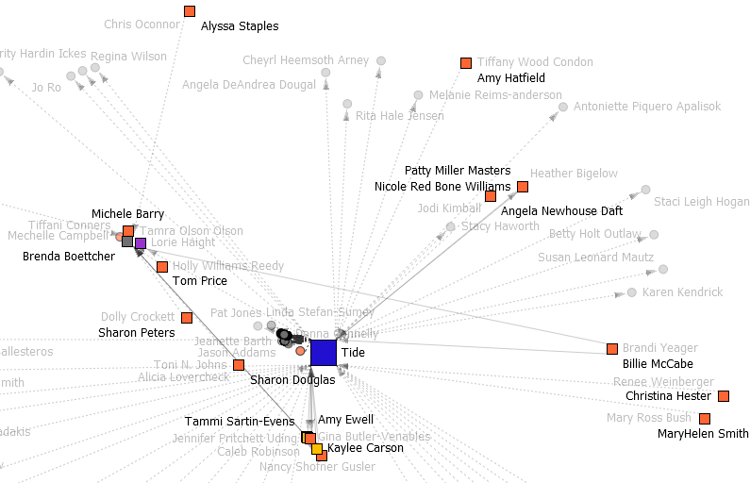
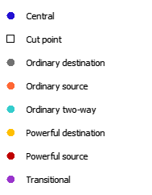
Social Network Analysis - Cut Point

Slide 38
Social Network Analysis - Subgraph

Slide 39
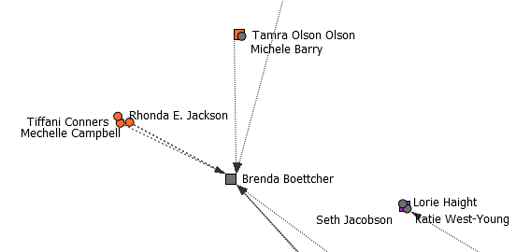
Brenda Boettcher’s Network

Slide 40
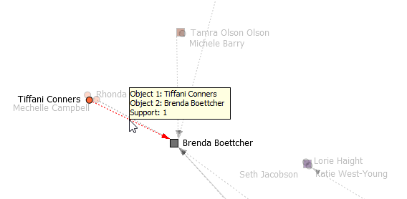
Brenda Boettcher’s Network

Slide 41
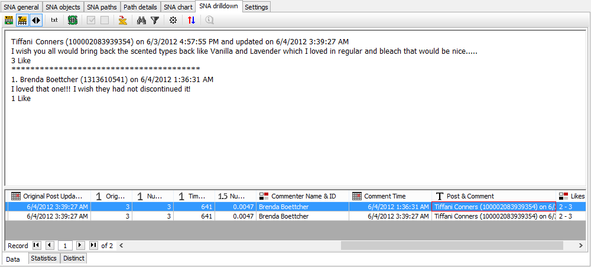
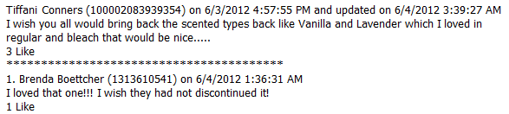
Drilldown

Slide 42
Other Considerations
Noise
Creditability
Rate Limit
Privacy Settings

Slide 43
Contacting Megaputer
Questions?

